Slide 1
Healthy Weight in Islington
Joint Strategic Needs Assessment
Public Health, November 2025

Slide 2
A Joint Strategic Needs Assessment (JSNA) looks at the current and future health and care needs of local populations to inform and guide the planning and commissioning of health, well-being and social care services within a local authority area.
This JSNA has a comprehensive focus on healthy weight across the life course. It includes:
The prevalence of overweight, obesity and underweight and health inequalities relating to weight in Islington.
The key drivers and determinants of overweight, obesity and underweight in Islington, including wider policy and environmental factors.
A review and evaluation of the current weight management services and how well they currently meet the population’s needs.

Slide 3
Notes on key data sources – children
Source | Notes on how the data is collected | Issues and caveats
National Child Measurement Programme (NCMP) | Annual measurements of the height and weight of children in reception (aged 4 to 5 years) and year 6 (aged 10 to 11 years) across England. The number of children measured in Islington in 2023 to 2024 was 1,460 in reception, and 1,550 in year 6. The participation rate in Islington in 2023 to 2024 was 95.7% in reception children and 96.0% for children in year 6. | Children not attending school are likely to be missed from the measurement. BMI does not account for some differences in adiposity between different ethnic groups or physical disabilities. 2024/25 data expected soon.
Health Related Behaviour Questionnaire (HRBQ) | Surveys conducted with a sample of Islington primary pupils aged 9 to 11 and secondary pupils aged 12 to 15 years in spring and summer 2025. In 2025, a total of 3,080 pupils took part in 22 primary and 9 secondary school settings in Islington. | Self-reported data.
Active Lives Survey data | A sample of schools is drawn each year from the ‘Get Information about Schools’ database, a register of educational establishments maintained by the Department for Education. The sample includes both state-funded and independent schools. Each school will carry out Active Lives survey with up to three randomly selected mixed-ability classes from different year groups. It aims to have 500 responses from each Local Authority (LA). | Detailed LA level data is not yet available online for 2023/24. Some years have low response rates. There were only 304 participants in Islington in 2022/23, with particularly low response from secondary school boys, meaning LA-level data for secondary boys was not available this year. Self-reported data.
School Census | Every school in England has a statutory duty to complete the school census each term. Free school meals, language and ethnicity are not collected for independent schools, therefore any breakdowns of these statistics will not include independent schools in the ‘Total’. | Schools should be recording who has a school meal on the day the School Census is taken, but variability between schools indicates that this is being recorded inaccurately.
Service-level data | Monitoring data from local children’s services were used to assess the coverage and performance of services. | Services don’t record the same performance and monitoring data. Data for 2023/4 wasn’t available for all services.

Slide 4
Notes on key data sources – adults
Source | Notes on how the data is collected | Issues and caveats
Health Survey England | The Health Survey for England are annual surveys which monitors trends in the nation’s health and care, providing information about adults aged 16 and over, and children aged 0 to 15, living in private households in England. They use a stratified random probability sample of households. HSE data are available at regional level but do not allow for local authority estimates to be produced. | National estimates of obesity prevalence are given however sample size (n=7,717) is not sufficient for robust estimates at local level. Adults living in institutions are not included.
Active Lives Adult Survey (ALAS). Sport England | The survey is sent out to a randomly selected sample of households across England. Two adults (aged 16+) are invited to take part by logging online. There's also an option to complete a paper questionnaire which is supplied with the second of three reminders. | Height, weight and physical activity are self-reported which may introduce bias. In 2022/2023, 507 adults responded to the ALAS.
HealtheIntent | Clinical data from across the NCL ICS. Data entered by acute or community providers. | Only captures people registered with a GP or accessing acute care. Relies on data collection and accurate coding by GPs. For obesity rates will only include people in the count if they have also been tested for smoking and alcohol dependency, most people will not have been tested for all three so is likely to be an underestimate.

Slide 5
Islington Context: An overview

Slide 6
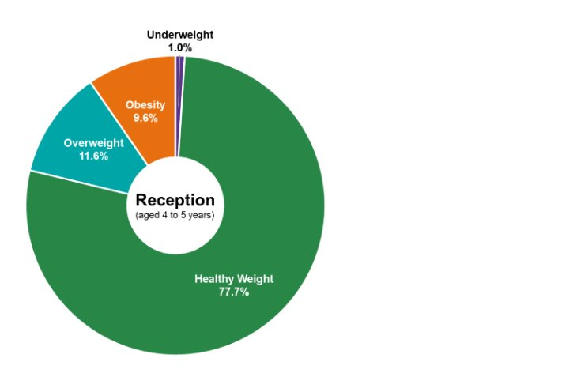
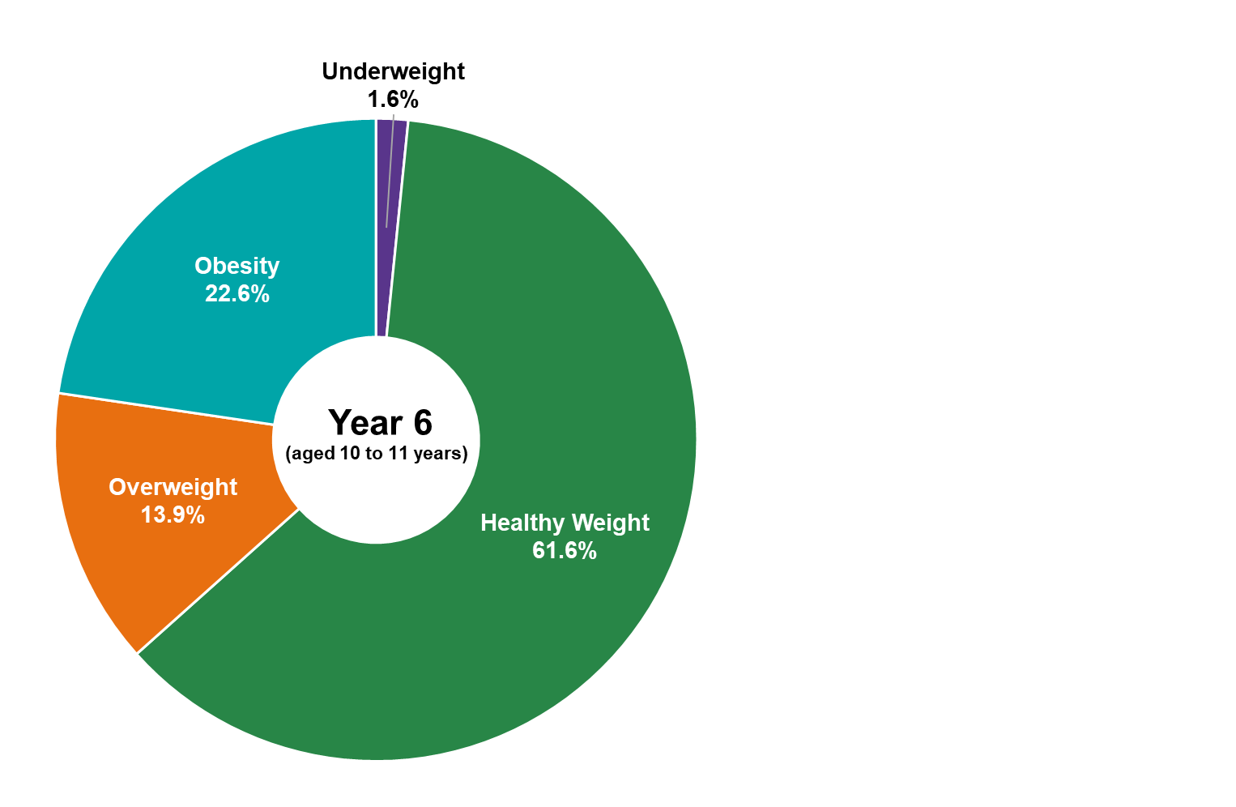
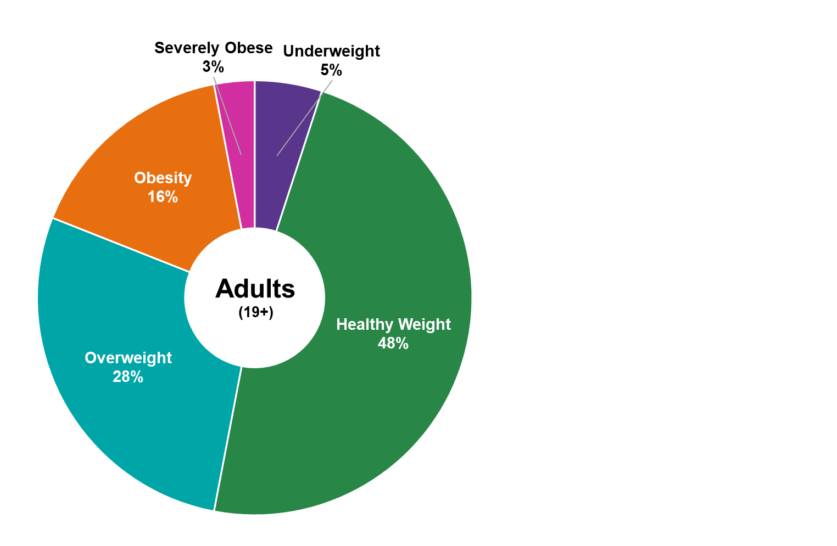
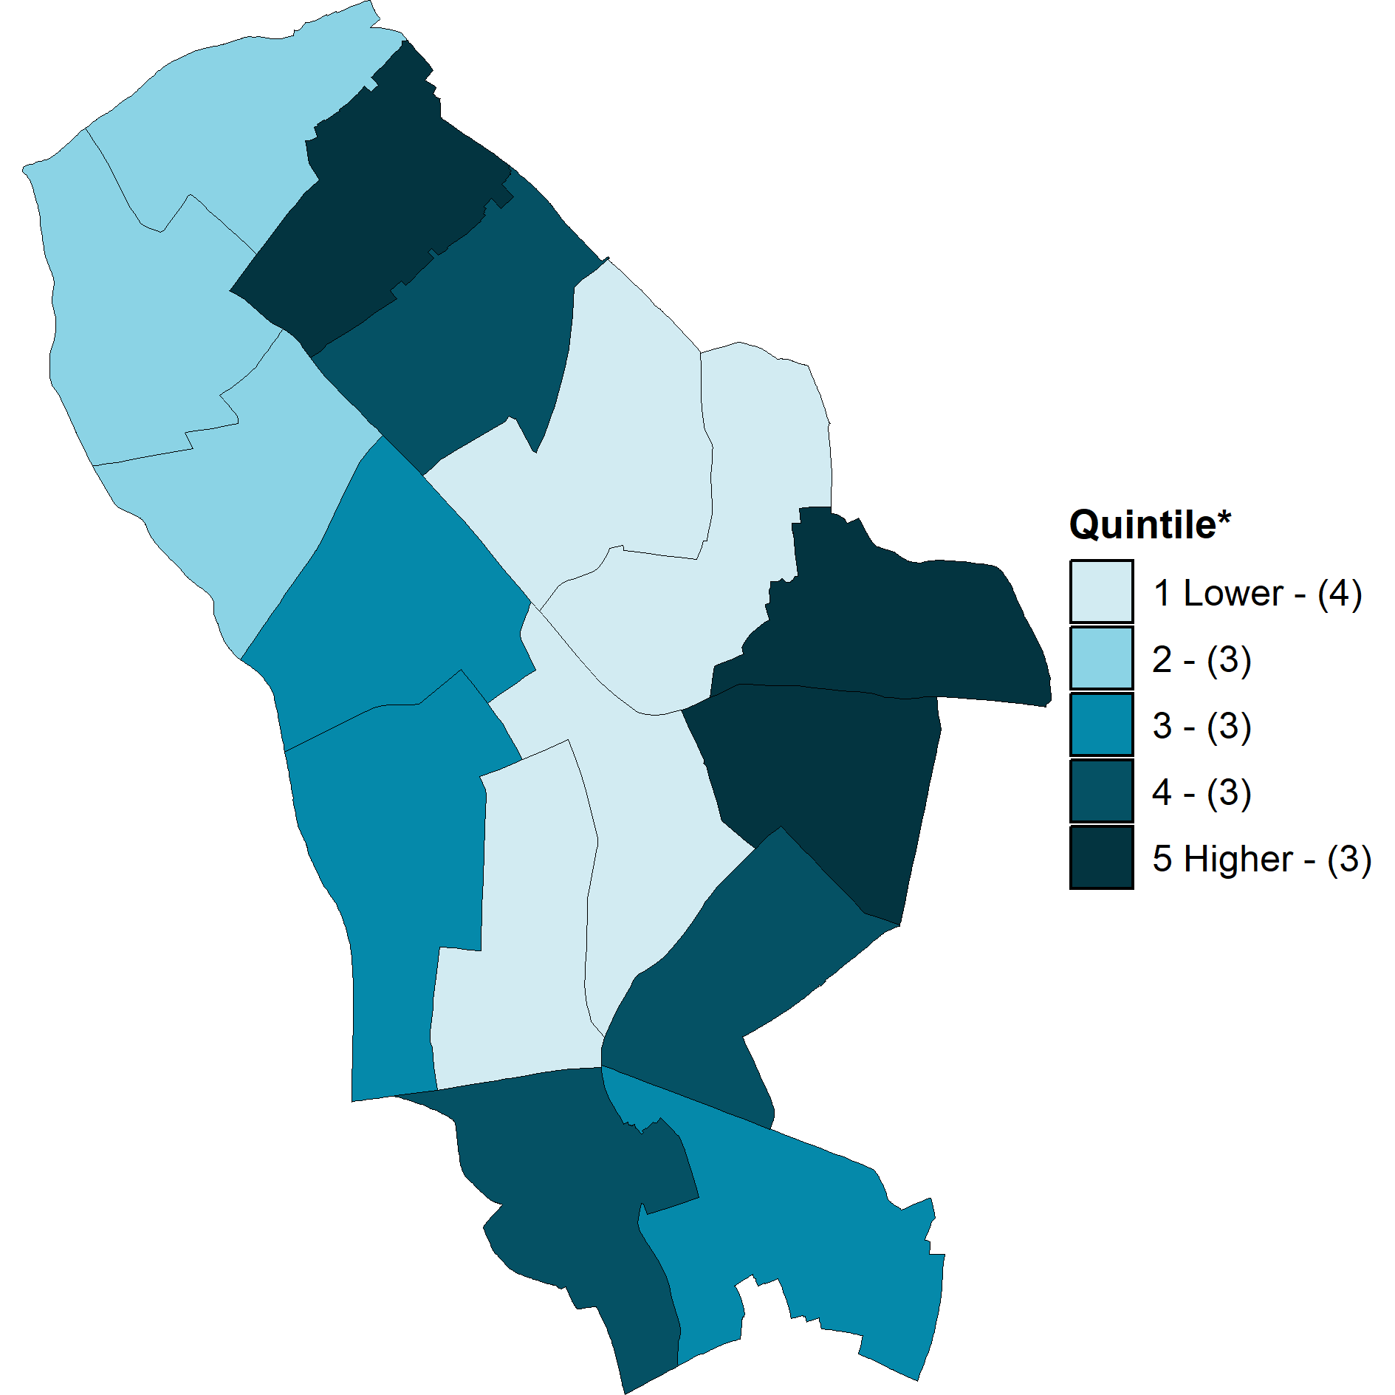
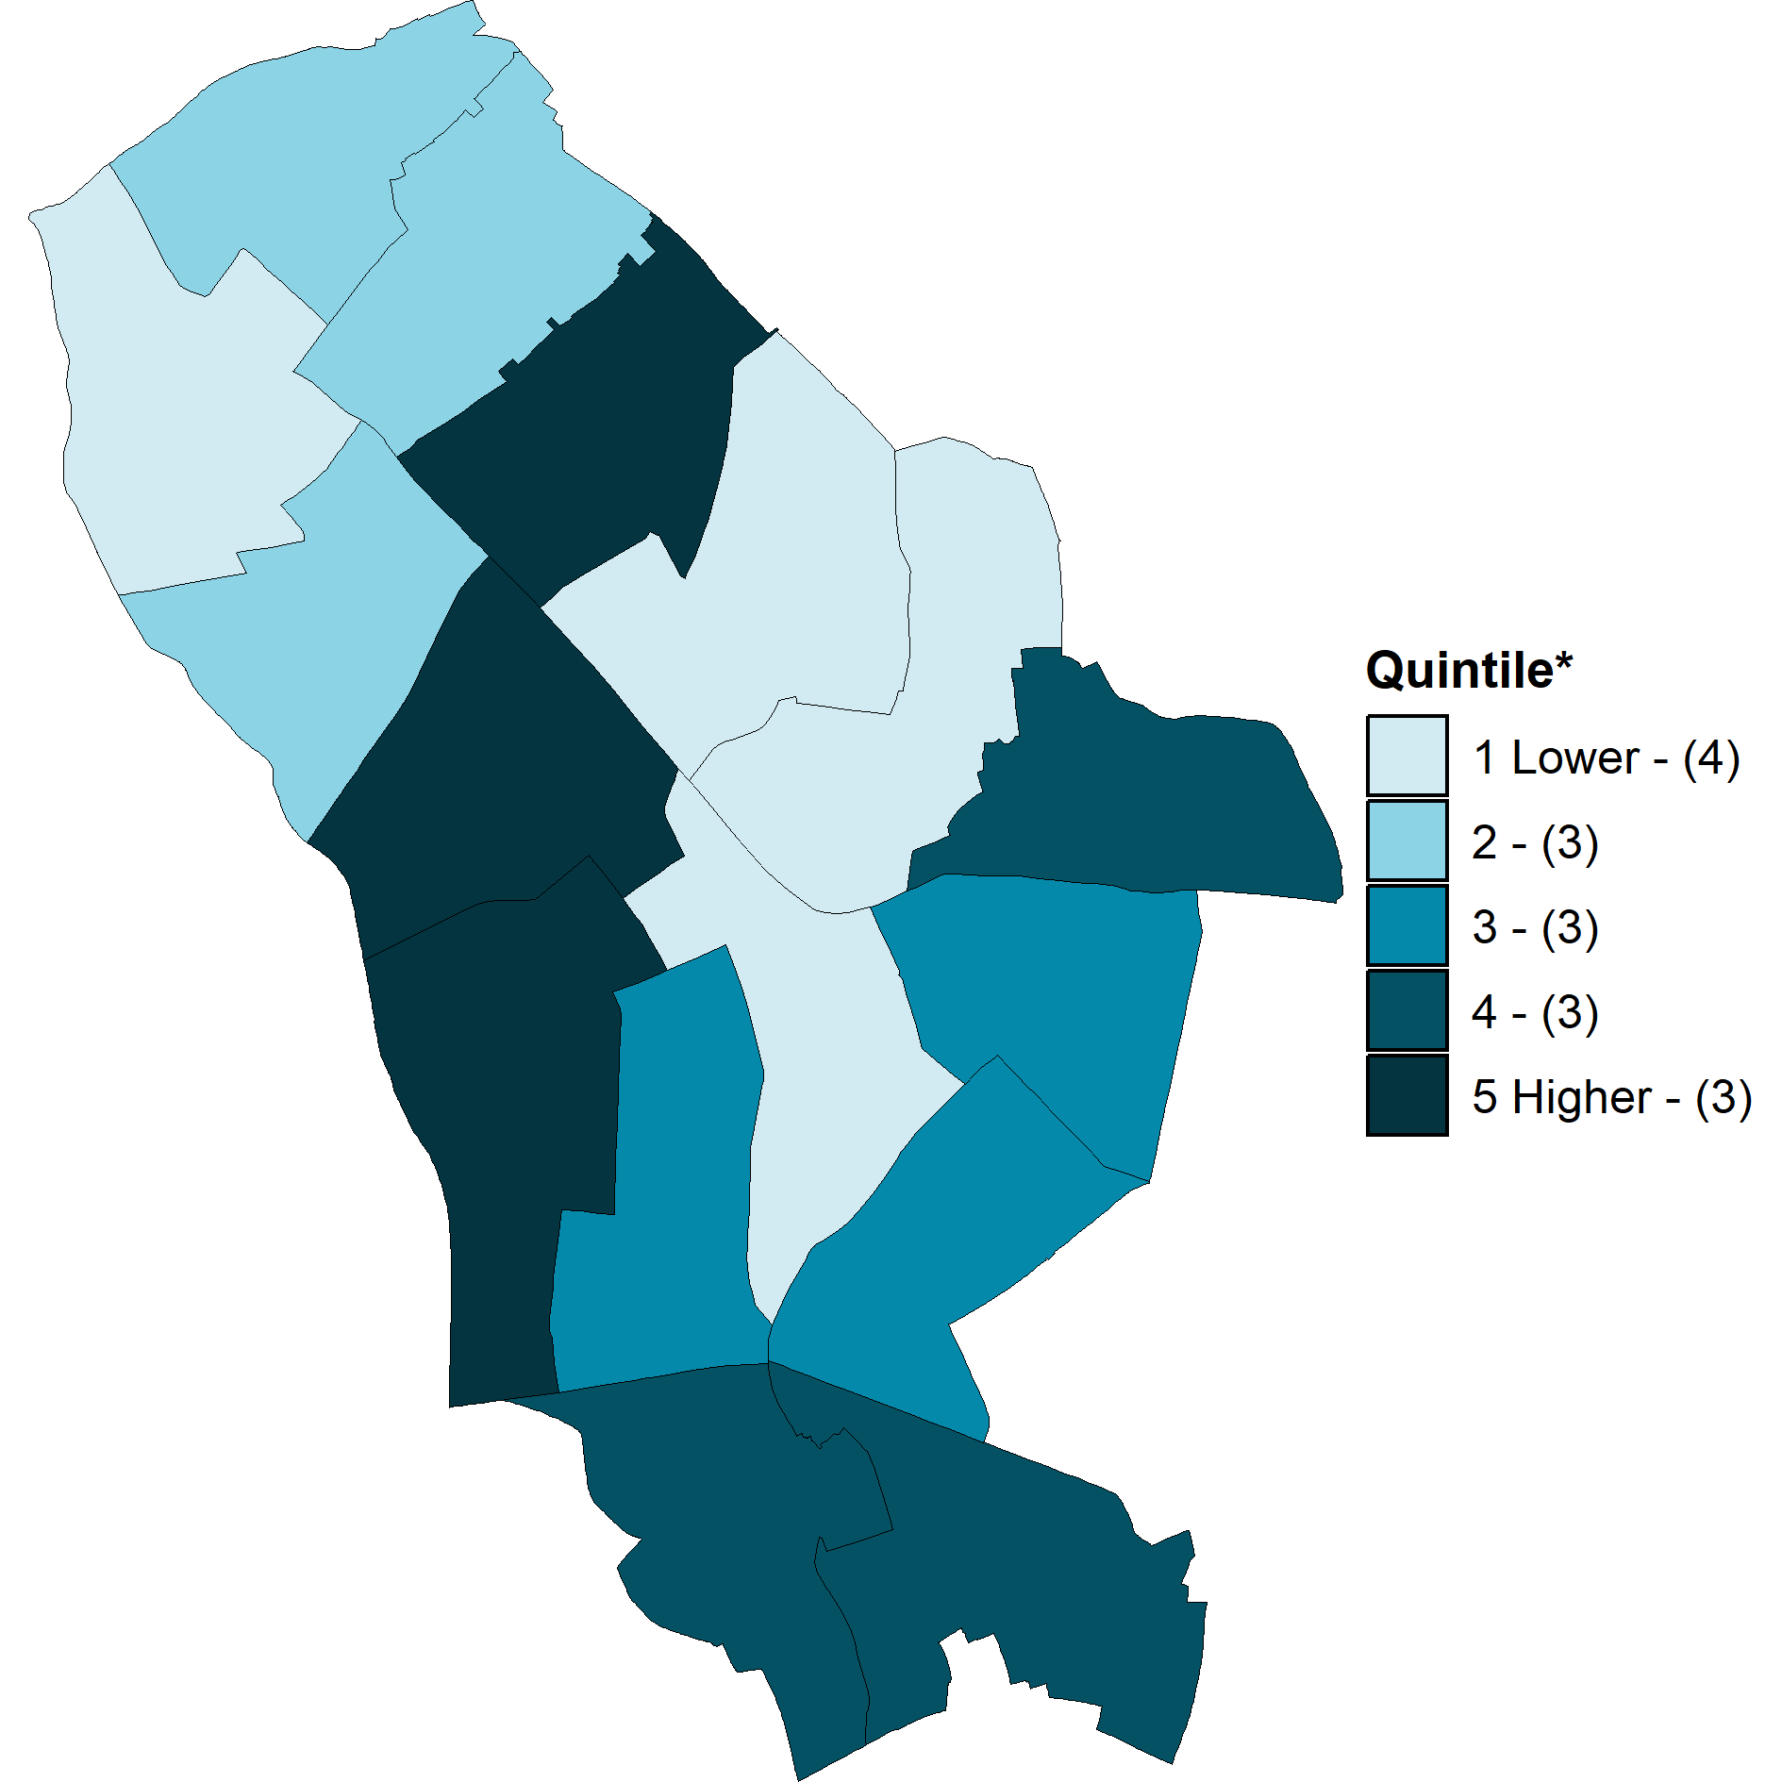
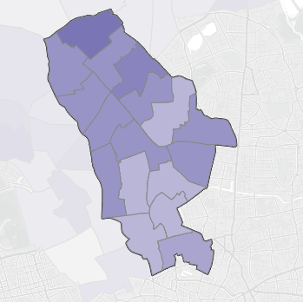

Prevalence of overweight and obesity across the life-course in Islington
Reception (aged 4/5 years) - 2023/2024
Year 6 (aged 10/11 years) 2023/24
Adults (19+ years) - 2023/24
1,460 reception children in Islington were measured (96% of registered), of these:
170 were overweight
140 were obese including severe obesity
Since 2015/6, prevalence of obesity and overweight amongst children in reception has remained relatively stable ranging between 21% and 22%.
Obesity prevalence is highest among Black (12%) and other ethnic groups (12.5%); and lowest for white (8.6%) and Asian (8.5%) pupils.
Obesity prevalence is highest in Tollington, Mildmay and Canonbury wards.
1,550 year 6 children in Islington were measured (96% of registered) of these:
215 were overweight
350 were obese including severe obesity
Since 2021, prevalence of obesity and overweight amongst children in year 6 has declined from 41.5% to 36.5% and is now below pre-COVID rates (37.7%).
Obesity prevalence doubles amongst children between reception (9.6%) and year 6 (22.6%).
Obesity prevalence is highest among Black (29.1%), Asian (27.1%) and other ethnic groups (28.8%) and lowest for White pupils (20.7%)
Obesity prevalence is highest in Finsbury Park, Holloway, and Caledonian wards.
262,026 were registered with GP in Islington of these:
59,951 were overweight
40,676 were obese including severe obesity
48,639 were unknown BMI
Since 2015/16 prevalence of obesity in adults in Islington has remained relatively stable around 17%.
A higher proportion of men (51%) compared to women (44%) are overweight or obese.
40% of people from a Black ethnic group are obese or very obese in Islington. This is significantly higher than all other ethnicities.
National data shows the prevalence of obesity increases significantly between the ages of 25-34 in women and 35-44 in men.
Obesity prevalence is highest in the north of Islington.
Map of obesity prevalence in reception by ward
Map of obesity prevalence in year 6 by ward
Map of obesity prevalence in adults by ward >
Across all age groups obesity prevalence increases as deprivation increases.
Children’s data source: National Child Measurement Programme data (2023/24) (accessed via OHID fingertips)
Adult data source: HealtheIntent Population Health Needs and Inequalities Dashboard (accessed 21/01/25)
Graph source: HealtheIntent

Slide 7
Diet and the food environment
In 2025, 25% of secondary school pupils and 39% of primary school pupils reported eating ‘5-a-day’ on the day before the survey.
In 2022/23, 32.9% of adults reported eating ‘5-a-day’ on a usual day. According to national statistics Black and Asian ethnic groups were least likely to eat 5-a-day
Things working well
Things to improve
Children and early years
Islington has excellent breastfeeding support services, and 84% of babies are breastfed at 6-8 weeks in Islington (including exclusive and partial breastfeeding). This is higher than England average of 52%.
Universal free school meals are provided to primary school children. Evidence suggests this initiative has led to improvements in maths and reading as secondary outcomes.
School meals adhere to enhanced food standards and Islington school food has achieved “Silver Food for Life” and “Pro Veg Bronze school plates” awards.
More than 40 teachers and early years professionals have been trained to deliver ‘TastEd’ sessions to increase children’s receptiveness to new food.
Majority of schools in Islington have committed to being water-only and water refill schemes have been promoted across the borough.
Holiday food programme supports children’s nutrition in school holidays and adheres to national school food standards (not Islington’s enhanced food standards).
Food insecurity and access to healthy foods
Islington food partnership and strategy co-ordinates efforts to provide food aid and aims to build a healthy, affordable and sustainable food system in Islington.
Availability and visibility of unhealthy foods
HFSS advertising is banned on TfL estate.
Planning restricts Hot Food Takeaways within 200ms of schools and over 4% concentration in Town Centres.
Local plan requires new food and drink establishments to adhere to the healthier catering commitment to reduce fat, salt and provide smaller portions.
National laws on product placement, and digital and TV advertisements of HFSS products reduce the visibility of these foods. However, product placement laws don’t apply to small businesses and other food settings and may not be enforced.
Children and Early Years
Need to increase uptake of Healthy Start payments and address the gap in support between when voucher eligibility ends (4th birthday) and free school meal eligibility starts (project to do this is just starting).
9% of primary and 34% of secondary pupils report eating nothing before school, this is an upward trend for secondary school pupils. At least 45.5% of primary schools don’t have breakfast club provision in Islington (based on 2022 data). Where breakfast clubs do exist the food offer is often not nutritionally balanced.
Universal free school meals are not provided to secondary school pupils.
Not all schools have signed up to be water-only.
Food insecurity and access to healthy foods
According to 2022 data, 27,291 people in Islington were estimated to be experiencing moderate to severe food insecurity, and the number is likely to have grown since then. Further support is needed to address food insecurity locally and increase the availability of healthy, nutritious and culturally-appropriate food aid. The council could support collective buying schemes and community kitchens for people who can’t prepare food at home.
In Islington in 2020, 15,000 people lived in areas that met the definition of a ‘food desert’, however this number is likely to have fallen as new supermarkets opened in Junction Ward since then.
There is more demand than supply of land for community growing, including allotments.
Reduce availability and visibility of unhealthy foods
Islington has the 9th highest concentration of hot food takeaways in London and 10% of children report eating takeaway food “on most days” in the previous week. There is a need to continue to restrict new Hot Food Takeaways and consider ways of expanding these restrictions - for example restricting other unhealthy food retailers (such as ice cream vans).
Although Islington has policies in place to restrict HFSS advertising on council-owned advertising estate, it was unclear how these policies are being enforced. There may be opportunities for further restriction or enforcement, for example by revoking planning permission from telephone boxes being used for HFSS advertising.
Include service specifications relating to healthy food and physical activity in adult social care contracts and increase support for family carers.
Work with other anchor institutions to increase the healthy food offer.
Source: Petersen, J., Bryant, M., Concha, N., Firman, N., Hawking, M. K., Jama, S., ... & Dezateux, C. (2025). Impacts of discretionary universal free school meal schemes on primary school children’s education attainment and school absence: A natural experiment study in England. International Journal of Educational Research, 102713.

Slide 8
Physical Activity
Things working well
Things to improve
54.8% of children complete the recommended of 60+ minutes of physical activity a day. This is above the national average (47.8%). However, 45.2% of children are still not getting the exercise that they need to be healthy.
73.8% of adults in Islington are physically active (do 150+ minutes of physical activity per week). This is above the England average of 67.1%.
Active travel
90% of primary school children and 74% of secondary school children either walk, cycle or scoot to school (note, these statistics include people who use multiple forms of transport, i.e. children who walk and take public transport in their journeys). Active travel is supported through the local plan, school travel planning (TfL Travel for Life) and Healthy Streets framework and 36 School Streets have been delivered across Islington.
In 2022/23, more than 50% of all residents aged 20+ in Islington achieved at least 20 minutes of active travel, making good progress against the Mayor’s travel target of 70% of London residents achieving at least 20 minutes of active travel per day by 2041.
In 2025 Islington was the top London borough on the Healthy Streets Scorecard. Low Traffic Neighbourhoods have been introduced across five areas Islington and there are plans for six new Liveable Neighbourhoods.
Health and social care
A new Physical Activity By Referral (PAR) scheme has been introduced (Healthwise). The scheme is already performing well against targets with high levels of use and 96 referrals in the first two months.
Four Physical Activity Clinical Champions Training sessions have been run with GPs and other primary care staff. These increase practitioners' awareness of the physical activity offer in Islington and encourage them to promote physical activity with patients.
Facilities and activities
Active Together partnership co-ordinates council, public, private, and voluntary sector organisations to increase the activity levels of those least likely to be active.
A diverse range of free local physical activity options can be found through an Activity Finder, with some targeted interventions for less active groups, for example secondary school girls (Girls Active) and people with long-term conditions (Healthwise).
Parks for Health strategy seeks to reduce inequalities in access to and use of parks.
19.8% of children are inactive (less than 30 minutes activity a day) and 17.4% of adults are inactive (less than 30 minutes of activity a week).
Health inequalities
Girls are more likely to do less than 30 minutes exercise a day than boys. Similarly, fewer women (72%) are active than men (77%).
Amongst adults, rates of physical activity decrease with age - 68% of people between the ages 55-74 were active, compared to 84% of 16-34 year olds.
Local-level data is not available to compare physical activity levels by ethnic group or income. However, national-level data indicates that people from black, Asian and other ethnic minority groups are less likely to be active than white people and those with lower incomes are less likely to be active.
Health and social care
Funding for the Physical Activity Clinical Champions programme is ending soon. Need to explore alternative ways to support practitioners to discuss physical activity with patients.
GPs report needing more information about the Islington physical activity offer to share with patients. This includes information on support for active travel.
High uptake of the physical activity by referral scheme means that demand may not be met. Need to explore other ways to support people with LTCs to exercise safely.
Continue to understand and explore physical activity specification in social care contracts to ensure that physical activity is embedded in people’s daily routines.
Facilities and activities
Islington is the 8th most deprived borough with regards to access to green space and there are inequalities in utilization of these spaces. Continue to implement pocket park framework and address inequalities in green space use.
Common barriers to physical activity include feeling unsafe or concerns around the appropriateness of spaces and facilities in terms of accessibility and cultural expectations. Cost also remains a barrier for many. Explore ways to address these barriers.
Weekend activity is lower than week-day activity in many school children. Need to continue to expand activity provision in school holidays to increase activity outside of school.
Increase implementation of targeted activity opportunities for least active groups.
Improve accuracy of data and reporting
There are large discrepancies in the physical activity data collected by HRBQ, and Active Lives Survey. Explore options to increase the accuracy of children’s physical activity data.

Slide 9
Weight Management (WM) services
Things working well
Things to improve
Demographics
Both adult weight management services report good engagement from groups more likely to be living with overweight. For example, MoreLife (adult T2 WM service) is meeting targets for participants from ethnic minority groups, people on low income, and those with a disability. They’re also piloting targeted groups for people with severe mental illness. Similarly, 60% of patients referred for Tier 4 bariatric surgery were from the 3 most deprived deciles.
Children’s services also receive high levels of engagement from families from minority ethnic groups and families living in deprivation (62% of those attending Families For Life are from Black, Asian and ethnic minority groups, while 55% of those attending the Enhanced Healthy Living Service are from black, Asian and minority ethnic groups and 80% are from the 2 most deprived quintiles).
Weight loss outcomes – adult services
Shape Up reports high levels of weight loss, with 98% of completers reporting weight loss. MoreLife has met weight loss targets in previous years (79% lost weight in 2023), however in 2024 these targets were not met (68% lost weight). There is ongoing analysis to understand why this performance has changed.
Oviva, Type 2 diabetes remission service, has high levels of engagement and weight loss (12% of body weight).
Behaviour change outcomes – childrens' services
Families for Life programmes have high completion rates (78%) and positive feedback from parents. Active Family Kitchen programme has incorporated 30 minutes of physical activity to the start of their sessions. 75.9% of families report reducing HFSS foods after the programme.
The Enhanced Health Living service offers a complex integrated obesity service. This provides a psychologically informed approach and has helped to simplify a fragmented care pathway. There is strong engagement among parents who start the Families, Food and Feelings group (78% complete). Pre and post healthy living surveys with parents show increased knowledge about healthy living but often no change in vegetable consumption or physical activity.
Qualitative feedback
Feedback from MoreLife participants is positive: 94% are satisfied with the service. However, this only represents people who complete the programme.
Aligning with new NICE guidelines
There is a need to align services with new NICE guidelines for Overweight and Obesity Management released Jan 2025. This will include aligning with plans for implementation of medications for WM, providing tailored care plans and increasing psychological support.
There is a need for improved psychological support including wrap-around care and preparation for engagement in WM services. This can help address associated issues such as eating disorders and mental health, which can improve outcomes
Gaps in care provision
There is currently no Tier 3 weight management service, a business case is in development by the ICB
There is a service gap for people with complex care needs: those who are too complex for tier 2 weight management service, due to comorbid mental health and eating disorders, but also ineligible for bariatric surgery. This includes people with learning disabilities and serious mental illness.
Increasing uptake of services
MoreLife is not seeing as many residents as initially planned when the contract was let. The service currently only reaches 0.5% of the eligible population in Islington.
Healthy Living Service experiences challenges around engagement, particularly among children who have been invited to use the service after their NCMP results. In April – September 2024, of 190 children identified as being very overweight only 2 parents accepted invite to Healthy Living Service support. 17 out of 51 of CYP discharged from the service was due to multiple DNAs.
Similarly, the Type 2 diabetes remission service (Oviva) is under-used. In 2023, 45 people were referred, representing just 1% of the eligible population.
Increasing capacity of some services
Need to increase capacity of maternal WM services (OWN), in 2023 the service was only able to support 5 women from Islington (14 women in total). There is also a gap in other areas of provision in post-natal period, for example a physical activity offer suitable for women in the post-natal period.
There is a large waiting list for bariatric surgery
Training staff, addressing weight stigma, and embedding a compassionate approach
Some healthcare professionals and providers describe feeling uncomfortable discussing weight with patients, for example the midwives delivering the maternal WM service. There is a need to train healthcare professionals, providers and members of the council on weight stigma and how to have sensitive conversations about weight.
There is evidence that people experiencing weight stigma find it harder to lose weight, and that weight neutral programmes, which focus on health goals and behaviours, are more effective than those targeting weight alone.

Slide 10
Stakeholder priorities
Stakeholder consultation was conducted between February and March of 2024. The following internal and external stakeholders were consulted: Community Wealth Building; Greenspace and Leisure; Children and Young people; Schools; Adult Social Care; Community Engagement and Wellbeing; NCL ICS; Islington Food Partnership; Environmental Health; MoreLife; GPs; Social Prescribers; Active Travel; Best start in Life.
For more details see Appendix 2
Communication: De-stigmatising conversations around healthy weight and empowering people to give informed advice and signpost to services. Promotion of healthy food (inc. local businesses, markets, community kitchens and food aid), physical activity, and healthy weight services in the borough and awareness of benefits to health. | Weight Management Services and Pathways Streamlining weight management pathways: meeting patients where they’re at – are they ready to enter a tier 2 course yet or do they need to attend prior courses for issues such as eating disorders or mental health issues; delivering family-based interventions; smoothing transition from adolescent to adult weight management services. Working with communities and reaching underserved groups: services for people with SMI, people with learning disabilities, asylum seekers, family carers Making more use of MECC pathways to promote healthy weight Collaboration with NCL on Tier 3 and wider tier system Training practitioners on how to have conversations about weight
Schools and CYP Creating healthy weight environments in and around schools e.g. healthy food environment, physical activity offers, school travel plan commitments, school super zones, fast food outlets etc. Provision of breakfast clubs, healthy lunches and holiday programs outside of school term. Food tech and opportunities to learn to cook healthily at school, PHSE curriculum review? | Wider Determinants – creating a healthy weight environment. Influencing policy: advertising, sponsorship, product placement, catering commitments (in schools, food aid, hospital, care home contracts), hot food takeaway (HFT) regulation Recognising and enacting links between mental health with Healthy Weight, including disordered eating: binge eating, anorexia, bulimia, etc. Working with planning to create healthy environments – safe active travel routes to schools, access to green spaces, allotments and community growing spaces, control of HFTs and their operational times Support promotion of local fresh fruit and vegetable businesses / markets More energy behind Healthy Catering Commitment and measures to enforce product placement laws Support for food aid providers to provide more nutritionally balanced offer Cycle training and school travel plans – promoting to schools, encouraging uptake of council bike provision

Slide 11
Inequalities in childhood obesity in Islington
Children – obesity prevalence
Children – physical activity
In Reception, obesity prevalence is highest among Black (12%) and other ethnic groups (12.5%). In Year 6, obesity prevalence is highest among Black (29.1%), Asian (27.1%) and other ethnic groups (28.8%).
Obesity prevalence is highest among children from the most deprived quintile.
Rate of obesity doubles between reception and year 6.
The highest obesity prevalence was recorded Finsbury Park, Holloway, and Caledonian. With high prevalence also recorded for Mildmay, Clerkenwell, and Bunhill.
Children from the least affluent families are the least likely to be active (45% compared to 57% for the most affluent).
Children from Black (42%), Asian (43%) and other ethnicities (44%) are least likely to be active compared to White students (50%).
Children – service provision
Children – dietary determinants
There is gap in maternal weight management support – OWN clinic has very low capacity and is currently under review.
Families for Life service may need to increase uptake with Asian families, or mixed ethnic groups.
Rates of exclusive breastfeeding are significantly lower among Asian Other, Bangladeshi, black African and black other compared to other ethnic backgrounds. Mothers aged 25 and under have lower breastfeeding rates compared to other age groups.
Children experience a gap in nutritional support after their eligibility for Healthy start vouchers end (age 4) but before they can receive free school meals. This gap is longest for children born in September.
National level data indicates that the most deprived children eat fewer portions of fruit and vegetables compared to the least deprived quintile.
14% more primary school children eat 5-portions of fruit and vegetables a day than secondary school children in Islington.

Slide 12
Inequalities in adult obesity in Islington
Adults – obesity prevalence
Adults – physical activity determinants
Adults from the most deprived areas of Islington had higher rates of overweight and obesity, with 50% above normal weight. A map showing areas with the highest prevalence of obesity is shown on slide 41.
Obesity rates increase with age, 25% of people aged 50+ are above normal weight.
Adults from black ethnic groups have significantly higher rates of obesity than all other ethnicities (40%).
Adults with a disability or LTC are less likely to be physically active than adults without disability or LTC in Islington
Women (72%) are less likely to be active than men (77%).
Adults over 55 were less likely to be active in Islington
Adults in routine jobs or long-term unemployed are less likely to be active.
London data indicates adults of Asian and black ethnicity were less likely to be active.
Adults – service provision
Adults – dietary determinants
People with co-morbid poorly controlled mental health conditions are often not eligible for weight management services, including bariatric surgery and MoreLife.
MoreLife programmes are currently meeting targets for attendees from Black, Asian and minority ethnic groups (33%), and those from lower income households (22%) and there’s a need to increase engagement with people with disabilities (14%).
Women are more likely to receive bariatric surgery than men.
Shape Up Tier 2 service is not meeting KPIs for participants from more deprived backgrounds.
Adults in the most deprived quintile were less likely to eat 5 portions of fruit and vegetable a day (23%) compared to 34% of adults in the least deprived quintile – according to national data.
Adults from Asian (20.7%) and Black ethnic (20.1%) groups were the least likely to eat 5 fruit and veg a day – according to national data.
Food insecurity is a major driver of obesity. Households most likely to be experiencing food insecurity in Islington include those:
With children (especially single parent households with multiple children)
Where the head of the household is aged 16-24 years
With a disabled adult
Black and minority ethnic groups (particularly Black ethnic groups)
On any income-related benefit, especially universal credit
Low-income households
Living in social housing
Areas in Islington with the highest food dessert Index scores, were Junction; Barnsbury; Bunhill

Slide 13
Aligning with Local and National Policy

Slide 14
Aligning with key local policies and strategies
Equitably supporting residents to maintain a healthy weight can support the 5 missions in the Islington 2030 plan.
Child Friendly Islington
Addressing the drivers of childhood obesity by investing in healthy eating at and around schools, promoting physical activity (including safe streets for scooting and cycling and play spaces) and building healthy habits from early life can promote a child friendly Islington.
Fairer Together
Working with local community groups/organisations and linking up with Access Islington Hubs to empower our residents to make healthy decisions, whatever their age or background. Ensuring access to tailored interventions, affordable and culturally appropriate foods can address drivers of obesity and make Islington Fairer.
Safe Place to Call Home
Investing in improving local streets and estates to ensure residents feel safe in their communities so children can play and use active travel safely outdoors.
Greener, Healthier Islington
Community Wealth Building
Supporting local food businesses and ensuring all residents have access to healthy, affordable food and the necessary skills and facilities to cook themselves nutritious meals.
Improving infrastructure for and promoting active travel as a means to maintaining a healthy weight can contribute to a reduction in car usage and reaching net zero carbon in the borough by 2030. Investing in parks, increasing biodiversity and tree coverage to increase valuable time spend outside.
Other relevant local policies include:
Islington Food Strategy 2023-2028 employs a partnership approach to build a better local food system. The strategy covers four themes including Healthy, Affordable Food for All.
Islington Active Together Strategy 2022-2030 aims to equitably support and empower communities to be more physically active.
Camden and Islington Parks for Health Strategy 2022-2030 aims to maximise the use of parks for prevention of health issues, early intervention, and promotion of wellbeing.
Islington Transport Strategy 2020-2041 aims to increase walking, cycling and the use of public transport. This aligns with outcomes identified in the Mayor’s Transport Strategy for London.
Islington Joint Health and Wellbeing Strategy 2024-2030 Priority areas are Start Well, Live well, Age Well, Healthy Environments. Healthy weight can improve health outcomes across all these life stages, and Healthy weight has been identified as an area of focus under Healthy Environments

Slide 15
Aligning with local and national policies
Aligning with local policies
Aligning with national policies
NCL Population Health and Integrated Care Strategy (2023) A vision for more prevention-oriented, proactive, integrated, holistic and person-centred approach to care across the five boroughs and new ways of working to enable this.
London Health Inequalities Strategy (2018) sets out the Mayor of London’s aim that every London child has a healthy start in life, including the help to achieve and maintain a healthier weight.
London Health and Care Vision 2019 A partnership publication signed by the Mayor, London Councils the NHS and the city’s public health system.
Every child a healthy weight (2019) outlines 10 key ambitions and actions needed for London’s children to be a healthier weight. This was updated in 2022.
National Food Strategy 2021 reviewed the national food system and produced recommendations to make food healthier and more sustainable, preparing for future risks of climate change
Get Active: a strategy for the future of sport and physical activity National strategy to tackle high levels of inactivity, by increasing opportunities to get active.
Childhood Obesity: Plan for Action sets a national target to halve childhood obesity by 2030.
Tackling obesity: empowering adults and children to live healthier lives (2020) policy paper on obesity including new legislation outlined below and a commitment to expand access to weight management services.
The Food (Promotion and Placement) (England) Regulations 2021. This prohibits placement of HFSS foods in prominent locations. Volume price promotions are also restricted however implementation of this component is delayed to Oct 25.
Calorie Labelling (Out of Home Sector) (England) Regulations 2021. This requires calorie labelling to be displayed on menus and food.
The Soft Drinks Industry Levy. This uses taxation to encourage manufacturers to reduce the amount of sugar in their drinks. It has resulted in a 46% average reduction in sugar in soft drinks in scope of the levy between 2015 and 2020.
HFSS advertising restriction on HFSS products online or on TV before 9pm. NICE guidelines Recommendations for overweight and obesity management. See slide 81 for more detail.
Major conditions strategy (2023) A blueprint for improving outcomes over the next 5 years, identifies promoting a healthy weight as a key driver of major conditions.

Slide 16
What is healthy weight?
The World Health Organisation (WHO) defines overweight as a condition of excessive fat deposits; and obesity as a chronic and complex disease defined by excessive fat deposits that can impair health (WHO, 2024).
Measuring excess weight
Body mass index (BMI) estimates body size and body fat percentage based on a person's weight and height.
The limitations of BMI include: not accounting for muscle mass and overall body composition; BMI also tends to overestimate adiposity in South Asian populations and underestimate adiposity in Black populations (Hudda et al, 2017). Despite these limitations, BMI remains the most standardised and easily scalable form of measurement. It is used in national measurement programmes.
A 2025 Lancet commission provided new recommendations for clinically defining and measuring obesity in individuals. They recommend only using BMI as a surrogate measure for population health risk. Clinical diagnoses should be confirmed using a direct measure of body fat or anthropometric criterion such as waist circumference or waist-to-hip ratio.
Adult BMI classification
Child BMI classification and monitoring
Adults: BMI Range | BMI Category
Less than 18.5kg/m² | Underweight
18.5 to <25kg/m² | Healthy weight
25 to <30kg/m² | Overweight
30kg/m² or more | Obesity
40kg/m² or more | Severe obesity
Children and young people’s BMI is calculated differently. For population monitoring purposes, a child’s BMI is classed as overweight or obese where it is on or above the 85th centile or 95th centile, respectively, based on the British 1990 (UK90) growth reference data.
The population monitoring cut offs for overweight and obesity are lower than the clinical cut offs (91st and 98th centiles for overweight and obesity) used to assess individual children; this is to capture children who are at high risk of moving into the clinical overweight or clinical obesity categories.
Note: People of south Asian, Chinese, other Asian, Middle Eastern, Black African or African–Caribbean ethnicity are recommended to use lower BMI thresholds, as their cardiometabolic risk occurs at a lower BMI: Overweight: BMI 23 kg/m2 to 27.4 kg/m2 , Obesity: BMI 27.5 kg/m2 or above.
Sources: WHO (2024) Obesity and Overweight Factsheet
NICE (2025) Overweight and Obesity management
Hudda, M. T., Nightingale, C. M., Donin, A. S., Fewtrell, M. S., Haroun, D., Lum, S., ... & Whincup, P. H. (2017). Body mass index adjustments to increase the validity of body fatness assessment in UK Black African and South Asian children. International journal of obesity, 41(7), 1048-1055.
Lancet Diabetes and Endocrinology Commission (2025) Definition and diagnostic criteria of clinical obesity
NCMP 2023/24
Cole TJ, Freeman JV, Preece MA. Body mass index reference curves for the UK, 1990. Archives of Disease in Childhood 1995 73:25-29.

Slide 17
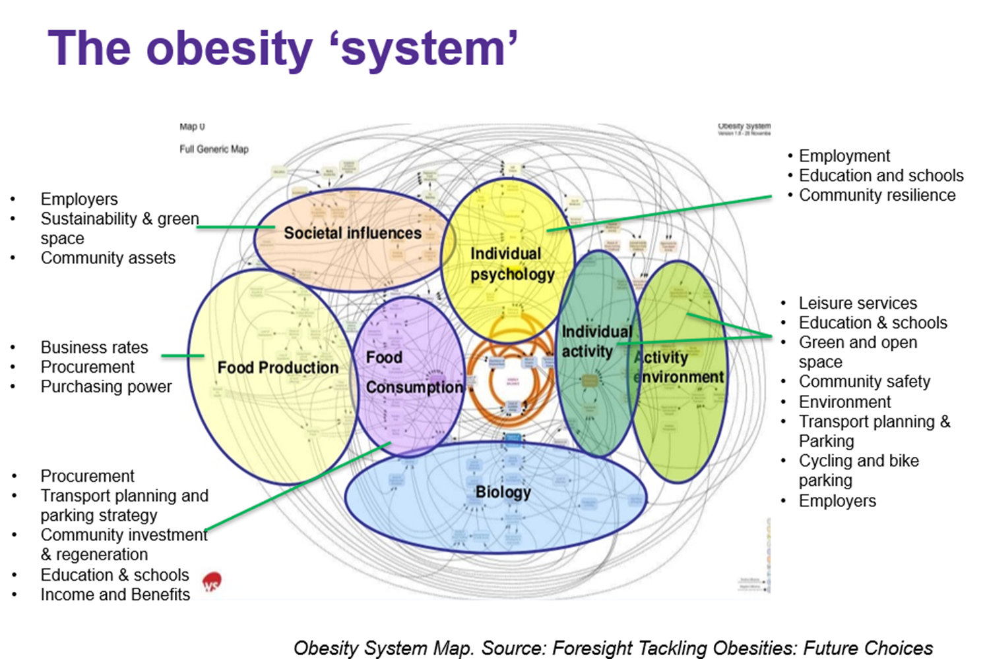
Causes of obesity
The causes of excess weight are multifaceted and complex.
The biomedical model identifies the causes of excess weight as an energy imbalance where energy intake from food and drink exceeds expenditure through metabolism and exercise.
However, there are several wider factors that contribute to an ‘obesogenic environment’ that make maintaining a healthy weight more difficult. The term ‘Obesogenic environments’ refers to the influence of the surroundings, opportunities or conditions of life that play a role in promoting obesity in individuals and populations.
In the last few decades there have been major social changes in working hours, physical activity and abundance of fast food that have contributed to obesogenic environments and growing rates of overweight and obesity.
In 2007 the UK government undertook a qualitative systems mapping exercise to explore systemic factors that underpin obesity. The figure on this slide shows an overview of their map of the obesity system. Note that the map identifies several social, biological, psychological and economic drivers leading to the complexity of this system.
Source: Government Office for Science (2007) Tackling obesities: future choices-project report (Vol. 10, p. 17). London.

Slide 18
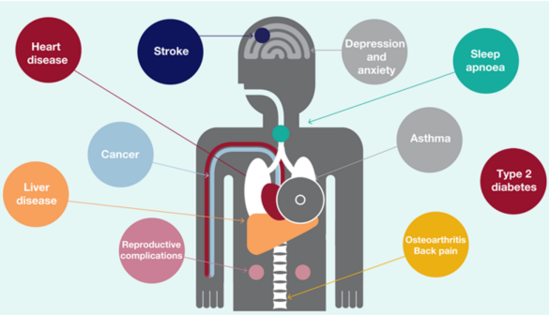
Obesity and health outcomes
Physical health
Obesity has overtaken smoking as the leading cause of morbidity in the UK and is one of the biggest contributors to Health inequalities (Ho et al, 2021)
Living with obesity has been found to reduce life expectancy by an average of 3-10 years depending on severity (NHS, 2025).
Obesity is linked to a wide range of health conditions including: type 2 diabetes, hypertension, some cancers, heart disease, stroke, liver disease and mental ill health (OHID, 2022)
A healthy lifestyle during childhood can reduce the risk of obesity-related illnesses, such as diabetes, cardiovascular disease, depression and liver disease in adulthood (Simmonds, 2016).
Mental Health
Overweight and obesity is also associated with poor mental health outcomes. Adults with extreme obesity are almost five times more likely to have experienced an episode of major depression in the past year as compared with those of average weight (Sarwer, 2016), while in young people the proportion of those with obesity with emotional difficulties, such as depression and anxiety, is around twice that observed for young people with a healthy BMI (19% vs 10%) (Puhl, 2020).
Weight is also the most common reason that young people are bullied (Puhl, 2020)
Health impacts of obesity
Source: OHID (2022)
Sources: Ho, F. K., Celis-Morales, C., Petermann-Rocha, F., Parra-Soto, S. L., Lewsey, J., Mackay, D., & Pell, J. P. (2021). Changes over 15 years in the contribution of adiposity and smoking to deaths in England and Scotland. BMC public health, 21, 1-8.
OHID (2022) Adult Obesity: applying All Our Health
Puhl (2020) Experiences of weight teasing in adolescence and weight-related outcomes in adulthood: A 15-year longitudinal study
NHS inform (2025) Obesity
Simmonds, M., Llewellyn, A., Owen, C. G., & Woolacott, N. (2016). Predicting adult obesity from childhood obesity: a systematic review and meta‐analysis. Obesity reviews, 17(2), 95-107.

Slide 19
Weight stigma
One contributor to the mental health impact of living with overweight and obesity is weight–based stigma.
Weight stigma is underpinned by beliefs that excess weight is caused by a lack of willpower or poor self-discipline. This leads to blame and negative stereotyping, which can perpetuate a cycle of shame and weight gain, as shown in the figure (Tomiyama, 2014).
People exposed to weight-based stigma are more likely to experience increased stress, depression and anxiety; engage in disordered eating behaviours; feel less able to manage their weight; and are more likely to gain weight over time (BPS, 2020).
A 2022 survey conducted with 417 residents in Doncaster found that 78% of respondents believe people who are overweight or obese are discriminated against and 32% had experienced negative or hurtful behaviour 'fairly' or 'very' often in the last year because of their weight (Doncaster, 2022).
New NICE guidelines (2025) recommend further research into how to address the negative mental health impacts of weight stigma through psychological therapies; and training for practitioners on how to discuss weight without perpetuating stigma.
Weight based stigma
Stress
Increased eating
Increased cortisol
Weight gain
Source: Tomiyama, A. J. (2014). Weight stigma is stressful. A review of evidence for the
Cyclic Obesity/Weight-Based Stigma model. Appetite, 82, 8-15.
Sources: BPS (2020) Rethinking Public Health approach to obesity BPS (2020) Psychological perspectives on obesity: Addressing policy, practice and research priorities
City Council of Doncaster (2024) Doncaster’s Compassionate Approach to Weight
NICE (2025) Overweight and Obesity management
Puhl, R. M., Himmelstein, M. S., & Pearl, R. L. (2020). Weight stigma as a psychosocial contributor to obesity. American Psychologist, 75(2), 274.
Sarwer, D. B., & Polonsky, H. M. (2016). The psychosocial burden of obesity. Endocrinology and Metabolism Clinics, 45(3), 677-688.

Slide 20
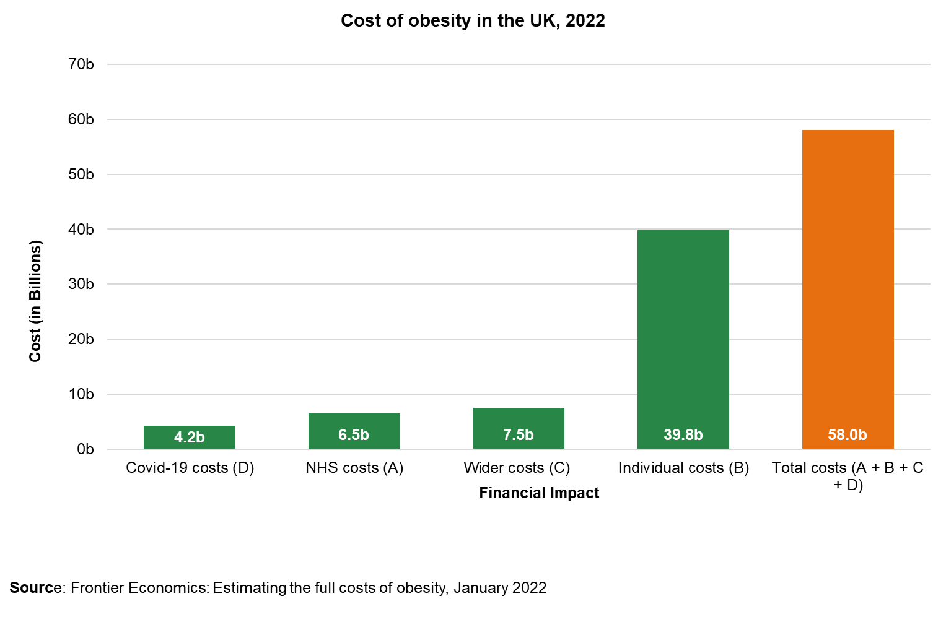
Social care costs
Economic impact of overweight and obesity
The economic impacts of the obesity epidemic are also important. If nothing is done, the global costs of overweight and obesity are predicted to reach US$ 3 trillion per year by 2030 and more than US$ 18 trillion by 2060 (WHO, 2024).
The Department of Health and Social Care (2022) found that obesity costs the NHS £6.5 billion which is expected to rise to over £9.7 billion each year by 2050 (DHSC, 2023).
Costs to the workplace and economy
Costs of caring for people with obesity-related long term health conditions are significant and likely to rise as people live more years in ill-health, often with complex needs.
Social care needs for people with severe obesity cost more, and include housing adaptations, specialised equipment, and care support (LGA, 2020).
The annual cost of adult obesity to UK society was around £54bn in 2022, roughly equivalent to 2-3% of GDP (similar to the total funding allocated to schools in England) (Nesta, 2022).
People with obesity face barriers to economic participation, which reduces the size of the labour market and impacts people’s productivity. In the other direction, economic demands and work-life balance can impact people’s ability to exercise, cook and eat healthy meals, which contributes to increased levels of obesity (IPPR, 2024).
IPPR analysed constituencies most impacted by obesity and rates of economic inactivity. Islington South ranked 19th on this list and Islington North ranked 13th in England, indicating that the borough is among the least affected (IPPR, 2024).
Sources: DHSC (2024) Government plans to tackle obesity in England
Frontier Economics (2022) Estimating the full costs of obesity
IPPR (2024) Obesity’s impact on businesses and workers prompts fresh calls to tackle ultra-processed foods | IPPR
LGA (2020) Social care and obesity
Nesta (2022) The economics of obesity
WHO (2024) Obesity factsheet

Slide 21
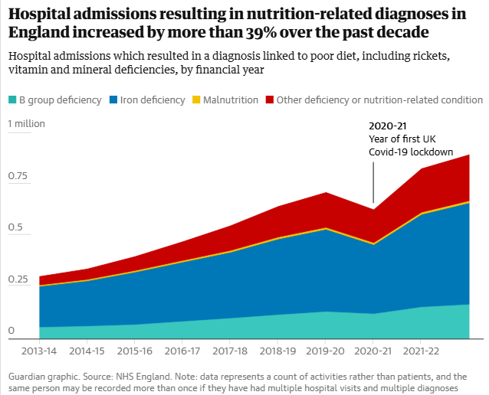
Malnutrition and obesity in the UK
The World Health Organisation (WHO) defines malnutrition as: deficiencies or excesses in nutrient intake, imbalance
of essential nutrients or impaired nutrient utilization. Undernutrition can be co-morbid with overweight and obesity, as well as diet-related noncommunicable diseases. Undernutrition manifests in four broad forms: wasting, stunting, underweight, and micronutrient deficiencies
Over half of people with obesity are also malnourished. This is because people consume food with excess calories but insufficient nutrition (Bradley et al., 2023).
In 2021, 3 million people in the UK were estimated to be malnourished or at risk of malnutrition. It affects:
35% of people recently admitted to a care home.
29% of adults admitted to hospital.
30% of adults attending hospital outpatient appointments.
11% of patients attending general practice.
In 2023, 800,000 people were admitted to hospital with malnutrition and nutritional deficiencies (a threefold increase from 2022).
Malnutrition in the UK is estimated to cost more than £23.5 billion per year, which includes costs of increased hospital admissions; longer hospital stays; and increased healthcare needs in the community.
Graphic source: The Guardian. Data source: NHS England Note: Data represents count rather than patients, same person may be recorded more than once if they have had multiple hospital visits or multiple diagnoses.
Sources: BBC (2024) The briefing room: Will new weight loss drugs save or bankrupt the NHS?
Bradley et al (2023) Obesity and malnutrition in children and adults: A clinical review
BAPEN (2022) Malnutrition and Nutritional Care Survey in Adults
Malnutrition Pathway (2021) Managing adult malnutrition in the community
NICE (2024) Adult malnutrition: How common is it?
WHO Malnutrition

Slide 22
Prevalence of overweight and obesity in children in Islington

Slide 23
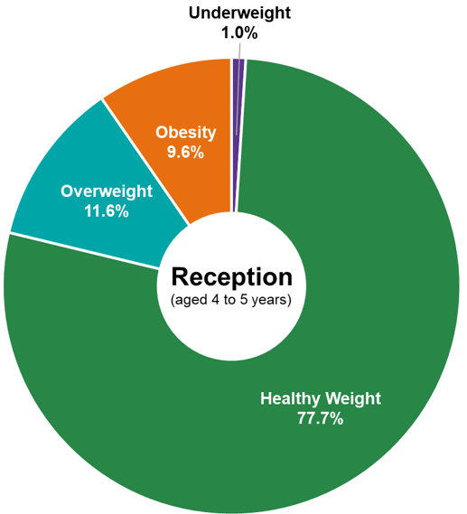
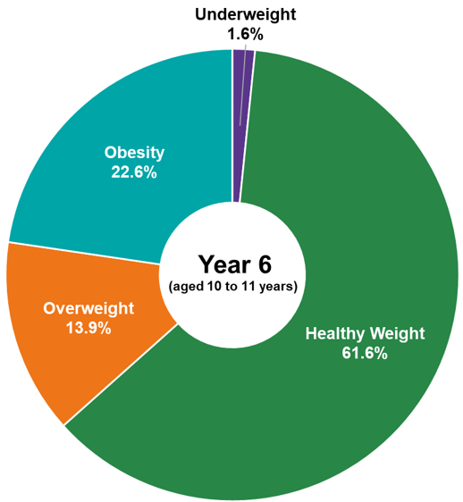
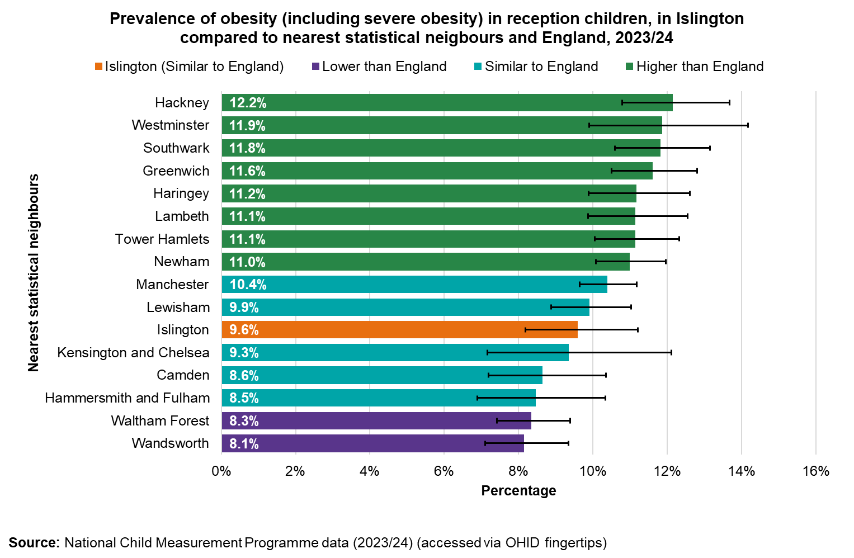
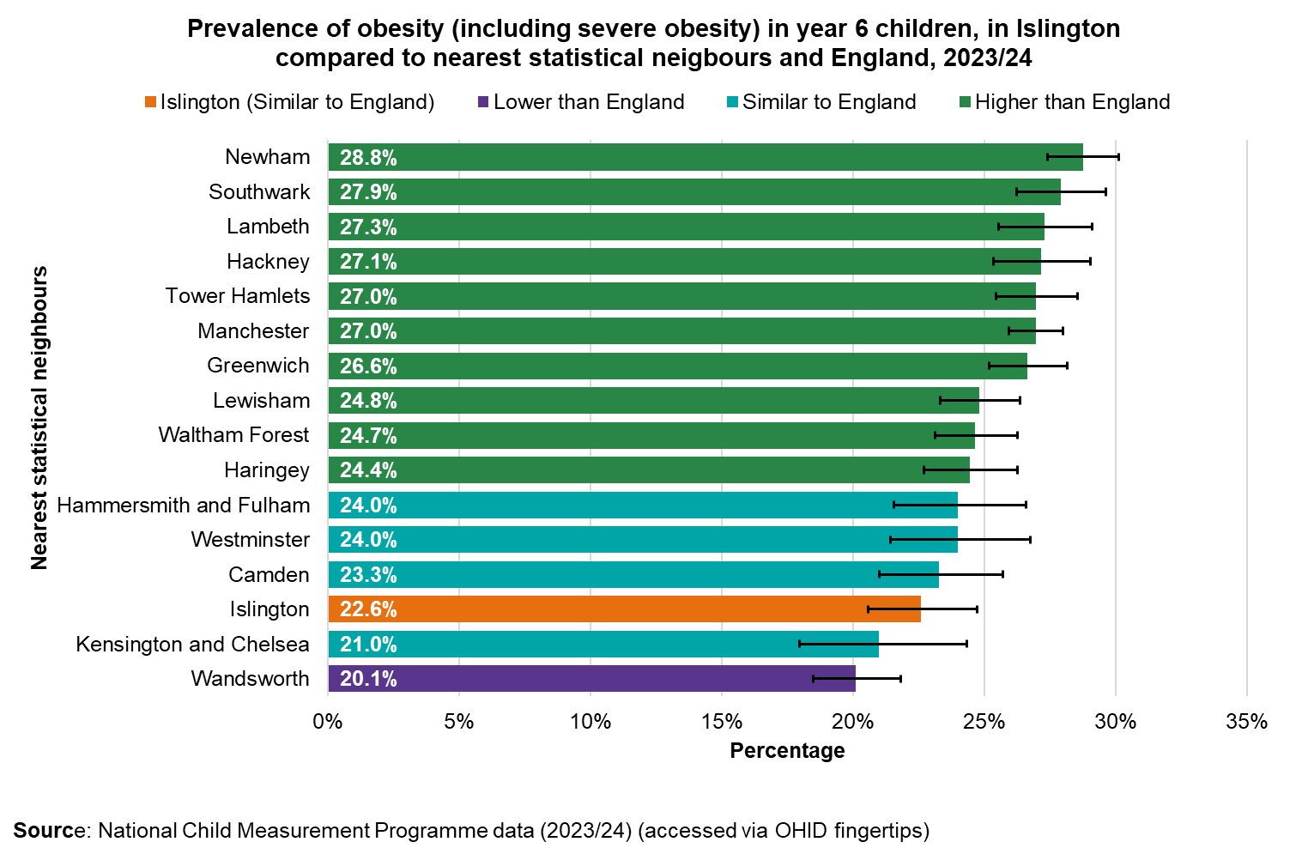
Overweight and obesity – Reception
Overweight and obesity – Year 6
In 2023/24 1,460 reception children (aged 4-5) living in Islington were measured (96% of registered). Of these:
1,135 (78%) were a healthy weight
15 (1%) were underweight
170 (12%) were overweight
140 (10%) were obese including severe obesity
In 2023/24, 1,550 children in Year 6 (aged 10-11) living in Islington were measured (96% of registered). Of these:
955 (62%) were a healthy weight
25 (2%)were underweight
215 (14%) were overweight
350 (23%) were obese including severe obesity
The prevalence of obesity more than doubles between Reception and Year 6
The prevalence of obesity in Year 6 in Islington is similar to the national average (22.1%).
It is also the second lowest prevalence among Islington’s statistical neighbours (prevalences which range from 20% to 29%)
Since 2021, the prevalence of obesity and overweight amongst children in Year 6 has declined and is now slightly below pre-COVID rates.
The prevalence of obesity in reception in Islington is similar to the national average (9.6%).
It is the sixth lowest prevalence among Islington’s statistical neighbours (prevalences which range from 8% to 12%).
Since 2007 prevalence of obesity and overweight amongst reception children has remained stable and similar to the national average
Note: Totals may not sum due to rounding
Source: NCMP 2023/24
Nearest statistical neighbour method developed by NHS England

Slide 24
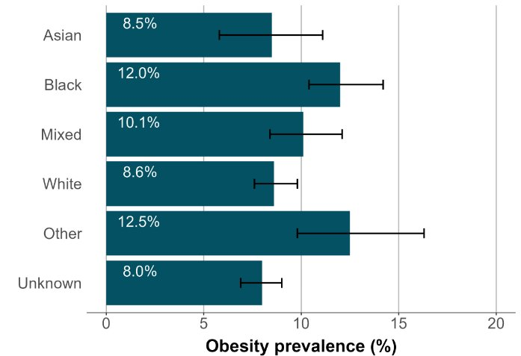
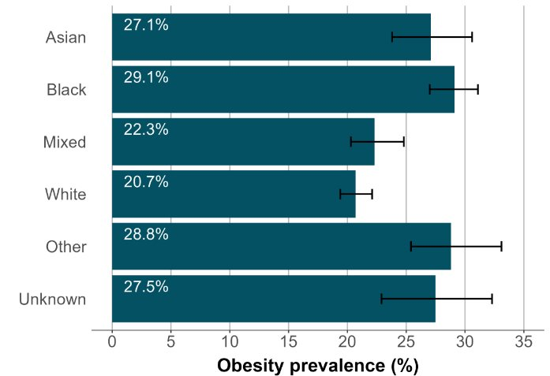
Childhood obesity by ward
Childhood obesity by deprivation
Among children in Reception, the highest obesity prevalence was recorded in Tollington, Mildmay and Canonbury. With high prevalence also recorded in St Peter’s, Clerkenwell and Finsbury Park.
The lowest obesity prevalence was recorded in Highbury West, Highbury East, Barnsbury and St Mary’s.
Children in reception
In Islington obesity prevalence is highest among children from the most deprived quintile.
From reception to year 6 obesity prevalence amongst children from the most deprived households increases by 15.8 percentage points.
Hillrise
Tollington
Junction
Finsbury Park
Childhood obesity by ethnicity
Highbury East
Highbury West
St George's
Mildmay
Obesity prevalence varies by ethnic group in Islington.
In reception, obesity prevalence is highest among Black (12.0%) and other ethnic groups (12.5%); and lowest for White (8.6%) and Asian (8.5%) pupils.
In year 6, obesity prevalence is highest among Black (29.1%), Asian (27.1%) and other ethnic groups (28.8%), and lowest for White (20.7%) and Mixed ethnicity (22.3%) pupils.
The prevalence of obesity amongst Asian children rises by 18.6% from reception to year 6.
This reflects national patterns in obesity prevalence for ethnicity. Amongst children in reception, obesity prevalence is highest for Black African and other Black ethnic groups. While in year 6 all minority ethnic groups have higher obesity prevalence than White British children.
Children in reception
Holloway
Canonbury
Caledonian
St Mary's
St Peter's
Barnsbury
Children in year 6
Clerkenwell
Bunhill
Hillrise
Tollington
Junction
Among children in Year 6, the highest obesity prevalence was recorded in Finsbury Park, Holloway, and Caledonian. With high prevalence also recorded for Mildmay, Clerkenwell, and Bunhill.
The lowest obesity prevalence was recorded in Highbury West, Highbury East, and St Mary’s
Finsbury Park
Children in year 6
Highbury East
Highbury West
St George's
Mildmay
Holloway
Canonbury
Caledonian
St Mary's
St Peter's
Barnsbury
Clerkenwell
Bunhill
Note: Data combined 5-years, (2018 to 2019, 2019 to 2020, 2021 to 2022, 2022 to 2023, and 2023 to 2024)
Source (including graphs): Office for Health Improvements and Disparities, 'Patterns and trends in child obesity in Islington', November 2024

Slide 25
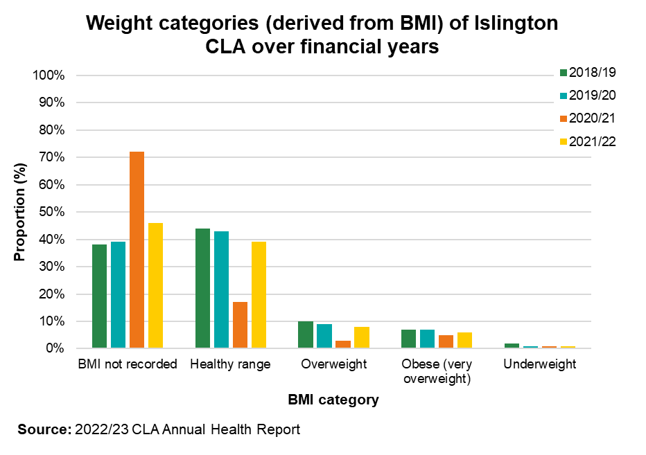
Children Looked After (CLA)
The CLA Health Service is provided by Whittington Health NHS Trust and is commissioned by NHS North Central London Integrated Care Board (ICB) since July 2022. Body mass index (BMI) is recorded at health assessments. There are times it is not possible to measure this e.g. when health assessments are completed as outreach.
Across years, there is a significant proportion of CLA who do not have their BMI recorded, especially in 2020/21 because of the COVID-19 pandemic.
Excluding 2020/21 from analysis, across years most of our CLA (with recorded BMI) are in the healthy weight range.
The proportion of CLA (with BMI recorded) who were overweight or obese has stayed broadly similar between 2018/19 and 2021/22.
In 2021/22, 8% of CLA were overweight and a further 6% were obese.
It was not possible to break this down against age ranges to compare with the general Islington child population.
Focus groups with 6 CLA (conducted in 2024) comments from these revealed that children: felt that there is a lack of basic information on the simple things such as healthy eating or meal preparation and we get no interaction with a dietician/nutritionist. Healthy food feels unaffordable and Junk food is too easily available.
There may be opportunities for primary caregivers to promote healthy routines and behaviours for the children they look after.
Source: Children Looked After Health Needs Assessment 2024-08-11.pptx

Slide 26
Prevalence of overweight and obesity in adults in Islington

Slide 27
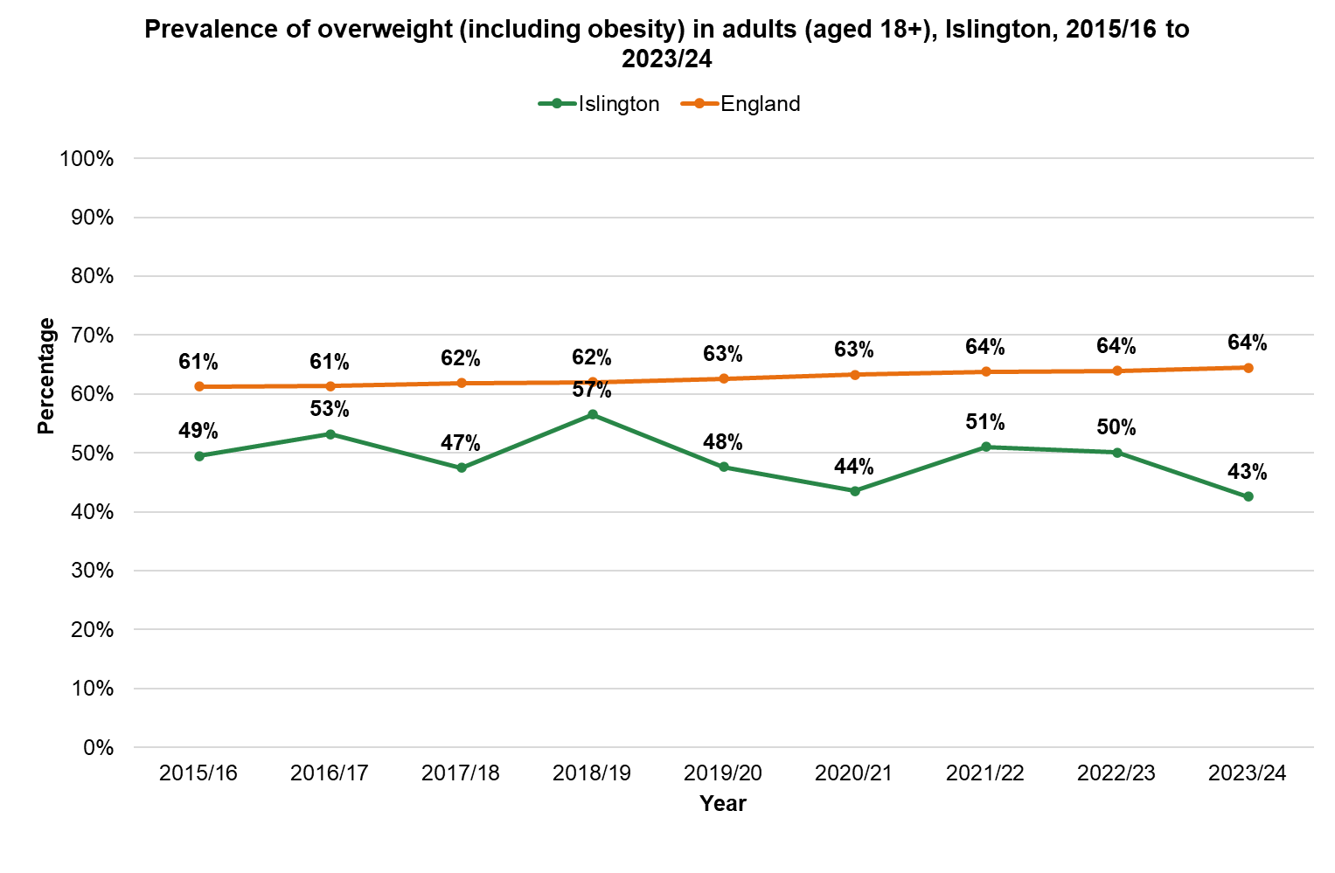
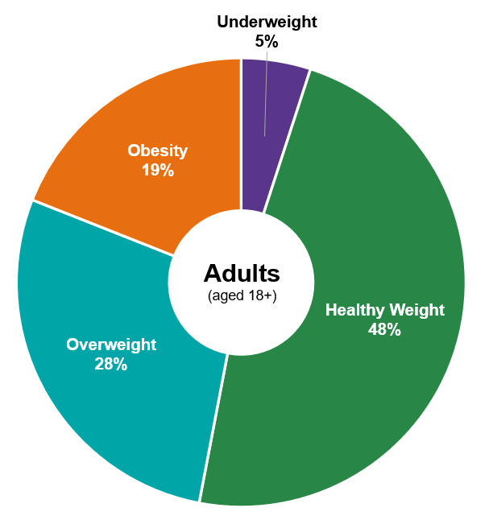
Adult prevalence of overweight and obesity in Islington
There are two primary sources which describe the prevalence of overweight and obesity among adults in Islington. The Sports England Active Lives Adults Survey which collects self-reported height and weight and the GP registers via HealtheIntent.
Sports England Active Lives Adults Survey
According to Sport England Data, in Islington 43% of adults are classified as living with overweight (including obesity). This is the lowest rate in London and is significantly lower than the London (58%) and England (65%) averages. It is also significantly lower than most other North Central London boroughs.
13% of adults are living with obesity.
Rates of overweight and obesity amongst adults in Islington have been relatively stable between 2015 and 2024 – ranging from 57% in (2018/19) to 43% (in 2023/24). Small fluctuations are what we would expect given small / medium sample sizes.
HealtheIntent
According to HealtheIntent data, 100,627 (38%) of adults registered with a GP in Islington are overweight or obese.
HealtheIntent provides lower estimates of the proportion of adults with overweight or obesity in Islington than Sport England. However, this discrepancy may be due to the high proportion of adults registered at a GP with an unknown BMI. Excluding adults with no BMI recorded, estimated proportions from HealtheIntent are similar to Sport England data (47%).
Note: HealtheIntent only includes data for adults registered with a GP or accessing acute care.
Source: HealtheIntent accessed 21/01/25
Source: Sport England Data 2024, accessed via OHID fingertips
HealtheIntent Population Health needs – behavioural risk factors (accessed January 2025)

Slide 28
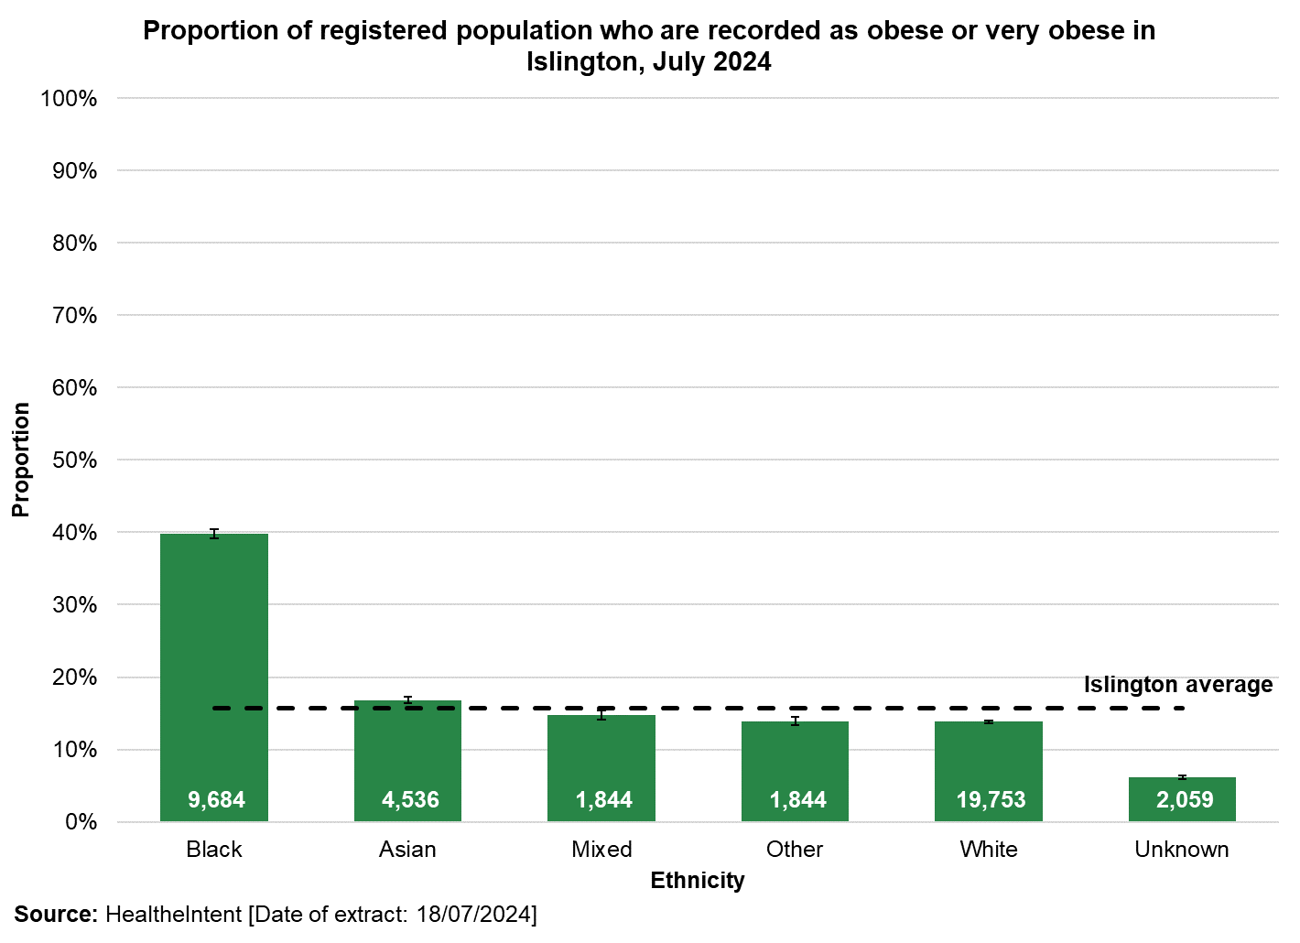
Health inequalities in adult obesity prevalence
Hospital admissions with obesity in Islington
40% of adults from a Black ethnic group are obese or very obese in Islington. This is significantly higher than all other ethnicities.
The prevalence of overweight and obesity increases with age in Islington, with around a quarter of people aged 50+ above a healthy weight.
A higher proportion of men (51%) compared to women (44%) are overweight or obese in Islington.
The prevalence of overweight, obese, and severely obese increases as deprivation increases, with almost half of people living in the most deprived areas of Islington above normal weight.
Prevalence of obesity is higher in the North of the borough, as shown in the map.
In 2022/23, in Islington, there were 3,855 finished admission episodes with a primary or secondary diagnosis of obesity (2,640 women, 1,215 men)
There were 35 finished consultant episodes with a primary diagnosis of obesity and a main or secondary bariatric surgical procedure (30 women).
Note: A finished admission episode (FAE) is the first period of admitted patient care under one consultant within one healthcare provider. Admissions do not represent the number of inpatients, as a person may have more than one admission within the year.
The primary diagnosis provides the main reason why the patient was admitted to hospital. There are a further 19 secondary diagnosis fields in Hospital Episode Statistics data that show other relevant diagnoses. A secondary diagnosis of obesity does not necessarily indicate obesity as a contributing factor for the admission, but may instead indicate that obesity is a factor relevant to a patient’s episode of care.
A finished consultant episode (FCE) is a continuous period of admitted patient care under one consultant within one healthcare provider. Figures do not represent the number of different patients, as a single patient could be seen by multiple consultants as part of the same admission.
Source: HealtheIntent Population Health needs – behavioural risk factors (accessed January 2025)
NHS Digital (2022/23) Statistics on Public Health, Admissions related to obesity, drug misuse and smoking.

Slide 29
Maternal Obesity
Maternal obesity can present health risks for both mother and foetus, including gestational diabetes, preeclampsia and increased risk of stillbirth. Greater support is needed for women to achieve and maintain a healthier weight before, during and after pregnancy. However, there is a lack of consensus on optimal gestational weight gain, there are no evidence-based UK guidelines on recommended weight-gain ranges during pregnancy and NICE guidance does not recommend dieting during pregnancy as it may harm the health of the unborn child.
Maternal obesity in England
Maternal Obesity in Islington
Public Health England’s 2020 Maternal high impact area papers showed that 46% of women in England start pregnancy a healthy weight. Approximately 28% of women are categorised as overweight (BMI ≥25) and 22% of women are categorised as obese (BMI ≥30) at the start of pregnancy (PHE, 2020).
According to 2017 data from the National Maternity Services Dataset (MSDS) maternal obesity prevalence varies between ethnic groups: 66.6% of black women were overweight or obese. Women of Asian (51.8%), mixed (51.2%) and white (48.6%) ethnicities also had high rates of being overweight and obese. Lowest rates of maternal obesity were observed for women of Chinese ethnicity (22.8%).
Prevalence of overweight and obesity increases as women get older. Younger women were more likely to be underweight at their booking appointment, 12% of women under 18 were underweight at their booking appointment. 31.3% of pregnant women under 18 were classified as overweight or obese (including severely obese) in early pregnancy, rising gradually with age to 55.4% of pregnant women aged 40 or over.
Data shows that in 2023/24, 15% of pregnant women were obese at the start of their pregnancy. This was significantly lower than the London (21%) and England (26%) averages.
Caveats:
In 2023/24, BMI measurements could not be used for 39.5% of records. This was for any of the following reasons:
The value for one or more of height, weight and supplied BMI was invalid, zero or missing
GESTATIONAL AGE (CARE CONTACT DATE) was greater than or equal to 14 weeks and zero days (the point at which it is considered the pregnancy affects the mother's weight)
GESTATIONAL AGE (CARE CONTACT DATE) was recorded as zero days, or a negative value
The calculated BMI was less than 13kg/m2 or greater than 80kg/m2
Source: Leddy, M. A., Power, M. L., & Schulkin, J. (2008) The impact of maternal obesity on maternal and fetal health. Reviews in obstetrics and gynecology, 1(4), 170.
NICE (2025) Overweight and Obesity management OHID fingertips
PHE (2020) Maternity High Impact Area: Supporting Healthy weight before during and between pregnancies.

Slide 30
Prevalence of Weight Associated Health Conditions in Islington

Slide 31
Weight associated health conditions in children
Weight associated health conditions in adults
Asthma
Obesity is a risk factor and disease modifier for asthma (Peters et al, 2018).
In Islington, the prevalence of asthma is higher among adolescents (5.3%, 775 adolescents) than children, young people and adults.
However, national estimates suggest 10% of children have asthma, as such this data may be underestimating the true prevalence, e.g. excluding cases of mild asthma
Dental health
Although deprivation and consumption of free sugars is a risk factor for both obesity and dental caries, it’s unclear whether being overweight increases the risk of dental caries or vice versa. However, it’s likely that interventions that reduce these common risk factors have the potential to impact both conditions at the population level (PHE, 2015).
All wards in Islington have similar levels of hospital admissions for dental caries, with only Highbury and St Mary’s reporting lower rates. Some ethnicities have higher rates of dental caries including black African and black British children and white other groups.
Obesity is closely linked to hypertension, and is a major risk factor for diabetes, coronary heart disease and musculoskeletal problems.
The table below shows the prevalence of weight-associated health conditions amongst adults registered with a GP in Islington, as per the business rules for QOF registers.
LTC | Islington Count | % of Islington population | Patients from minority ethnic groups | Patients over 65 yrs | Patients living in the most deprived quintile (20%) | England (QOF)
Hypertension | 23,866 | 7.8% | 13,760 (58%) | 12,359 (52%) | 6,927 (29%) | 14.8%
Diabetes mellitus | 11,719 | 3.9% | 8,011(68%) | 5,341 (45%) | 3,870 (33%) | 7.7%
Asthma | 13,517 | 4.4% | 6,894 (51%) | 2,490 (18%) | 3,841 (28%) | 6.5%
Coronary Heart Disease | 3,900 | 1.3% | 2,104 (54%) | 2,523 (64%) | 1,163 (30%) | 3.0%
Note: Prevalence of LTCs recorded using the business rules for QOF registers. Some QOF registers have minimum age criteria – Asthma (6+), Diabetes (17+). The proportions shown have not taken minimum age into consideration. Diabetes mellitus is defined as per the QoF register and so combines type 1 and type 2.
Source: HealtheIntent. Population Health Needs – Long Term Conditions (accessed 25th January 2025)
Peters et al (2018) Obesity and Asthma. J Allergy Clin Immunol. 141(4):1169–1179. doi: 10.1016/j.jaci.2018.02.004
NHS digital Hospital Episode Statistics
PHE (2015) The Relationship between Dental Caries and Obesity in Children: An Evidence Summary

Slide 32
Dietary Determinants of Healthy Weight across the Life Course in Islington

Slide 33
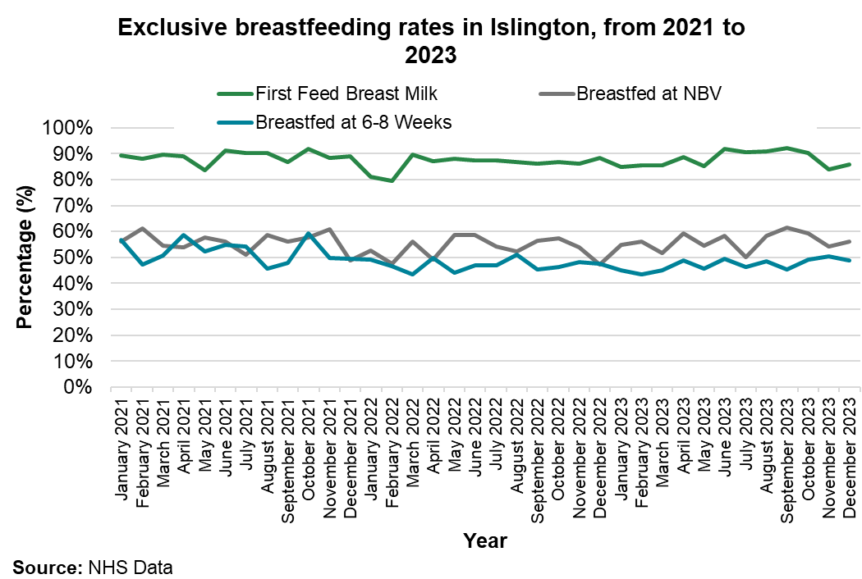
Breastfeeding
How is breastfeeding linked to obesity
Exclusive Breastfeeding for at least four months is associated with a lower prevalence of overweight and obesity in mothers and their children after 2–5 Years from delivery (Mantzorou et al., 2022).
Breastfeeding in Islington
Inequalities in breastfeeding
Exclusive breastfeeding rates in Islington have remained relatively stable over the two years from January 2021 until November 2023.
Between 85-90% of babies are exclusively breastfed at first feed. Higher than the England average
Breastfeeding rates by ethnicity
Asian other, Bangladeshi, black African and black other all have significantly lower exclusive breastfeeding rates at 6 to 8 weeks compared to other ethnic backgrounds. Whereas white British and white other are significantly higher for exclusive breastfeeding at both visits.
Breastfeeding rates by age
Over 25s have significantly higher levels of exclusive and partial breastfeeding at NBV and 6-8 weeks than under 25s .
The biggest drop in exclusive breastfeeding is between baby’s first feed and the new birth visit (NBV) at 10 days. By the NBV, exclusive breastfeeding decreases to around 55%.
Exclusive breastfeeding rates then decrease by a further 5-10% by the 6–8 week visit. This suggests that the most important time to receive breastfeeding support is in the first 10 days of birth.
Although rates of exclusive breastfeeding drop at this point, partial breastfeeding remains high in Islington at 84%. This far surpasses the England average of 52%.
Opportunities
Support all public sector buildings to become Breastfeeding Welcome Continue to commission distinct infant feeding support services within Bright Start.
Source: OHID (2023) Breastfeeding at 6 to 8 weeks: a comparison of methods
NHS data , OHID fingertips
Mantzorou, M., et al. (2022). Exclusive breastfeeding for at least four months is associated with a lower prevalence of overweight and obesity in mothers and their children after 2–5 years from delivery. Nutrients, 14(17), 3599.

Slide 34
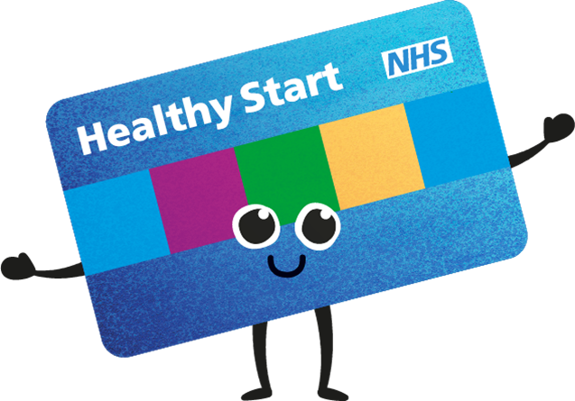
Healthy Start Scheme
What is the Healthy start scheme
Healthy Start is a means-tested scheme in the UK that supports pregnant women and families with children under four years old in purchasing healthy food and vitamins. Eligible families receive £4.25 each week for each child between 1 and 4 years old.
How is the Healthy Start scheme linked to obesity?
The scheme can help low-income families access healthy food, which can help prevent obesity and other health conditions.
Islington Context
It was estimated that in 2023 that only 64.14% of eligible beneficiaries were receiving Healthy Start payments in Islington. This was slightly below the England average of 64.5% uptake and represents a loss of £247,435 of support for families.
The number of people claiming Healthy Start Vouchers has increased since January 2023 from 1,691 to 1,775 in December 2024, however due to inaccuracy in eligibility data we cannot assess how many eligible families still do not receive this support.
The scheme continues to be promoted through a multi-disciplinary steering group with members from Bright Start, Health visiting, midwifery, council teams and VCS partners. Promotional activities have included communication campaigns, direct mail to families, training for key professionals and support through Bright start children’s centers.
Comments/ gaps in delivery
At a child's 4th birthday, the Healthy Start scheme ends. If that child's birthday falls after 31st August, they won't start school until the following September, when they would become eligible for free school meals. This creates a gap in food support, potentially leading to increased food insecurity for families until their child starts reception. This gap can be particularly problematic for children with birthdays near the start of the school year, who may go without support for an entire year.
Source: Sustain (2023) Healthy Start map: Estimated loss to families in 2023

Slide 35





Dietary determinants in children
Fruit and vegetable intake
In 2025, 25% of secondary school pupils and 39% of primary school children reported eating 5 portions of fruit and vegetables on the day before the survey. This is a significant increase since 2021, but only slightly exceeds 2017 levels.
The percentage of secondary school students eating fruit and vegetables on ‘most days’ or ‘every day’ continues on an upward trend.
Primary school pupils continue to be more likely than secondary school pupils to eat fruit and vegetables on 'most days' or 'everyday'. Although the percentage of primary school pupils eating vegetables on 'most days' or 'everyday' has reduced in 2025, it remains above 2017 levels.
Percentage of Islington pupils eating at least 5 portions of fruit and vegetables
Percentage of Islington pupils eating vegetables on ‘most days’ or ‘every day’
Percentage of Islington pupils eating fruit on ‘most days’ or ‘every day’
Primary
Secondary
2021: 54%
2025: 58%
2021: 34%
2025: 39%
2017: 38%
2021: 62%
2025: 60%
2021: 48%
2025: 55%
2021: 19%
2025: 25%
2017: 23%
Primary
Secondary
2021: 67%
2025: 69%
Secondary
Primary
Takeaway food
Drinks
Access to water during class time increased for both primary and secondary school pupils between 2017 and 2021. However, we see significant decreases in 2025.
The number of secondary pupils who reported not having drank any fizzy drinks in the week before the survey has increased consistently since 2017.
One in ten secondary pupils who responded to the HRBQ survey said that they had eaten takeaway food “on most days” or "everyday" in the week before the survey
Percentage of Islington pupils who have access to water during class
Percentage of Islington pupils who have never drank fizzy drinks with sugar in week before survey
Primary
Secondary
Primary
Secondary
2017: 48%
2021: 67%
2025: 63%
2017: 14%
2021: 21%
2025: 12%
2017: 28%
2021: 28%
2025: 39%
2017: 21%
2021: 28%
2025: 30%
Source: Health Related Behaviour Questionnaire 2025

Slide 36
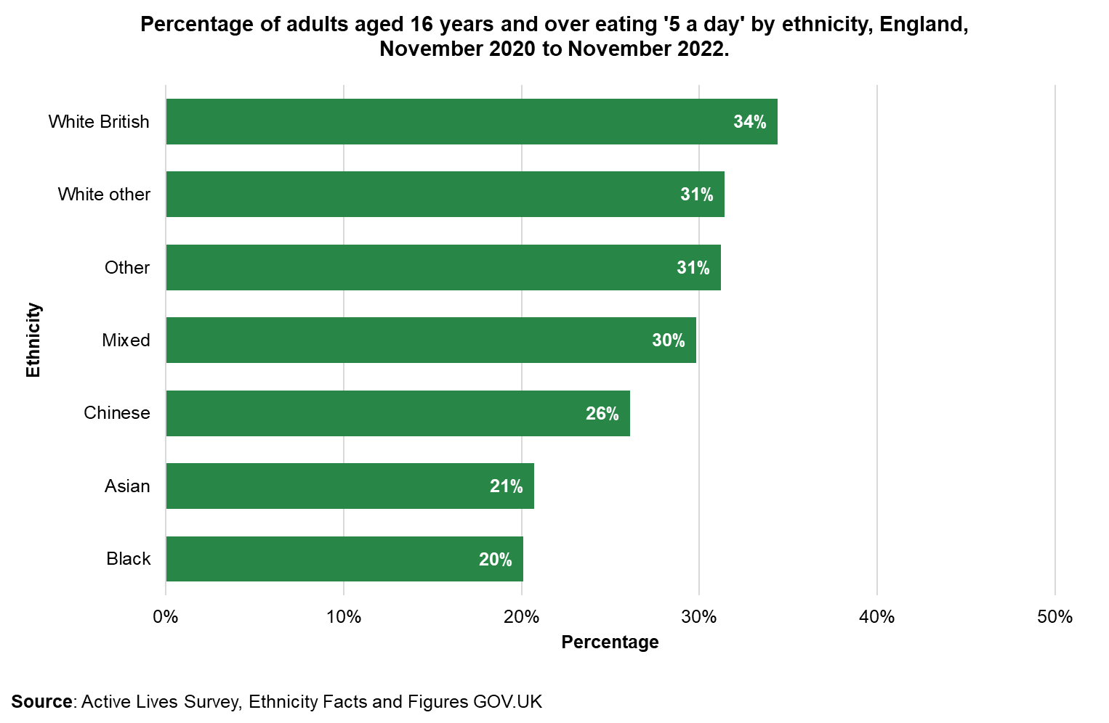
Dietary determinants in adults in Islington
Islington context
In 2022/23, in Islington, 32.9% of adults reported meeting the dietary requirements of ‘5-a-day’ fruit and vegetable consumption.
This is similar to the England average of 32.5% of adults eating ‘5-a-day’ (Health Survey for England, 2022)
National data on health inequalities
The proportion of adults in England eating the recommended 5 portions of fruit and vegetables varied by deprivation group. Only 23% of adults in the most deprived fifth of the population ate five portions of fruit and vegetables a day, compared to 34% of adults in the least deprived quintile.
Nationally, white British ethnic groups are most likely to eat 5 fruit and vegetables a day (34.4%), while Asian (20.7%) and black ethnic (20.1%) groups had the lowest proportion of adults who ate 5-a-day.
Source: Health Survey for England, 2022
OHID fingertips

Slide 37
Islington Food Environment: Food Insecurity

Slide 38
Food insecurity
Drivers of food insecurity
Uncertainty regarding ability to obtain food
Compromising on food quality and variety
Reducing food quantity, skipping meals
Food secure to mild food insecurity
Moderate food insecurity – this person has
No food for a day or more
Insufficient money or resource for a healthy diet
Uncertainty about the ability to obtain food
Probably skipped meals or run out of food occasionally
This person has
Run out of food
Gone an entire day without eating at times during the year
What is food insecurity?
Food security is defined as a state in which “all individuals, always, have physical, social, and economic access to sufficient, safe, and nutritious food to meet their dietary needs and food preferences for healthy life” (FEIS)
According to Food Insecurity Experience Scale (FIES), food insecurity can be experienced at different levels of severity.
Food insecurity scale
National data from the Family Resources Survey indicates that households most likely to be experiencing food insecurity include those:
With children (especially single parent households with multiple children)
Where the head of the household is aged 16-24 years
With a disabled adult
With a Black head of household
On any income-related benefit, especially universal credit and Low-income households
Living in social housing
Local context
Between July and August 2022, 19 interviews were conducted with VCS organisations from Camden and Islington to discuss the drivers of food insecurity in the boroughs. These interviews identified the following factors as the most common drivers of food insecurity:
Low income – income is not sufficient to meet their outgoings
Difficulty accessing benefits
Debt
Lack of knowledge around cooking
Lack of local food choices
Issues with health or mental health
Lack of facilities to store and cook food
Barriers to accessing services: shame, stigma, physical accessibility
Lack of awareness about what is healthy food
People with no recourse to public funds.
How is food insecurity linked to obesity?
There are several factors that underlie the associations between food insecurity and increased obesity. For example, people who struggle to access food may rely on lower-quality diets and more calorie dense foods. They may also have reduced access to healthy foods, physical activity, or health care services. Psychological stress and disrupted eating patterns may also contribute to increased levels of obesity (Carvajal-Aldaz et al, 2022)
Islington context
Food insecurity in Islington is likely to be higher than national averages due to local patterns of ethnicity and deprivation.
According to 2022 data from the National Food Insecurity tracking, 27,291 people in Islington were estimated to be experiencing moderate to severe food insecurity.
In 2021/22, Islington Foodbank (just one of the emergency food providers in the area) supported 3,304 people with food.
Across London the number of adults using food banks has increased from 150,000 in 2017/18 to over 400,000 in 2023/24.
Source: Carvajal-Aldaz et al (2022) Food insecurity as a risk factor for obesity: A review
Food and Agriculture Organisation: The Food Insecurity Experience Scale
Statista (2024) London Food Bank users
The Food Foundation (2023) National Food insecurity tracking
Camden and Islington (2022) Food insecurity Needs Assessment Department for Work and Pensions (2024) Family Resources Survey

Slide 39
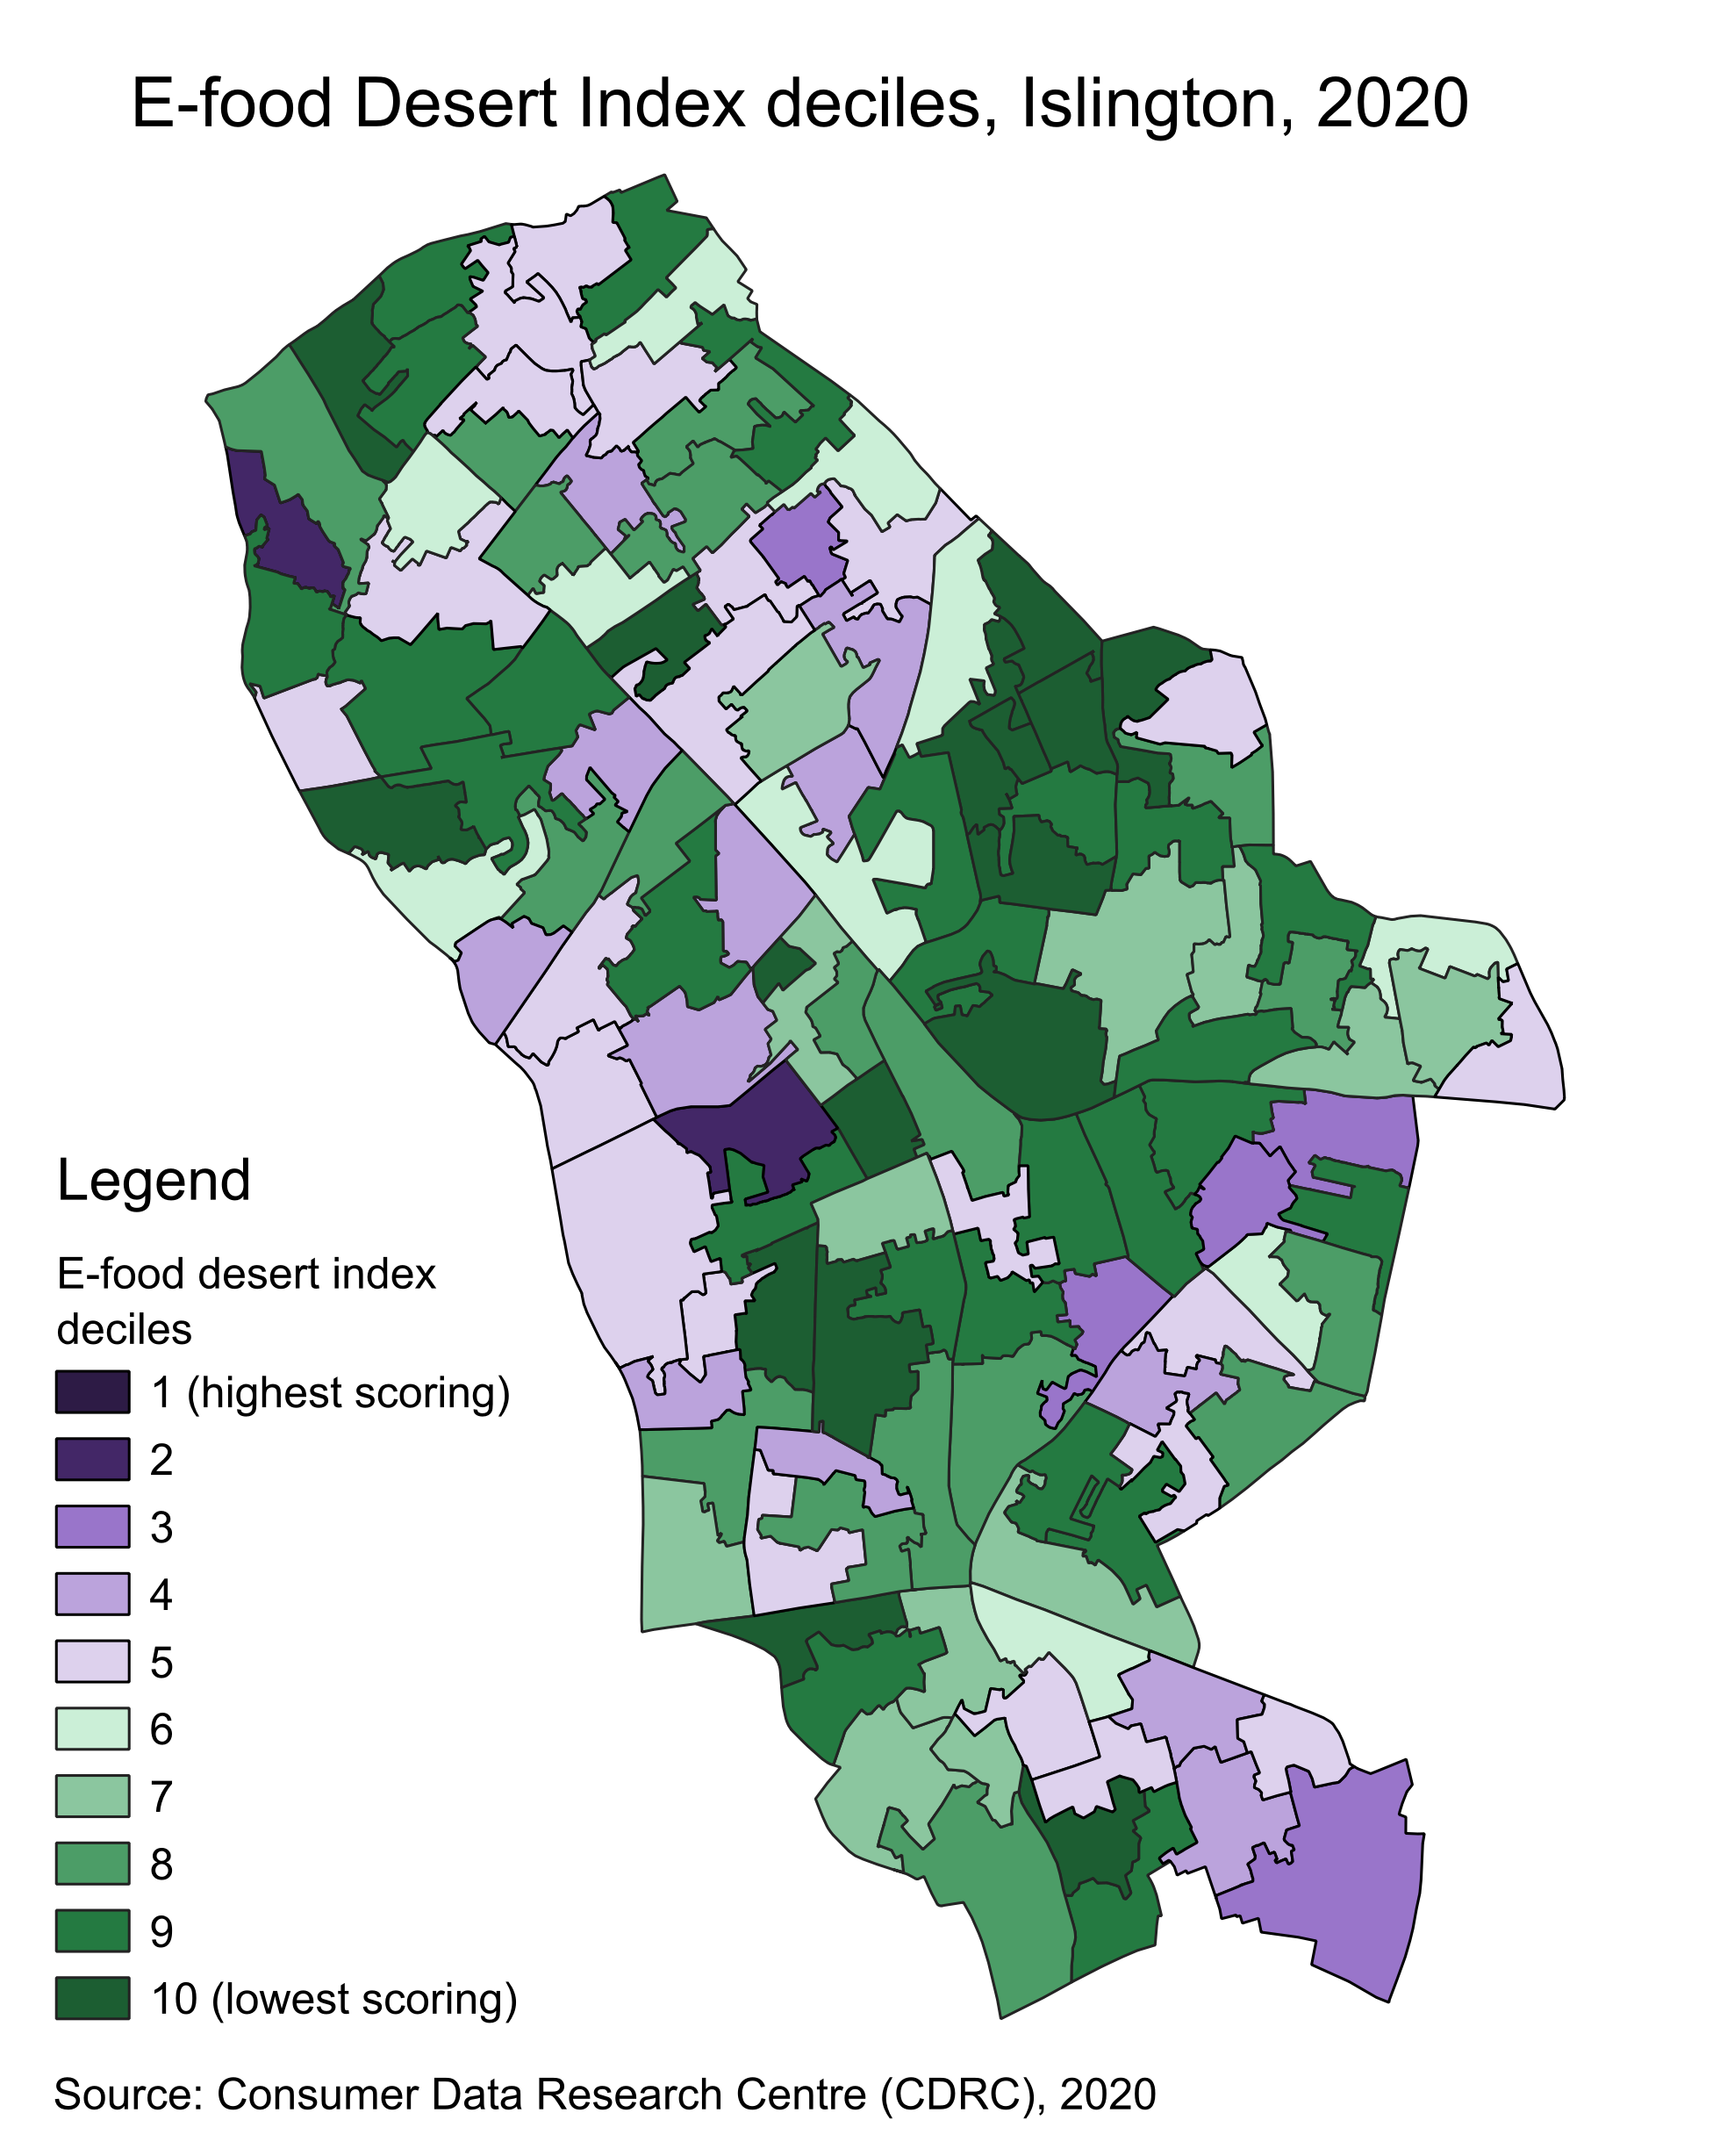
Food Deserts
Food Deserts are areas that are most vulnerable to increases in the cost of living and have a lack of access to cheap, healthy, and sustainable sources of food.
The E-Food Desert Index identifies ‘food deserts’ by looking at the following characteristics:
Proximity and density of grocery retail facilities
Transport and accessibility
Neighbourhood socio-economic and demographic characteristics
E-commerce availability and propensity.
Food deserts can contribute to food insecurity and increase populations’ risks of obesity.
Food deserts in Islington
Food deserts and the availability of culturally appropriate foods
Many people in Islington have poor access to supermarkets, with around 15,000 people living in areas that meet the definition of a ‘food desert’. However, this figure does not account for local markets or independent or small chain food retailers, including cultural supermarkets. Some new supermarkets have also opened since the food desert index was last calculated.
The areas in Islington with the highest food desert Index scores in 2020 are Junction, Barnsbury, and Bunhill. However new supermarkets have opened in Junction since 2020, likely reducing scores around Archway.
The lack of availability of affordable, healthy and culturally appropriate foods can make certain groups more vulnerable to food insecurity and exacerbate food deserts for certain cultural groups.
In 2023, a food basket analysis was conducted to assess the cost and availability of different foods for healthy diets in four areas of Islington: Highcroft; Holly Park; Copenhagen Street; Tollington Road. They also included an online shop for comparison. The availability and cost of culturally appropriate food items for three ethnic groups (white British, Bangladeshi, and black African) was assessed.
The study revealed that Highcroft and Holly Park area had the highest prices and Tollington Road had the lowest prices for food items from all cultures.
Across all areas, including the online shop, the White British food items had the highest prices, while the cheapest prices can be observed for the Black African/Caribbean basket. The highest prices per 100g of protein were noted for the White British basket while the lowest prices were seen for Bangladeshi.
From all shops the highest % availability was for the White British basket. Copenhagen Street and in the Highcroft and Holly Park area had better availability of products from the Black African/Caribbean and Bangladeshi baskets. The percentage of products available for the Black African Basket has increased from 36% to 64% between this study and the one preceding in 2022.
There was a dearth of fruit and vegetables in convenience stores, which tend to be closer to communities, and the cost of these items were more expensive compared to the large supermarkets.
Source: Consumer Data Research Centre: E-Food Desert Index (EFDI)
Food cost and availability report 2023.docx

Slide 40
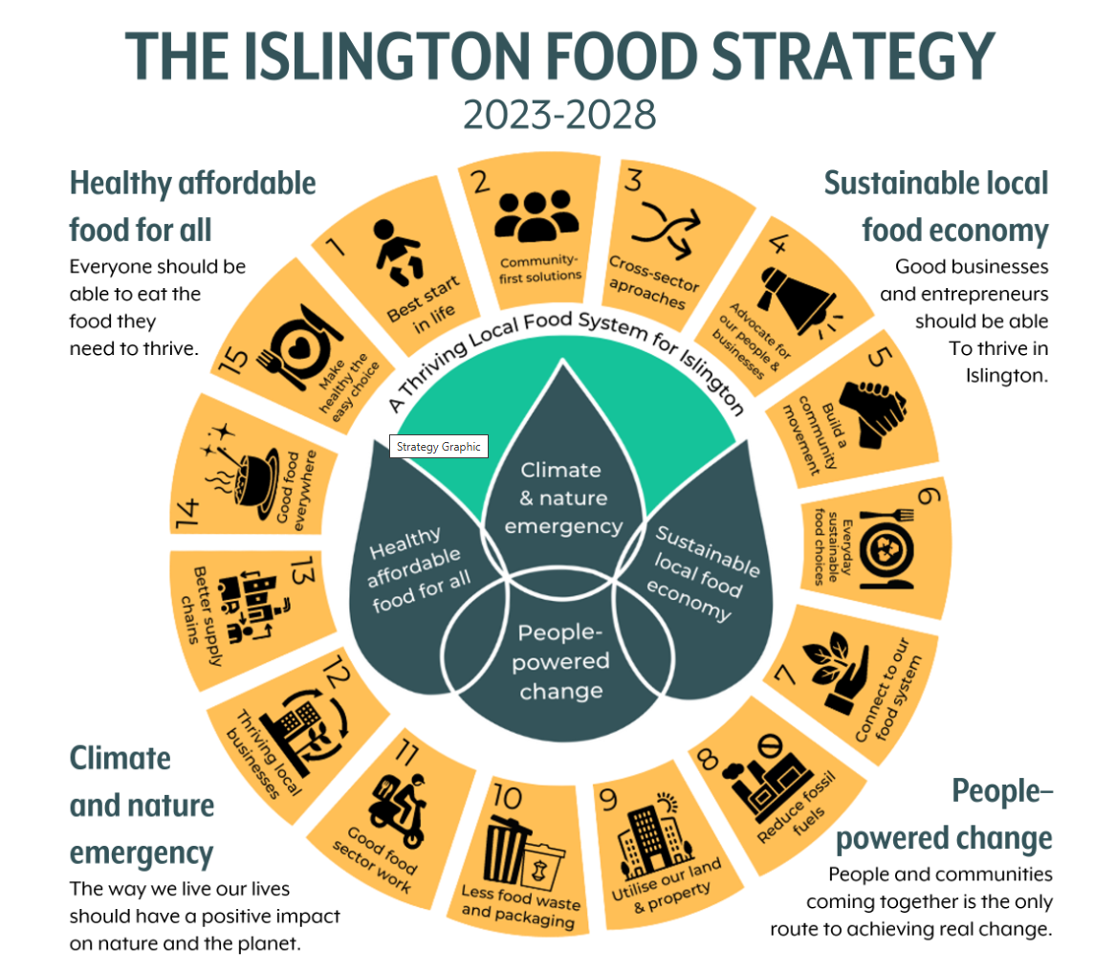
How is Islington addressing food insecurity?
What is the Islington Food Partnership (IFP)?
The Islington Food Partnership (IFP) was originally established to address food poverty in the borough. The partnership co-ordinates action to ensure residents have information about food services, including emergency support. It also works towards creating a healthy and sustainable local food system.
Islington council supports the work of the IFP, and the Islington Food Strategy created by the partnership. In 2024 the council allocated £200,000 to four voluntary sector organisations (including Manor Gardens who coordinate the IFP) to deliver a capacity-building project in food aid settings.
How can the IFP support efforts to address obesity?
Food partnerships are one way of applying systems thinking to addressing obesity and healthy weight.
The IFP is currently supporting food-aid providers to explore options for collective buying. This involves collectively purchasing food from wholesalers to enable emergency food services to acquire provisions according to need, cultural appropriateness and healthiness. It is hoped that this will help increase the availability of healthy food in food aid. There may be opportunities for the council to support this endeavour (e.g. providing storage locations or funding equipment such as fridges).
Source: IFP (2023) Food Strategy 2023-2028
Taheem (2023) How do local authority plans to tackle obesity reflect systems thinking?
Jackson (2024) Values-based food systems: the role of local food partnerships in England

Slide 41
Community growing
Opportunities
How is community growing linked to obesity and health?
Community growing opportunities can increase access to affordable fruit and vegetables.
Growing also provides opportunity for physical activity and community connection.
Community gardens can also provide Sustainable Urban Drainage Systems (SuDS) to prevent flooding and increase the greening of a local area.
Islington context
Islington is a densely populated borough, with the second lowest proportion of public green space of any local authority in the country.
Islington maps and tracks the amount of land available to grow food and sets targets to increase availability. There is currently more demand than supply of land for community growing, including allotments.
Islington’s local plan supports community growing opportunities, including working with developers to ensure that accessible community gardens and food growing are part of the design of new developments.
Islington has put aside space in parks to support community growing activity.
Islington provides support and has a lead contact in the council for food growing.
Octopus Community network has secured funding to support further urban growing programmes and is a member of Islington’s food partnership and strategy.
Using SUDs for community growing.
Support community food growing and composting by ensuring planning for new developments must include provision for this.
Encourage street tree planting and more public edible trees.
Create a pathway for residents to request the creation of a food growing area on their street or estate.
Land map for suitable places to grow food or set aside plots for green food production.
Implement innovative models to enable community-led food growing, composting and vending, for example Urban Cultivate.
Source: Sustain Reporting – Islington Council
Mayor of London (2019) Reimagining rainwater in schools
Fields in Trust. (2024) Green Space Index 2024. Available from: Green Space Index 2024 (arcgis.com)

Slide 42
Islington Food Environment: School Settings and Interventions

Slide 43
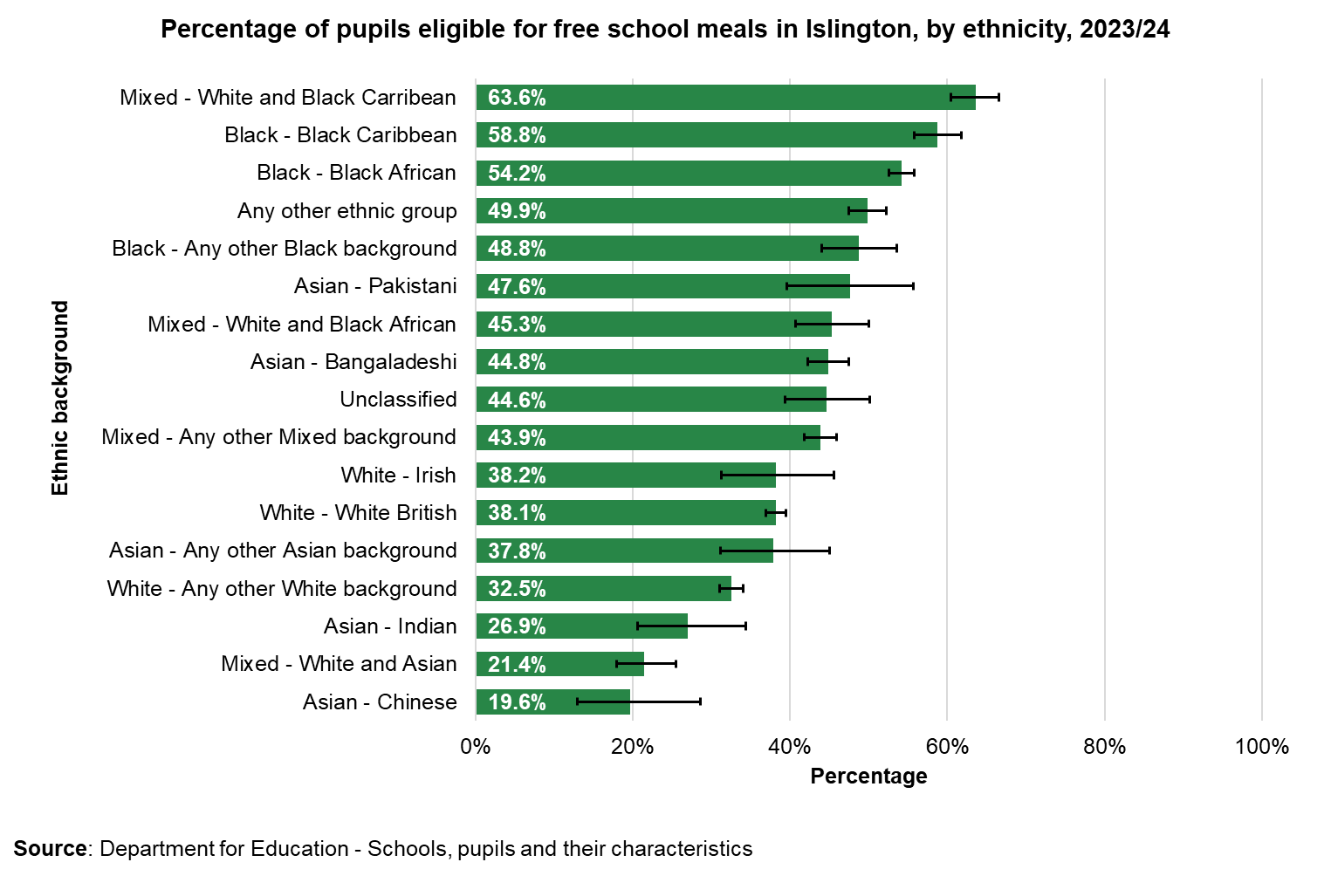
Free school meals (FSM) in Islington
How are free school meals linked to obesity?
School settings provide an opportunity to introduce a positive food culture and good eating habits for the whole school community. FSMs ensure all primary school children receive at least one hot, healthy meal each day.
Islington has the second highest proportion of pupils in mainstream schools known to be eligible for FSM in the country, after Manchester.
In 2023/24, 43% of primary pupils and 46% of secondary pupils were eligible for FSM. This is significantly higher than the London averages (primary=25%, secondary =28%).
Of these, 87% of students eligible for FSM took up the lunch offered. Similarly, 88% of students not eligible for FSM also had a school provided lunch.
FSM eligibility in Islington has significantly increased from 2019/20, when 30% of primary and 34% of secondary school pupils were eligible for FSM. This reflects growing levels of poverty in the borough, as eligibility criteria are tight.
However, once a pupils is known to be eligible, they remain eligible for Free School Meals up to the end of their current phase of school, even if the household’s circumstances change. Therefore, the true number of pupils living in household in receipt of the relevant benefits will be lower than these rates suggest.
Free School meal eligibility in Islington by school phase, 2019/20 – 2023/24
2019/20
30.3%
2021/22
40.2%
2023/24
42.5%
Secondary
Primary
2019/20
34.3%
2021/22
41.3%
2023/24
45.5%
Source: Schools, pupils and their characteristics, Pupil characteristics - number of pupils by FSM eligibility
Petersen, J., Bryant, M., Concha, N., Firman, N., Hawking, M. K., Jama, S., ... & Dezateux, C. (2025). Impacts of discretionary universal free school meal schemes on primary school children’s education attainment and school absence: A natural experiment study in England. International Journal of Educational Research, 102713.

Slide 44
Food provision in schools in Islington
Islington has provided universal free school meals to primary age children since 2014.
Islington has enhanced school specifications to ensure high nutritional standards in school meals. View details of these food specifications. In Islington, a school meal is supposed to provide a third of the nutrient requirement of the day.
Caterlink supply about 11,500 healthy and nutritious meals a day to over 60 schools and children’s centres across Islington. They’ve committed to buy from local food suppliers that are small and medium sized enterprises. They also provide guidance on healthy eating, taster sessions and cookery lessons for pupils, parents and guardians. They support school events, fund farm visits and help with the growing of fruit and veg in school kitchen gardens.
The provision of universal FSM has also been shown to have positive effects on maths and reading for Islington pupils.
Children who report having nothing to eat before school
2015:
3%
2017:
8%
2021:
12%
2025: 9%
2015:
16%
2017:
19%
2021:
29%
2025: 34%
Primary
Secondary
Breakfast clubs
TastEd
9% of primary and 34% of secondary pupils said they had nothing to eat or drink before lessons on the day of the survey. This is a consistent and significant increase for secondary pupils since 2015 (16%). For primary this is a decrease from 2021 (12%) but remains above 2017 (8%) and 2015 (3%) levels.
All secondary schools (except New River College, the Bridge and St. Mary Magdalene) have breakfast clubs in Islington. However, at least 46% of primary schools don’t have a breakfast club provision in Islington, (note this is based on 2022 data).
Different schools work with different providers for breakfast clubs, as such menus and availability of healthy options vary across schools. For example, Magic Breakfast mainly provides bagels and cereal but are introducing milk and eggs in some schools across England.
Schools access different funding sources for breakfast clubs and there is concern that additional funding to upscale their offer could create an unlevel playing field.
Islington has recently rolled out a TASTE education programme with schools, which uses sensory food education to help increase children’s receptiveness to new food, especially fruit and vegetables.
More than 40 teachers and early years professionals have been trained by the ‘TastEd’ team in Islington
How is TastEd linked to Obesity?
An Randomised Control Trial from 2021 showed that TasteEd intervention has significant impact on food fussiness compared to waitlist controls (Thorsteinsdottir et al 2021)
Evidence from Finland suggests that children who have received taste education are more likely to taste and enjoy new vegetables, fruits and berries (TastEd)
Source: The effectiveness of Islington’s Free School Meals policy
Petersen, J., Bryant, M., Concha, N., Firman, N., Hawking, M. K., Jama, S., ... & Dezateux, C. (2025). Impacts of discretionary universal free school meal schemes on primary school children’s education attainment and school absence: A natural experiment study in England. International Journal of Educational Research, 102713.
Islington Local Plan
https://www.tasteeducation.com/tasted-comes-to-islington/
Health Related Behaviour Questionnaire 2021
Wilson (2024) SUPPLEMENTARY EVIDENCE FROM TASTED: GENERATING A PREFERENCE FOR VEGETABLES AND FRUITS IN CHILDREN
Thorsteinsdottir, S., et al. (2021). Taste education–a food-based intervention in a school setting, focusing on children with and without neurodevelopmental disorders and their families. A randomized controlled trial. Appetite, 167, 105623.

Slide 45
Islington Food Environment: Access to and Promotion of Unhealthy Foods

Slide 46
Advertising of food high in fat, sugar or salt (HFSS)
Opportunities
How is HFSS advertising linked to obesity?
Evidence suggests that exposure to HFSS advertising can influence food behaviours (Yau, 2022).
People in areas of greater deprivation are exposed to more HFSS advertising (Yau, 2022).
What restrictions are in place on HFSS advertising in Islington?
In 2019 Transport for London (TfL) introduced restrictions on HFSS advertising on London transportation. A 2022 study indicated that this resulted in a 20% decrease in sugary purchases, with no loss of advertising revenue. Researchers modelled the health impacts and predicted that these restrictions would lead to a 5% reduction in the number of people living with obesity in Greater London and would save £218 million for the NHS and social services.
In addition to public transport restrictions, Islington council similarly restricts HFSS advertising on council owned advertising real estate. However, council-owned advertising real estate is limited.
The local plan includes provisions to revoke planning permission for phone boxes being used for advertising purposes. This is one mechanism through which the council can restrict the advertisement of HFSS products.
A new national law was passed to restrict paid digital advertising of HFSS products and introduce a 9pm watershed on TV advertising (banning adverts from 5.30am -9pm). This legislation is set to take effect in October 2025.
Greater monitoring of how advertising real estate in Islington is being used to promote HFSS products, including privately owned billboards.
Expand HFSS advertising prohibition zones around schools to 400 meters or apply HFSS advertising restrictions to areas with higher levels of childhood obesity.
Sources: Nesta (2024) Blueprint for halving obesity
Yau, A., et al. (2022). Changes in household food and drink purchases following restrictions on the advertisement of high fat, salt, and sugar products
across the Transport for London network: A controlled interrupted time series analysis. PLoS medicine, 19(2), e1003915.
Thomas, C. et al. (2022) The health, cost and equity impacts of restrictions on the advertisement of high fat, salt and sugar products across the transport for London network: a health economic modelling study. Int J Behav Nutr Phys Act 19, 93

Slide 47
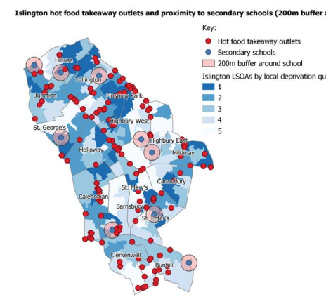
Hot Food Takeaways (HFT) and planning restrictions around food in Islington
Local context
In Islington, there are 297 fast-food outlets, a rate of 13 per 10,000 population, the 9th highest rate in London.
This is not evenly distributed; the density of fast-food outlets varies across the borough and is higher in areas of greatest deprivation. See the map for detail
School Exclusion Zones
In 2018, the Mayor of London introduced ‘London School Super Zones’, which restrict new hot food takeaways within 400 metres walking distance of an existing or proposed primary school. In Islington the ‘Location and Concentration of Use’ policy within the Local Plan (2023) opposes new hot food takeaways within 200m of a new or proposed school or and where a new hot food takeaway would result in 4% or more of total units in a Town Centre or Local Shopping Area being HFT.
Nesta estimate that restricting new fast-food restaurants within 400ms of schools has a very low impact on obesity rates, less than 0.1% in the next 5 years.
The Healthier Catering Commitment
Islington local plan requires new developments which include uses serving food and drink (for example new cafes, restaurants or hot food takeaways) to achieve, and operate in compliance with, the Healthier Catering Commitment standard. The Healthier Catering Commitment encourages caters to reduce the saturated fat, salt and sugar in products, and make smaller portions available.
Source: Islington Council (2024) Annual Public Health Report - Commercial Environment Nesta (2024) Blueprint for halving obesity Rogers et al (2024) Health impacts of takeaway management zones around schools in six different local authorities across England: a public health modelling study using PRIMEtime

Slide 48
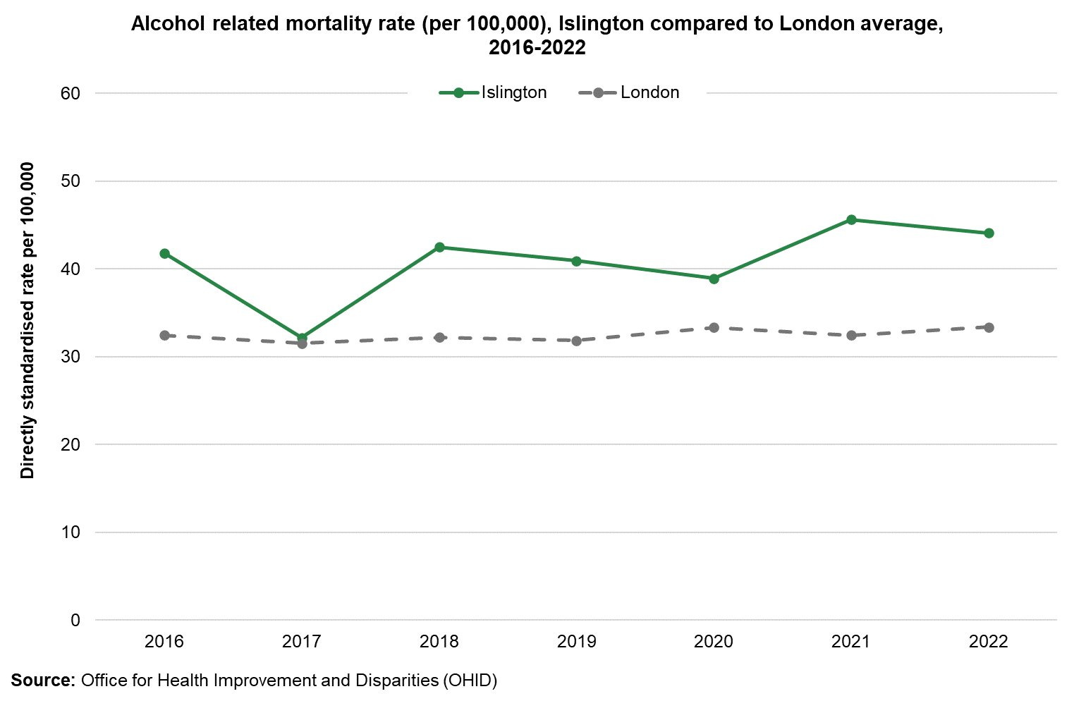
How is alcohol consumption linked to obesity?
Alcohol contains about 7 calories per gram on average, making it as calorie dense as fat. Two large glasses of red wine can account for 25% of a woman’s daily calorie intake.
A recent study estimates 6.9 million adults in England are living with overweight or obesity and are drinking at higher-risk levels, and approximately 280,000 adults are at-risk gamblers who also drink at higher-risk levels. This highlights the intersections between weight, alcohol intake and gambling (Burton et al; 2023).
Alcohol in Islington
In Islington there are 1,369 premises licensed to sell alcohol for consumption on site and/or off-site. In 2021/22 (most recent data), Islington had the highest density by area of licensed premises in England (91.9 per square kilometre) and the third highest rate of licensed premises by population in London (804 per 100,000 residents aged 18 and over).
There are 89 off licenses in Islington, 63% (n=56) of these operate 24hrs a day. 70% of the 24-hour off-licenses are in areas of higher deprivation (index of multiple deprivation quintiles 1 and 2).
Alcohol-related harm is high in Islington. The borough has the second highest rate of deaths due to alcohol-related conditions in London (44 per 100,000 deaths) and many people, particularly men, are dying younger because of alcohol.
Source: Burton, R., Sharpe, C., Sheron, N., Henn, C., Knight, S., Wright, V. & Cook, M. (2023) The prevalence and clustering of alcohol consumption, gambling, smoking, and excess weight in an English adult population. Preventative Medicine 175
Notes:
Copy pasted from APHR

Slide 49
Physical Activity Determinants of Healthy Weight across the Life Course in Islington

Slide 50
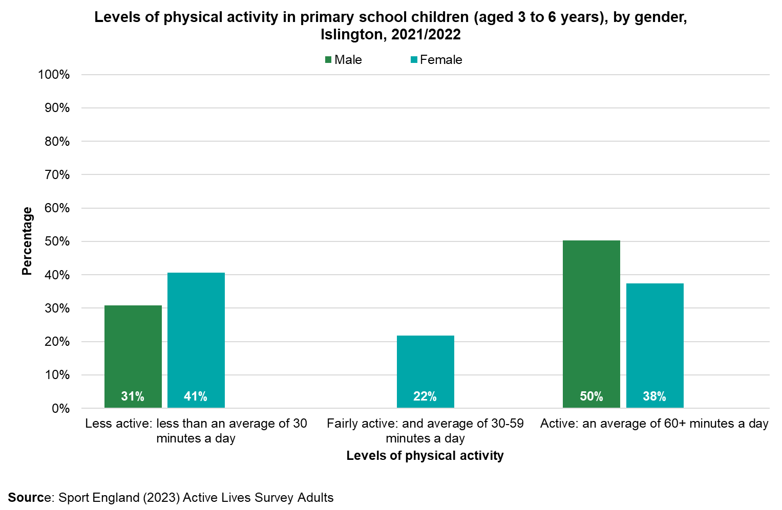
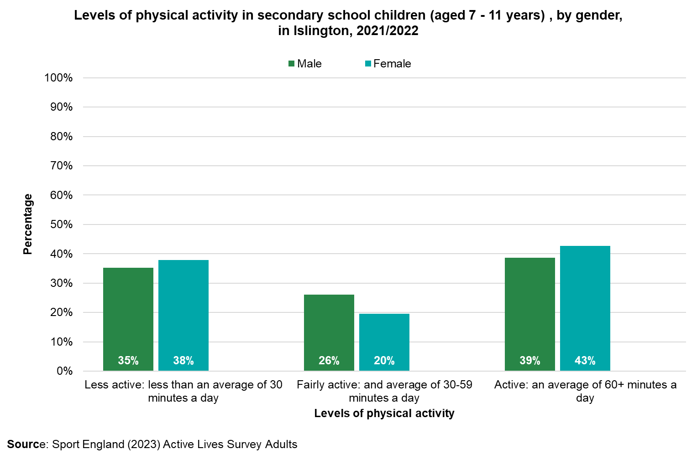
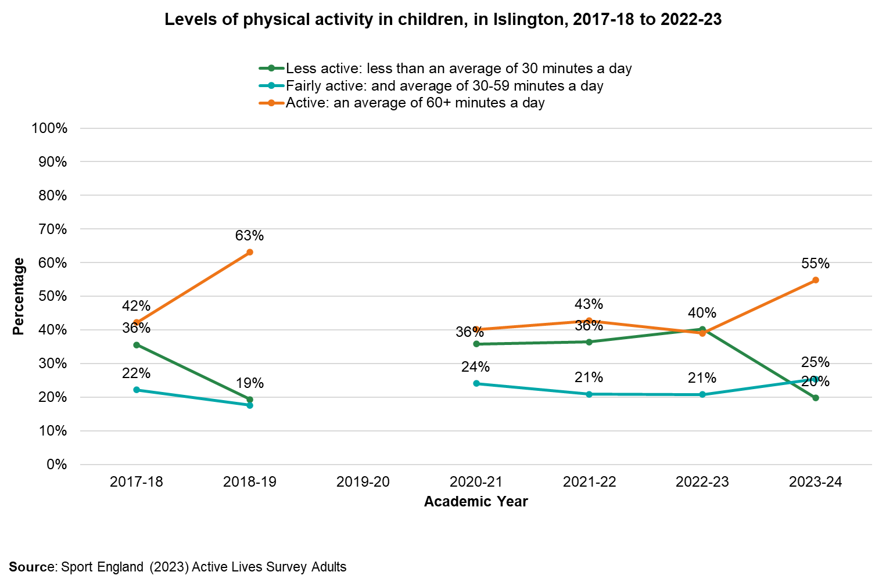
Children’s physical activity
Children are recommended to do 60+ minutes physical activity a day
Trends in children’s physical activity
Inequalities in children’s physical activity
According to the Active Lives Survey (2023/24) in Islington, 55% of children and young people were active (achieving 60+ minutes of activity a day). This is higher than the England average of 48% and represents a 15.8% increase on the previous year.
Activity levels in children have dropped since 2018/19, and have not recovered to pre-COVID levels.
Secondary school girls in Islington are slightly more likely to be inactive (complete less than 30 minutes of exercise per day) compared to boys, but rates are similar. The gender gap is wider in junior schools than secondary schools.
Primary school (years 3-6)
Secondary school (years 7 - 11)
Due to small sample size, local-level comparisons by ethnicity, income and free school meal eligibility are not available for most recent survey data (2022/23). However, national data indicates that:
Children from the least affluent families are the least likely to be active (45% of least affluent compared to 57% of the most affluent).
Children from black (42%), Asian (43%) and other ethnicities (44%) are less likely to be active compared to white students (50%)
Children with disabilities and LTCs are just as likely to be active as those without (NB this does not differentiate between types of disability).
Source: Sport England Data Active Lives | Children And Young People Activity Data
Note: Data for secondary school boys in Islington was unavailable for 2022-2023. As such data presented is from 2021-2022 for primary children, and
2020 and 2021 for secondary school children

Slide 51
Children’s physical activity levels according to the HRBQ (2021) in Islington
There are discrepancies between the physical activity levels reported by the Active Lives Survey (ALS) and the Health Related Behaviour Questionnaire (HRBQ). Although the data from the HRBQ is older (2021- a year in which the activity levels of children may be particularly low due to COVID) the sample size is much greater for the HRBQ (n=2799) compared to the Active lives survey (n=301). As such there is reason to believe that the lower estimates provided by the HRBQ may be more reliable. According to HRBQ data there is also a greater discrepancy between the physical activity levels of boys compared to girls.
In primary school: 28% of boys and 13% of girls said they did 60 minutes of physical activity on at least 5 days in the 7 days before the survey; 31% of primary pupils didn’t do this on any day.
In secondary school: 19% of boys and 6% of girls in secondary school said they did 60 minutes of physical activity on at least 5 days in the 7 days before the survey; 33% of secondary pupils didn’t do this on any day.
2015:
58%
2017: 39%
2021:
31%
Primary Boys
There has been a fall in the proportion of primary pupils reporting being active on at least 5 days the previous week:
A significantly higher proportion of pupils had lower levels of physical activity (less than 30 minutes) on a weekend compared to on a weekday, on average (57% vs 52%).
Low physical activity levels on a weekend ranged from 48% to 68% by school.
Low physical activity levels on a weekday ranged from 39% to 62% by school.
2015:
43%
2017:
21%
2021:
14%
Primary Girls
Source: Health Related Behaviour Questionnaire (2021)

Slide 52
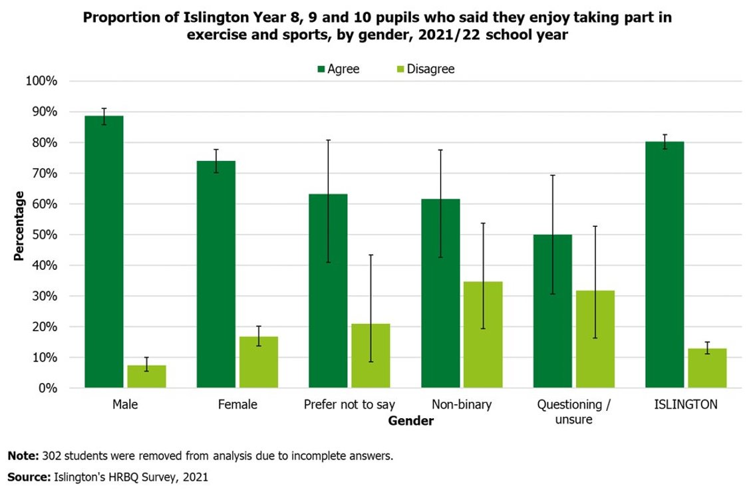
Attitudes towards physical activity amongst students
Girls' physical activity consultation
Data from the Health-Related Behaviours Questionnaire, which surveyed students in Years 8, 9, and 19 in 2021/22 found:
93% of primary and secondary pupils 'agree' or 'strongly agree' that they understand why exercise and sports are good for them.
80% of pupils enjoy exercise and sports. This ranged from 50% among students questioning their gender to 89% for boys.
13% of pupils don’t enjoy exercise and sports. This ranged from 7% for boys to 35% for non-binary students.
63% of pupils found school lessons on physical activity quite useful or very useful.
Qualitative interviews explored the barriers and motivators to participate in physical activity with secondary school girls. They found:
Barriers for secondary school girls
Too much schoolwork,
Physical activity being tiring,
Having a period,
Lack of self-confidence,
Negative peer influence or embarrassment
Not having friends to do activities with.
Motivators
Doing fun and varied activities,
Positive encouragement from family and teachers
Being consulted on what activities they would like to do.
“[Talking about period] afraid of leaking” (Girls physical activity consultation
"We have to prioritise schoolwork and stuff and sometimes you get really overwhelmed.” (Girls physical activity consultation
“It’s only fun when you do it with family or friends“(Girls physical activity consultation
“Girls only sessions in the gym” (Girls physical activity consultation
Source: Islington Council. Secondary School Girls Physical Activity Engagement in Islington; 2020; Health Related Behaviour Questionnaire (2021)
Notes:
https://www.islington.gov.uk/~/media/sharepoint-lists/public-records/publichealth/information/adviceandinformation/20222023/20230912-islington-children-and-young-people-jsna.pdf

Slide 53
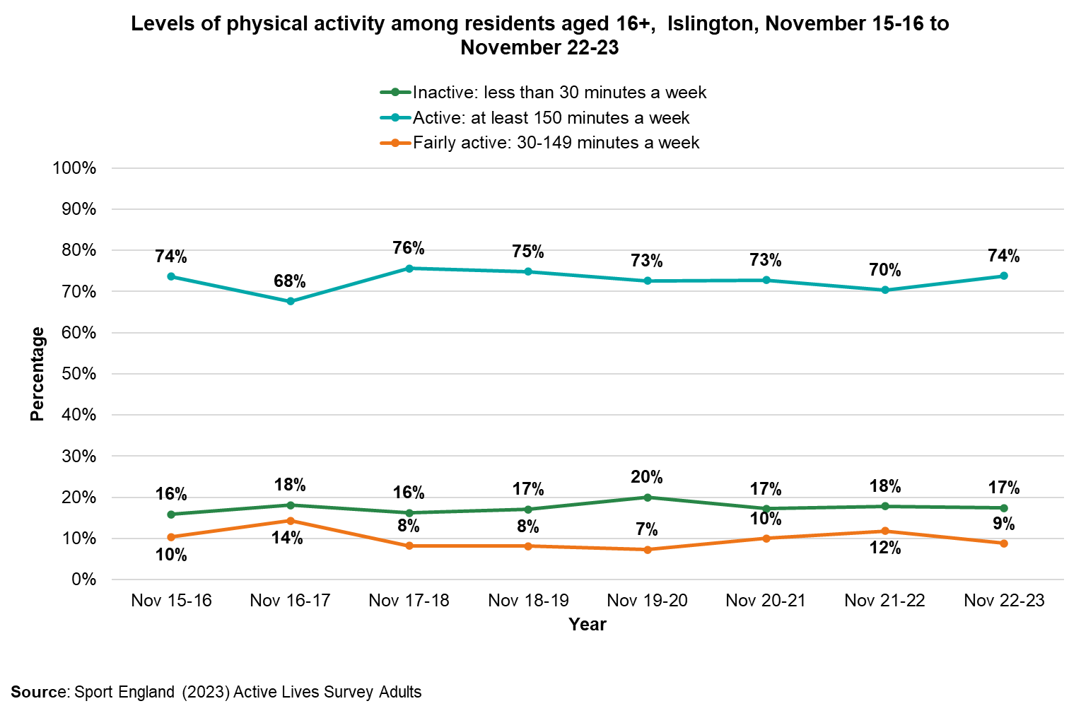
Adults’ physical activity in Islington
According to the Active Lives survey (2022/23), 73.8% of adults in Islington are physically active (do 150+ minutes of physical activity per week). This is above the England average of 67.1%.
Rates of physical activity among adults in Islington have remained relatively stable since 2015-16.
Gender disparities in physical activity exist among adults in Islington, as fewer women (72%) than men (77%) are active.
Levels of physical activity decrease with age, with 68% of people between the ages 55-74 being active, compared to 84% of 16-34 year olds.
Those in routine/semi routine jobs, and those who are long-term unemployed are less likely to be active.
Physical activity data for different ethnicities is not currently available in Islington, however London-wide data indicates that there are disparities in physical activity levels across different ethnic groups. 70% of white adults are active, compared to 57.2% of those of Asian ethnicity (excluding Chinese), 54.4% of black ethnicity, and 60.2% of Chinese ethnicity.
Adults are recommended to do 150+ minutes of moderate intensity activity per week OR 75+ minutes of vigorous intensity activity per week AND to minimise sedentary time
Graphic source: Sport England data, Active lives survey 2022/23
Source: Sport England (2023) Active Lives Survey Adults

Slide 54
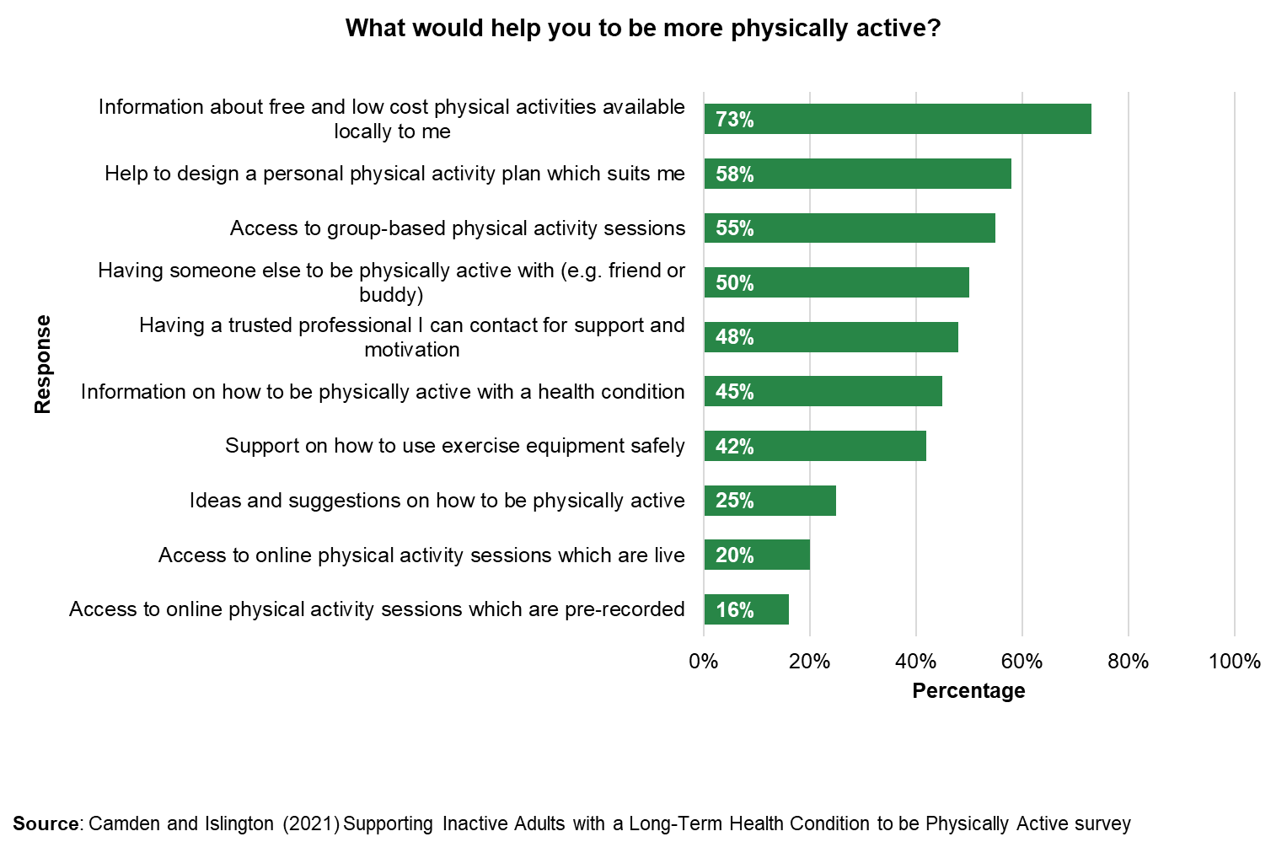
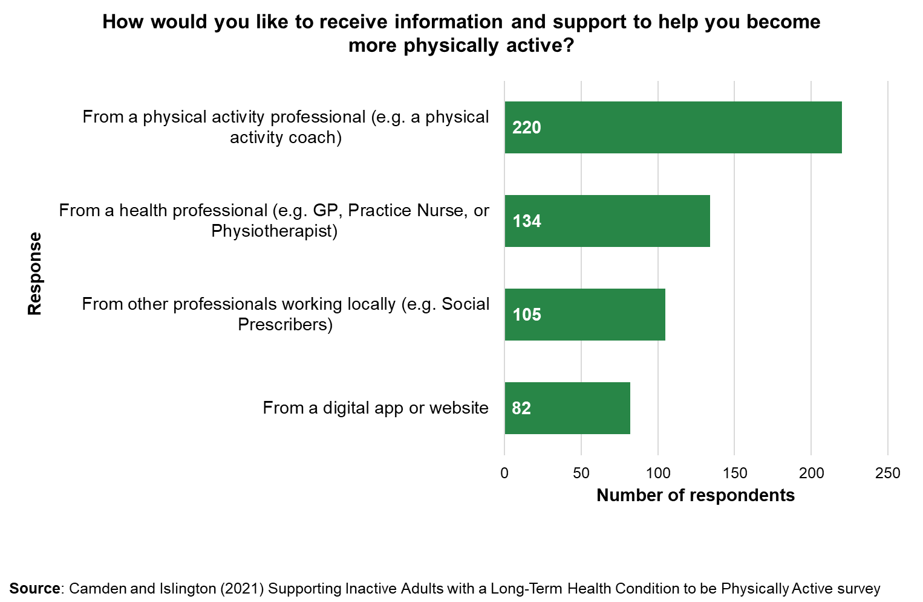
Physical activity and LTCs in Islington
What support is available in Islington?
According to the Active Lives Survey, in 2022/3 only 55% of people with a disability or Long-Term Condition (LTC) in Islington were physically active compared to 79% of people with no disability or LTC.
In 2021 an online survey was conducted with adults in Camden and Islington with a long-term health condition (LTC) to understand barriers preventing people who are inactive and living with LTCs from being physically active and identify options for support. The figure shows the types of support that adults with LTCs would find helpful to increase their physical activity.
Responses showed that 73% of adults with a long-term health condition wanted more information about free and low-cost physical activities available locally and 58% wanted help to design a physical activity plan to suit them. Most people preferred to receive information and support to help them become active from a physical activity professional or a health professional.
A Physical Activity Referral Scheme (PARS), to manage and prevent LTCs was introduced in Islington in October 2024 - Healthwise
The scheme provides individuals with three one-to-one assessments delivered by a qualified Health professional. These provide health and lifestyle consultation and health monitoring including height, weight and blood pressure.
Based on the consultation individuals are recommended physical activity to suit their needs.
Data from September – June 2024 shows:
The scheme has received 515 referrals. More than double the target of 234 (for 3 quarters).
43% of participants have completed the scheme, below target of 60%
92% of those who complete do at least 30 / 150 minutes of at least moderate physical activity per week
Obesity was the most common reason forthree quarters. With a total of 177 referrals.
referral across all 69% of those referred were female, compared to 31.3% male
The two most common ethnicities of referees were Black African and White British.
Source: Camden and Islington (2021) Supporting Inactive Adults with a Long-Term Health Condition to be Physically Active Camden and Islington Public Health Clinician Engagement Report- Supporting Patients to be Physically Active, and Shaping Future Services (2021)

Slide 55

Islington's physical activity environment
This section will discuss the support available in Islington to help residents be more physically active.
Islington has:
8 leisure centres
25 swimming pools
More than 100 parks
50 sports clubs
21 community centres with opportunities to be active
8 outdoor gyms
12 adventure playgrounds

Slide 56
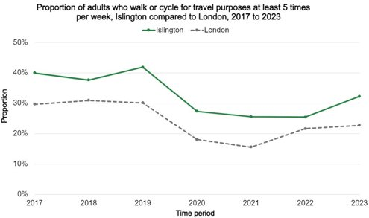
Active Travel and Healthy Weight
How can active travel promote healthy weight
Active travel can increase physical activity and reduce adiposity.
Longitudinal studies have indicated that switching to active travel, compared to using private transport, is associated with lower BMI and body fat in children in the UK (Laverty, 2021)
Active travel in Islington
Active travel statistics in Islington
Islington was deemed the top London borough for active travel and 50% of the borough is now a low-traffic neighbourhood.
32% of adults walk or cycle for travel at least 5 times per week
90% of primary school children either walk, cycle or scoot to school
74% of secondary school children either walk, cycle or scoot to school
70% of Islington households do not own a car
How is Islington promoting active travel:
Islington’s active travel plan aims to make it easier to walk, cycle and wheel by:
Creating more accessible pavements, adding shade and new resting places
Reducing motor traffic outside 37 schools to make streets safer and quieter
Building cycle lanes, provide cycle training and bike hire
Offering a widening participation programme including women's only cycle training
Developing Liveable Neighbourhoods (see next slide)
Impact of Active Travel measures in Islington
Introducing school streets has resulted in a 23% increase in cycling on these streets.
3,500 residents use on-street bike hangars
Canonbury primary school travel plan increased active travel to school from 67% to 88% since 2013 and saw car use drop from 20% to 7%
2,087 children and 346 adults took part in cycle training in 2023/4
Source: TFL (2011) Barriers to cycling for ethnic minorities and deprived groups Pan et al (2020) Access to bike lanes and childhood obesity: A systematic review and meta-analysis Greener Healthier Streets - factsheet.pdf Active travel in Islington | Islington Council Laverty, A. A., Hone, T., Goodman, A., Kelly, Y., & Millett, C. (2021). Associations of active travel with adiposity among children and socioeconomic differentials: a longitudinal study. BMJ open, 11(1), e036041.

Slide 57
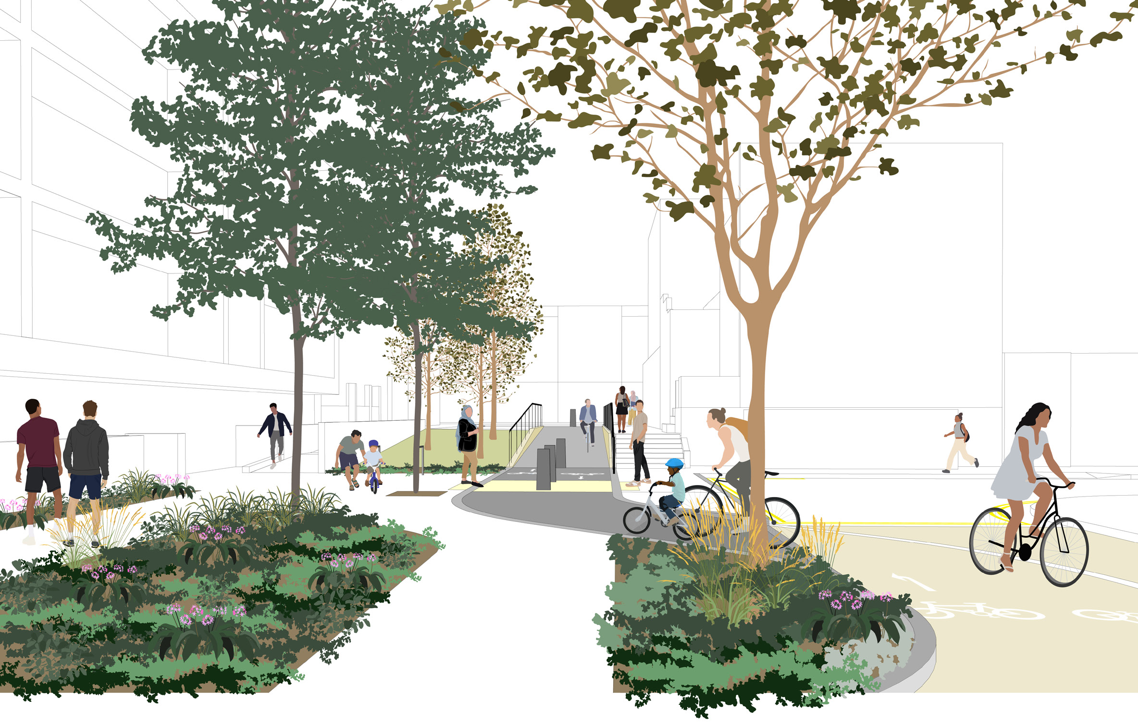
Case study: Liveable Neighbourhoods
What are Liveable Neighbourhoods?
Neighbourhoods where it’s easier to walk, cycle, scoot, use buggies and wheelchairs
These build on existing Low Traffic Neighbourhoods (Highbury, Amwell, Canonbury
East and West, Clerkenwell Green, St Peter's and St Mary's Church). What does building liveable neighbourhoods involve?
Adding new cycle paths, closing some roads to vehicles, improving lighting.
Planting trees and building attractive green space to boost flood resilience.
Cutting carbon emissions and air pollution by reducing trips by motor vehicle.
What is the evidence for Liveable neighbourhoods?
Although the evidence-base is still growing, neighbourhoods that promote active travel have the potential to reduce air pollution, increase activity and reduce the risk of traffic injury. Aldred et al. (2020) found that living in a low-traffic neighbourhood was associated with reductions in the probability of car ownership.
An evaluation of Bristol’s travel plan which promoted active travel had increased the percentage of respondents who reported walking to work 4-5 times per week increased from 19-30%.
An evaluation of Oslo’s livability programme showed an 11%–19% reduction in car traffic in the city centre from 2016 to 2019, along with increases in pedestrian activity, cycling, and public transit use, though effects were localised.
Planned livable neighbourhoods in Islington:
Annette Road;
Barnsbury and Laycock;
Bunhill;
The Cally;
Dartmouth Park;
Mildmay
Image: Artist’s impression of Livable neighbourhood in Lyon street
Source: Aldred, R., & Goodman, A. (2020). Low traffic neighbourhoods, car use, and active travel: evidence from the people and places survey of outer London active travel interventions. Findings.
Nieuwenhuijsen, M. J. (2021). New urban models for more sustainable, liveable and healthier cities post covid19; reducing air pollution, noise and heat island effects and increasing green space and physical activity. Environment international, 157, 106850

Slide 58
The Active Together Partnership
Outcomes
Active Communities
- Groups who are traditionally less active meet physical activity guidelines.
- Residents find work in the physical activity sector.
Active facilities
- Leisure centres and facilities are used more by local children, young people and adults from target groups
- Residents are able to access a range of quality community-based facilities.
Islington’s least active residents are more active, more often
Impact
Start Well
Children and young people achieve their potential at school
Children and young people are happy, healthy and resilient.
Children and young people are a healthy weight
Live Well
Residents are a healthy weight
Long term conditions are prevented, or well managed
Residents experience good mental health
Communities are socially connected
Age Well
Older adults live independently in their own homes as long as possible
Rates of hospital admissions due to inactivity are low
Residents experience good quality of life
Reduced health and social care costs
Active Environments
- More residents travel around the borough by walking or cycling.
- Parks are healthier and greener spaces for all communities.
- Our streets are greener and healthier.
Active Health and Social Care
- Individuals with long-term conditions or disabilities know how to be active.
- Health and Social care professionals are confident in encouraging patients to be physically active.
The Active Together Partnership brings together members from across the council including Travel, Leisure, Public Health and Schools along with Leisure providers from the community.
The programme focuses on delivering the Active Together Strategy which has a focus on encouraging the least active residents to become more active, more often.
This figure shows the theory of change for the Active Together Strategy and Partnership.
Source: Active Together Strategy Action Plan

Slide 59
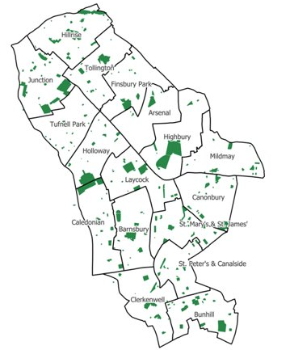
Local environment: parks, play and outdoor space
How is access to parks and outdoor space linked to obesity?
Systematic reviews have indicated that exposure to green spaces, especially in people’s neighborhood, reduce the risk of being obese and increase the likelihood of physical activity (De la Fuente, 2020).
According to England data, young people (16-24), people from minority ethnic backgrounds are more likely to report that they don’t have parks within easy walking distance (People and Nature Survey for England, 2023/24).
Commonly cited barriers to access include physical barriers: proximity, lack of facilities, social expectations, cultural experiences, safety concerns, lack of opportunity, time constraints, confidence (PHE 2020).
Green space in Islington
Parks for Health Strategy
Map of green space in Islington
Islington’s Parks for Health Strategy (2022-2030) seeks to address inequalities in access to green space. Priority groups include people living in deprived circumstances, people from black, Asian and other ethnic minority groups, women and girls, people with disabilities.
Council will invest 7.5 million in parks and greenspaces in the next 2 years.
Islington will create a new pocket park framework with a target of delivering 1.5Ha of new green space in the next 4 years.
13% of Islington’s land is green space. This is the second lowest proportion of any local authority in the country.
Islington scores 71.0 on access to green space according to the ONS health index. This is significantly below average for England (which would be 100).
Source: De la Fuente et al (2021). Green space exposure association with type 2 diabetes mellitus, physical activity, and obesity: a systematic review. International
journal of environmental research and public health, 18(1), 97.
Camden and Islington Parks for health strategy
Treeconomincs (2019) Islington borough Council – ORVal Report Natural England (2024) The People and Nature Surveys for England: Adults' survey year 4)
PHE (2020) Improving access to greenspace

Slide 60
Supporting children to be physically active in Islington
Physical education in schools
Schools have been trained to offer a more diverse range of sports including dance and gymnastics and disability-inclusive sports like Boccia and New Age Kurling. The competitions programme that most primary schools buy into provides 30+ inter-school competitions and festivals per year, with a focus on inclusivity.
The Daily Mile
A free program that encourages children to run, jog, or walk for 15 minutes every day. A systematic review assessing the impact of the daily mile on markers of children’s health have shown that the intervention can significantly increase children’s physical activity but have not found significant reductions in BMI or hip to waist ratios compared to controls (Hannaet al, 2023). 15 Islington schools currently take part in The Daily Mile between 2-5 days per week. 10 additional schools are interested in starting or restarting.
The Healthy Schools Programme
A voluntary scheme that allows schools to self-assess how well they are promoting healthy eating and physical activity. 20 schools in Islington are now recognised as Healthy Schools, with 25 working towards healthy school status or other projects, only 7 schools are not engaged.
Play streets
At least 22 play streets have been implemented across Islington. These allow residents to close their streets to traffic for up to three hours a week so children can play safely
Girls active club
Through additional funding, all the secondary schools with girls, and 6 targeted primary schools have been supported to run Girls Active clubs. Partnerships with GLL and Access to Sports have been fundamental to this work, including delivery of an innovative and highly successful Family Swim project targeted at minority ethnic families.
School streets and school travel planning
36 school streets have been delivered across Islington. ​School Streets apply temporary restrictions on motorised traffic on roads with schools at drop-off and pick-up times, aiming to improve air quality and road safety. 75% of Islington's eligible education settings are engaged or accredited with the TfL Travel for Life scheme, encouraging active modes of travel.
Sources: Hanna, L., Burns, C., O’Neill, C., & Coughlan, E. (2023). A systematic review of the implementation and effectiveness of ‘the daily mile’on markers of children’s health. International Journal of Environmental Research and Public Health, 20(13), 6203.
Department for Education (2022) Healthy Schools Rating scheme guidance for schools.
Islington Council School Streets (accessed 25 January 25)
Islington Council Play Streets (accessed 25 January 25)
Islington Council: The Daily Mile Executive Summary Report (released internally February 2025)

Slide 61
Weight-management services in Islington
Notes:
What services are available?
How many people are using the services available?
Which people are using the services?
What are some barriers to access?
Are there different patterns in usage across the borough?
What are the outcomes from those services in terms of weight loss?
Are there other health behaviour outcomes?
Are there outcomes in terms of mental health and wellbeing?
What are the qualitative feedback – people’s experiences?
Are there any issues in the pathway – key points of engagement/ drop off?
https://www.nhs.uk/conditions/obesity/treatment/
Better Health – activities
https://assets.publishing.service.gov.uk/government/uploads/system/uploads/attachment_data/file/942476/Maternity_high_impact_area_3_Supporting_healthy_weight_before_and_between_pregnancies_.pdf

Slide 62
NICE guidelines for overweight and obesity management
NICE previously recommended a four-tier approach to weight management services as follows:
Tier 1: Universal services such as health promotion or primary care.
Tier 2: Lifestyle interventions, containing multiple components: diet, physical activity, behaviour change.
Tier 3: Specialist weight management services.
Tier 4: Bariatric surgery.
In January 2025, NICE reviewed these recommendations and released updated guidance on overweight and obesity management. The new NICE guidelines recommend moving from the four-tier system for weight management to one that offers personalised care pathways with a choice of behaviour change support, diet, physical activity surgical, medical and psychological interventions for weight management. See next slide for details. This needs assessment provides a review of current services organised according to the previous four-tier structure.
The new guidelines also include approval of the use of Tirzepatide for people aged 18+ with a BMI > 35 and weight-related comorbidity.
Tirzepatide will be accessed through specialist weight management services or primary care.
Tirzepatide with be rolled out using a staged approach to manage demand and ensure safe prescribing.
NICE will evaluate implementation over the next 3 years to determine how to scale roll-out.
North Central London (NCL) Integrated Care Board (ICB) is reviewing current service provision to assess need for adaptations to current care pathways.
Source: NICE (2025) Overweight and obesity management

Slide 63
Maternal Weight Management
NICE guidelines do not recommend dieting during pregnancy is as it may harm the health of the child. There’s no consensus on optimal gestational weight gain during pregnancy, instead advice focuses on maintaining a healthy diet. NICE emphasise the need for dietetic advice by appropriate professionals in early pregnancy and that all women have the opportunity to optimise their weight before pregnancy.
Maternal weight management in Islington: Whittington Hospital Obstetric, Weight and Nutrition (OWN) clinic
Service information:
The service supports women with BMIs >35 from as soon after their first scan as possible, normally by 12 weeks pregnant. However, this service is currently under review.
The service is run by two midwives who share the role one day a week.
The service provides discussions on healthy weight management at 11, 28 and 34 weeks.
At discharge women should be signposted to MoreLife.
Performance Data 2023
In 2023 the service supported 5 women from Islington (and 14 women in total). This is a decrease from 2021 when the service supported a total of 30 women from Islington and 80 women in total.
Due to the small sample in 2023, it’s not possible to meaningfully explore the demographics of service users. Based on data from 2021, in Islington 43.3% of service users were of a white British ethnicity, 10% were of black African ethnicity.
Comments
Due to low capacity, the service can only make five appointments a week, each lasting one hour.
In addition, many women opt out of the service due to discomfort talking about weight.
Many midwives lack the confidence to give advice on healthy eating and/or weight management in pregnancy as they haven’t received relevant training on this.
Midwives report a lack of clarity about what tier 2 weight management services are available locally and whether these are suitable for postnatal women. Additionally, there is little physical activity offer for pregnant and post-natal women.
Time is a challenge as midwives struggle to fit everything into a 20-minute appointment
Source: Maternal Obesity Rapid Needs Assessment 2024
NICE (2025) Maternal and child nutrition: nutrition and weight management in pregnancy, and nutrition in children up to 5 years

Slide 64
Paediatric Dietetic Community Service – Whittington Health NHS Trust
Service information
The service provides weight management support for children aged 4 years and under who are not yet in school.
Children are seen in general paediatric clinics and families are supported with weight management/healthy weight advice.
The service has three half day clinics each week seeing between 4-7 infants/children/families each clinic.
The service refers to Families for Life where appropriate and has had good feedback from families attending.
Performance Data 2023/24
There are approximately 10-15 children referred into clinics for weight management advice each quarter. In 2023/24 there were a total of 51 children referred for weight management support. Referrals for weight management support have remained stable since 2013.
There are no specific performance data relating to outcomes as children are referred for a variety of different nutritional needs and reviewed/discharged depending on clinician and family joint working. Discharge depends on whether the family can work on goals by themselves or with support i.e. health visiting.
Comments
Clinicians report high number of referrals, while this shows high demand, limited capacity means that case load is challenging.
Clinicians report referrals being more complex than in past requiring increased liaison with nursery, health visitors and other health care professionals.
There is ongoing challenge of children not attending their appointments.

Slide 65



Children’s Weight Management (WM) services
Complications from Excess Weight clinic (CEW)
Clinic to identify and treat the complications of obesity such as diabetes, heart disease, sleep apnoea and poor mental health.
Tier 4
Enhanced Healthy Living Service (EHLS) Supports children and families with complex needs & circumstances and coordinates the childhood obesity MDT meetings across Camden and Islington.
Tier 3
The Healthy Living Service
Tier 2
Provides one-to-one weight management, support for children and young people aged 5-17 yrs with a high BMI and their family, without complex needs.
Tier 1
Universal 4 and 6-week healthy lifestyle programmes for families with children aged 2-11 years including healthy eating, active play and cooking activities.
NB: Data from CEW and Children and Young People’s Eating Disorder Clinic was requested but not available. See slide 102 for details.
Source: NCL weight management services April2024 from NCL GP website.pptx

Slide 66
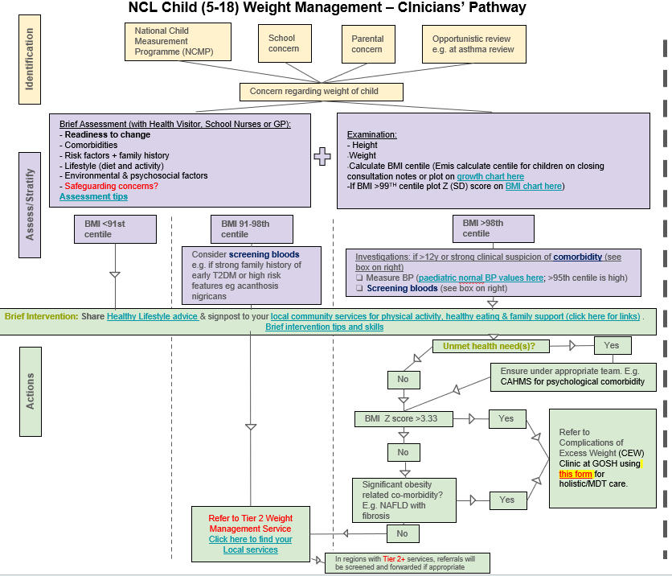
Paediatric Weight Management referral pathway
The NCL ICB has been collaborating with local authorities to simplify the referral pathways for children’s weight management services across the 5 boroughs.
The new pathways will allow children with weight concerns to be identified in a variety of settings, including through General Practice (GPs), NCMP results, schools, parental concerns and/or opportunistic reviews.
Initial assessments will take place in General Practice, health visiting or school nursing. Screening for co-morbidities will be done within Primary Care. This will help to ensure children are referred to the appropriate service at their first point of contact.
The new pathway will increase signposting and linkages to community services with support around physical activity and food.
Similar guidance has been developed for early years settings on how to identify and respond to weight concerns in children between the ages of 0-5 and will be led by Health Visiting.
Next steps are to understand how to support parents to take up the local community offer and increase linkages between children’s and adults’ weight management pathways - to support a whole family approach.

Slide 67
Tier 1: Families For Life (FFL) healthy lives programme
Service information
The service supports families with children aged 2 – 11 years old in Islington.
The programme supports parents to gain the skills and knowledge they need to help their children (and wider family) live active, healthy lives. A number of healthy lifestyle programmes and sessions are available.
The service is delivered in house by Islington Council.
Performance Data 2022/23
Families for Life ran 31.5 full programmes, including: 10 family kitchens, 4 active spaces family kitchens, 2 taste education programmes at schools
174 families attended sessions and 62% of families were from black, Asian and minority ethnic groups. This surpasses the KPI of 50%.
78% of families completed the programme.
Pre and post child eating behaviour questionnaires showed that there were significant reductions in food fussiness and slowness in eating, but no significant differences in food responsiveness or satiety responsiveness.
75.9% of families reported to have reduced food high in fat, sugar and salt, 90.7% of families reported increases in cooking together. 48.1% of families reported changes in wider wellbeing, including sleep and physical activity.
Comments
Overall, the programme reports high levels of retention and positive feedback from families.
The programme provides early intervention and uses a holistic approach. This means that families report a wider range of benefits including changes in diet and improved sleep.
Active kitchen sessions have incorporated physical activity into their offer and so address multiple determinants of overweight.
Multilanguage offers, including Turkish and Kurdish language sessions, make programmes more accessible and inclusive.
Engagement is high, including from people from black, Asian and minority ethnic groups.
Although the programme reports reductions in food fussiness, it doesn’t result in significant differences in food satiety.
Source: Families for Life annual report 2022-23

Slide 68
Tier 2: Healthy Living Practitioner Service
Service information
The service supports primary and secondary school children, who are above a healthy weight (BMI > 91st centile), and their families. It is run by the Islington School Nursing Service.
The service provides 1:1 healthy lifestyle and dietary advice and support either virtually or face-to-face. Students are offered 4 appointments but can have more if needed. The service can also provide joint appointments with community paediatric dieticians if specialist dietary support is needed.
The Healthy Living Service receives NCMP data on children and young people who have been identified as very overweight. These pupils are contacted by phone to invite them to an initial appointment with the Healthy Living Nutritionist.
The service also runs a monthly Healthy Living in Action Clinic with a paediatric physiotherapist for children above a healthy weight with musculoskeletal pain.
Performance data April – September 2024
52 initial appointments and 133 follow up appointments were conducted.
17 children were discharged due to multiple DNAs.
Different behavioural changes are reported among children, including: increased fruit and vegetable intake, eating more slowly, opting for healthy snacks, limiting fizzy drinks, increasing physical activity and reducing screentime. A number of children also reported reduced BMI – however the full data set on this was not available.
Comments
The Healthy Living Service embeds a family-based approach engaging with both parents and children.
The service has strong links with other local services including CAMHS, Community Paediatric Dietetics Service and CEW services.
Providers report increasing concerns around the complex needs of children that are seen by the service, with increased concerns around disordered eating and referrals to eating disorder services and CAMHS.
The service experiences challenges around DNAs.
Many parents and families offered support after receiving their child’s NCMP results do not take up the offer.
Some families face barriers to accessing the service including housing challenges.
Source: Whittington Health School Nursing Team Q1 and Q2. Islington commissioning data and report December 2024

Slide 69
Tier 3: The Enhanced Healthy Living Service Brandon Centre
Service information
The Enhanced Healthy Living Service co-ordinates childhood obesity MDT meetings and supports staff working with children aged 5-18 with complex cases. It focuses on understanding the factors influencing weight with input from specialist psychologists, early years help and social services.
The Enhanced Healthy Living Service also provides termly 6-week parent programmes called Families, Food and Feelings, with some 1:1 support sessions available as needed.
The service provides ad hoc training and consultation to professionals.
Performance data August 2023 - July 2024 (note data missing for Q3 (November – February))
The service received 57 referrals to the MDT, 78% of families accepted the referral, indicating high engagement.
In total 207 families attended 162 sessions, supported by 791 case management activities.
51% of the CYP referred were female, with an average age of 12 years (80% were 11 or over). 55% were from black and minority ethnic background, and 80% were from the 2 most deprived socio-economic quintiles.
Reasons for referrals varied and included anxiety, stress, sleep difficulties, binge eating, poor school attendance, picky eating, sensory problems around food, OCD related to eating. Service outcomes varied depending on intervention.
Parent-reported benefits (qualitative) included reduced bullying, increased school attendance, improved management of online gaming activity, and strategies to manage eating behaviours.
The service provides an important source of support for families. Pre/post programme surveys show that parents have increased knowledge, confidence and skills around healthy living; however, for most parents no changes were reported in healthy habits, such as fruit and vegetable consumption, physical activity, sleep and sugary drink consumption.
“I was very pleasantly surprised how the course covered more than just eating habits. I think giving the holistic approach to parenting gave me more confidence.” – parent feedback
Comments
The service provides support for children and families with more complex needs.
The holistic approach to parent programmes means parents report a wide range of health and wellbeing benefits.
Referral numbers are often lower than hoped and there are challenges translating these referrals into engagement. One issue may be that professionals working with these families often don’t recognise obesity as a priority issue, delaying access to obesity services.
Although parents frequently report positive changes in their knowledge, skills and confidence; Changes in healthy living habits, such as fruit and vegetable consumption and levels of physical activity are less frequently reported.
Source: The Brandon Centre. Quarterly Reports 2023-2024 Thomas, M., Drummond, M., Kapel, K., Cooke, R., & Povey, R. (2024). Evaluating the effectiveness of a parent programme focusing on parental feeding styles as part of a childhood obesity intervention. Journal of Family and Child Health, 1(4), 186-195.

Slide 70
Services for which performance and monitoring data was unavailable
Children and Young People – Eating Disorder Service. Royal Free London
The service supports young people with anorexia nervosa, bulimia nervosa, binge eating disorders or atypical variations of these disorders to recover fully in the community and avoid unnecessary inpatient admissions into eating disorder units.
The service provides a specialist eating disorder service. Outpatient treatment includes family and individual evidence-based treatment approaches.
Complications of Excess Weight Clinic (CEW): Great Ormond Street Hospital
The service uses a holistic approach to treating conditions related to obesity in children and young people (CYP). Care is delivered by a multidisciplinary team (MDT), linked to a Great Ormond Street Hospital.
Data on the outcomes from these clinics is analysed at national level, as such no performance data was available for Islington. In the future, clinic and ICB-level data may become available, however this is likely to focus on demographics of service-users, rather than outcomes.

Slide 71






Adult Weight Management Services
Bariatric Surgery services
Multidisciplinary services for pre-operative preparation and surgical treatment of adults with complex/high risk obesity who have failed to achieve weight loss successfully via lower intensity interventions
Tier 4
Hospital-based specialist care
An NCL wide Tier 3 adult weight management business case is currently under development
Tier 3
Specialist weight management services
Free 12-week weight management support for adults in Camden and Islington who are living with overweight and obesity.
Tier 2
Lifestyle weight management services
Better Health – Lose weight
Free Online Weight Loss Plan
Can be broken into 12 weeks,
support to: Set weight-loss goals
Plan meals and Get more active
Tier 1
Universal interventions involving health promotion or primary care

Slide 72
Tier 1: Better Health
Service information
Better Health is a free NHS Weight Loss app. The plan is broken down into 12 weeks, and supports individuals to set weight loss goals, plan meals, and be more active. Anyone can access the Better Health app.
Alongside the Better Health app, National and local campaigns also promote healthy lifestyles to universal audiences. Public health campaigns are run through our corporate communications and other outreach events. These provide brief advice to a large number of people.
National Performance Data July 2020 - February 2021
A national evaluation of Better Health found that:
The programme had been downloaded 864,403 times. Of these downloads: 726,126 users inputted their details into the BMI calculator 68,942 started the 12-week plan 8,305 completed the 12-week programme.
Of downloads, 81.5% were female and 18.5% were male, 54.2% were 40+ years, 88.2% had a BMI > 25 and 71.2% were of white ethnicity. For most ethnic groups, downloads reflected the national ethnic breakdown.
77.4% of starters and 94% of completers reported a reduction in weight whilst using the 12-week plan. On average, starters reported 2.4% (2.1kg) and completers reported 6.5% (5.8kg) reduction in weight compared to their starting body weight.
Comments
Evaluation data suggests that the app has high appeal, but low conversion to completers.
Qualitative research suggested that users want greater consideration of mental health, some people with eating disorders found calorie counting triggering and fat-shaming, some felt that it failed to account for the complexities of obesity – including the price of healthy food.
People valued the sense of community provided by the app.
Source: Better Health campaign Phase 1: evaluation of the NHS weight loss plan app
Talbot and Branley-Bell (2022) #BetterHealth: A qualitative analysis of reactions to the UK government’s better health campaign
Better Health Data (2023-2025) Islington

Slide 73
Tier 2: National Digital Weight Management Programme
Service information
The programme supports adults 18 years +, with a BMI > 30 (or ≥27.5 for people from black, Asian and ethnic minority backgrounds) and have a diagnosis of diabetes (type 1 or type 2), hypertension or both.
12-week online behavioural and lifestyle programme that people can access via a smartphone or computer with internet access
National Performance data: 2021/2022
Outcomes data for individual boroughs is not available, however a national evaluation conducted found that:
63,937 people were referred to the scheme in its first year (2021/2022)
Of those referred 31,718 people who started the initiative.
14,268 of those referred completed the programme
The average weight loss was 2.2kg or 4.85lbs (including those who did not complete the programme)
More than a third of referrlas were from Black, Asian and minority ethnic backgrounds
Performance data for Islington
Access to performance data for the Nationally available Tier 2 digital weight management app is limited.
According the most recent data there were 276 referrals to the app for the year 2024/2025, of which 77% met the eligibility criteria for use.
Comments
Borough level referral and usage data is limited.
National level evaluation data indicates that the NHS Digital Weight Management Programme is effective at achieving clinically meaningful weight loss and good engagement from groups disproportionately affected by overweight and obesity.
Year | Total referrals | Eligible referrals | % eligible
2023/24 | 297 | 210 | 71%
2024/25 | 276 | 212 | 77%
Source:
Taylor et al. (2024) Early outcomes of referrals to the English National Health Service Digital Weight Management Programme. Obesity. 32(6) doi: 10.1002/oby.24024. Epub 2024 Apr 21

Slide 74
Tier 2: MoreLife
Service information
The service supports adults with a BMI > 25 and a co-morbidity; or a BMI > 30 without any co-morbidities.
It provides a free 12-week, community-based, weight management programme to help people to understand their relationship to food and manage their weight.
Service is jointly commissioned by LB Islington and LB Camden.
Performance data 2023-2024
In 2024, 2229 people were referred to Morelife from Islington, of these 615 started the programme ( and 205 people completed the programme (33%). These numbers are below target as shown in the graph.
44% of attendees were from Black, Asian and Minority Ethnic groups; and 25% are people of lower income– meeting set targets for engagement with these key groups. There were no significant differences in completion or weight loss achieved by ethnicity or deprivation.
In 2024, across Camden and Islington 28% of completers lost 5% of their body weight (against a target of 30%) and 48% lost 3% of their body weight (against a target of 50%).
Participant feedback from the MoreLife programme is generally positive with 94% of participants being satisfied or very satisfied with the programme, 4% were neutral and 2% were dissatisfied; 55% of clients report ‘feeling better about myself’, 39% report ‘improved mental health’, 32% report ‘increased activity’, & 28% report ‘more self-confidence’. Note: feedback is only gathered from clients who complete the programme.
Comments
Too few people starting the programme due to low referrals and there’s high drop out during triage.
In 2024 only 615 people attended one session or more of a MoreLife programme, this represents 1.5% of the eligible population according to HealtheIntent data.
Many of the people being referred to MoreLife are not suitable for the programme. One challenge is the absence of a Tier 3 service. 43% of non-completers of MoreLife service meet the criteria for Tier 3 services.
Participants report wanting further support after the programme ends, including access to the online dashboard to monitor their progress and additional check-ins.
Source: : Morelife (2024) Islington Data
MoreLife Commissioning Board Presentation.pptx
MoreLife (2024) Camden and Islington deprivation and ethnicity data 2024

Slide 75
Tier 2: Shape UP - Arsenal in the Community
Service information
Shape Up supports men and women with a BMI > 27.5
Shape Up is a 12-week programme to help people improve their nutrition, increase their physical activity, and reach a healthier weight​.
The programme provides weekly evening sessions of 90 minutes that include body composition monitoring, nutrition education and lifestyle behaviour change, and physical activity.​
Participants have access to a remote support network and 12 months of support and monitoring after the 12-week intervention.​
The programme is funded by Arsenal in the Community and is not funded by Islington Council.
Performance data January- December 2024
In this year, Shape Up met all its performance targets, apart from the percentage of completers from a deprived area (12% compared to target of 30%).
150 people in Islington were referred to the programme (filling all the spaces available).
132 people started the programme (88% of referrals) and 110 people completed the programme (83.3% of attendees) and 98.8% of participants rated the programme as good or excellent
96.4% of participants lost weight (85% of completers lost 3% of their body weight and 53% of completers lost 5% of their body weight ).
“My diet and lifestyle have quite dramatically changed – I hadn’t realised just how sedentary my life had become before Shape Up” - Shape UP participant feedback
Comments
Performance against targets for starters, completers and weight loss is strong.
However, there is a need to increase participation among groups from more deprived backgrounds.
Source: Shape UP reporting matrix (January – December 2024)

Slide 76
Tier 4: Bariatric Surgery
Service information
The service supports adults with a BMI > 35 and a qualifying co-morbidity (such as T2 diabetes), or a BMI > 40 with no comorbidities.
All patients should have tried non-surgical weight loss methods for at least 6 months.
The service is provided by Whittington Hospital and UCLH consultants
The service provides different surgeries including gastric bypass and sleeve gastrectomy.
Performance data 2023/24
In 2023/24, a total of 170 patients were referred for bariatric surgery across the NCL ICB
Of these 92% were female and 7.8% were male
60% of bariatric surgery activity was for patients from the three most deprived deciles, compared to 11% for patients from the three least deprived deciles.
White British, white other and black African were the three most common ethnicities of people receiving surgery
Comments
Bariatric surgery is not accessible for people with complex care needs as there’s not enough support available after surgery to help avoid complications.
Significantly more women are referred for bariatric surgery than men.
Source: Tier 4 – Bariatric Surgery monitoring data 2023/24

Slide 77
NHS Type 2 Diabetes Path to Remission Programme (T2DR) - Oviva Total Dietary Replacement programme
Service information
The service supports people recently diagnosed with type 2 diabetes between ages of 18-65 with a BMI>27
The programme uses Total Diet Replacement (TDR) to achieve significant weight loss (>15kg) and potentially attain diabetes remission (non-diabetic HbA1c results, at least six months apart, off all glucose-lowering medicines). It can be accessed face-to-face or online.
It is a 12-week programme, with 4 weeks of food reintroduction, and 8 months of maintenance
There is no cost to participants, with all TDR (usually shakes) products funded by the NHS.
Performance data 2023/24
In 2023/24 in Islington there were 45 eligible referrals to the Oviva dietary replacement programme. This represents less than 1% of the eligible population.
65% of people referred are from the two most deprived quintiles.
35% of referrals are of white ethnicity, compared to 25% of people of black and Asian ethnicity.
60% of referrals are women compared to 40% of men.
Average weight change by the end of the programme is -12% body weight.
In the recent quarter, face to face retention was 50%, compared to 85% for digital retention.
Comments
High levels of retention and weight loss achieved, but only reaching 1% of eligible population.
Source: NHSE – NDPP dashboard (accessed 10th January 2025)

Slide 78
Alternative models for weight management services

Slide 79
Evaluating Weight Management services
Uptake and adherence
A 2022 systematic review of uptake of and adherence to weight management services found that there may be inequalities in the uptake, adherence and outcomes of weight-loss interventions or weight loss trials and interventions (Birch et al, 2022).
Evidence suggests some groups are more likely to take up weight management services than others. There are few widely implemented weight management programmes designed for specific population groups, meaning cultural and content applicability of existing programmes is likely to vary by population group. People living in deprived areas and with complex additional needs such as disabilities, along with men, are less likely to engage and more likely to drop out. This has the potential to widen health inequalities. Co-designing services with underserved groups to better meet their needs may be an effective way to counter this (Nesta, 2024).
In 2017 PHE commissioned a qualitative study to understand journeys and experiences in tier 2 and tier 3 weight management services for children, families and adults, from the perspective of service users, providers and commissioners. They conducted co-design workshops with 29 service-users; 11 ethnographic interviews with 15 service-users; analysed using grounded theory.
Findings highlighted the importance of the instructors in developing positive group dynamics and peer accountability through sharing goals.
Findings also revealed a number of opportunities for improvement, including:
Ensuring timely referrals after major health events
Better segmentation of groups based on shared health needs not just location and age.
Increased engagement with families
Individualising support
Providing psychological input – including CBT and using motivational interviewing approaches
Providing holistic assessments that take into account people’s situation
Measuring wellbeing outcomes alongside weight loss (PHE, 2017).
Source: Birch, J.M., et al. (2022) A systematic review of inequalities in the uptake of, adherence to, and effectiveness of behavioral weight management interventions in adults. Obesity Reviews, 23(6):e13438. NESTA (2024) Blueprint for halving obesity PHE (2017) Weight management services: insights into user experiences Findings from qualitative research into journeys and experiences of tier 2 and tier 3 weight management service users www.gov.uk/government/publications/weightmanagement-services-insights-into-userexperiences

Slide 80
Family-based obesity prevention programmes
What are family-based obesity prevention programmes?
Parents and families have a strong influence over children’s lifestyles and behaviours, including modelling health behaviours, choosing and preparing foods, reinforcing environments and habits to promote physical activity. As such, family-based interventions are key components of obesity prevention programmes.
Family-based prevention programmes are typically funded by LAs or ICSs. There are a range of private, public and voluntary-led programmes in existence. One example of a family-based prevention programme is: HENRY (Health Exercise and Nutrition for the Really Young). This is an 8-week programme targeted towards families to change eating and physical activity habits for maintaining a healthy weight long-term. HENRY programmes are currently offered in 50 local Authorithies.
How is Islington currently implementing family-based obesity prevention programmes?
Islington Currently commission Families for Life, a programme that supports healthy lifestyles with families. This meets the definition of family-based programmes.
How effective are these programmes in reducing population-level obesity?
Evaluations of HENRY show that the programme regularly results in increased self-efficacy in parents to encourage healthier behaviours. A full RCT testing the effectiveness of the programme is currently underway.
NESTA estimates that increasing investment and referrals to family-based obesity prevention programmes would result in reducing population level obesity rates by 0.04% and would cost £320 per family (based on the cost of the HENRY programme). They judge this to be a low impact on obesity.
A meta-analysis of 17 studies that tested the effectiveness of lifestyle programmes for weight management in young people found an average of 0.01 reduction in child BMI after 6 months (Morgan et al, 2013).
NESTA notes that as these programmes target those at increased risk of overweight and obesity, there may be a risk that interventions exacerbate weight stigma.
Source: NESTA (2024) Blueprint for halving obesity
Boutelle, K. N., Kang Sim, D. E., Rhee, K. E., Manzano, M., & Strong, D. R. (2021). Family-based treatment program contributors to child weight loss. International Journal of Obesity, 45(1), 77-83.

Slide 81
Supporting healthcare professionals to discuss weight and lifestyle
Supporting currently available in Islington
Why is it important for healthcare professionals to discuss weight and lifestyle?
Primary care clinicians can offer advice and support for people to manage their weight.
Recent qualitative research indicates that HCPs face different barriers to discussing weight with parents and children, including limited time, lack of referral opportunities, lack of access to data about childrens weight, worry about damaging the relationship with the parent and child. Sometimes HCPs were worried about raising the issue if they were living with overweight themselves (Pallan et al , 2024). This study recommended providing dedicated appointments to discuss weight, incentivising discussions about weight through QoF, increasing knowledge and skills on how to talk about weight and involving the whole family (Cunningham, 2020).
NICE guidance recommends that managers address barriers to healthcare professionals providing support and advice (such as internalised and societal weight stigma), particularly their concerns about the effectiveness of interventions, people's receptiveness and ability to change, and the impact of advice on relationships with the person (NICE, 2025).
Islington context
Similarly, Islington recently conducted an online survey (n=77) and focus groups were undertaken with GPs across Camden and Islington to understand the barriers and facilitators to discussing physical activity with residents, after the Get Active scheme came to an end in 2021.
Survey results showed that 83% of GPs reported discussing physical activity frequently or very frequently with patients, 86% reported feeling very confident in these discussions.
Barriers to discussing physical activity included: Limited Time, finding it difficult to discuss with patients with LTCs; lack of awareness of local options for referring and signposting patients; difficult to prioritise physical activity. Facilitators included: Up to date information on physical activity opportunities in the borough; the ability to refer patients to someone who has more time for signposting and coaching; variety of options needed for different patients' needs (Camden and Islington, 2021).
Enhanced Healthy Living Service
Provides online training on how to talk to parents/carers and young people about their weight in an empathic way, psycho-education on obesity and eating behaviours, parenting a child with weight concerns and whole family approaches, addressing the stigma of obesity, and identifying mental health and safeguarding concerns in relation to overweight.
The Physical Activity Clinical Champions Programme (PACC)
Provides health & care professionals with training to increase their knowledge and skills of how to incorporate physical activity within routine care. This is aligned with the personalised care agenda and supports better patient outcomes.
Four PACC training sessions have been run so far with trainee GPs and primary care networks across Islington.
Changes in funding means that these sessions may no longer be available.
Source: Camden and Islington (2021) Public Health Clinician Engagement Report- Supporting Patients to be Physically Active, and Shaping Future Services Cunningham (2020) Methods of connecting primary care patients with community-based physical activity opportunities: A realist scoping review Pallan et al (2024) Supporting Healthcare Professionals to Address Child Weight with Parents: A Qualitative Study

Slide 82
Opportunities and effective approaches to promoting healthy weight
Compassionate Approaches to healthy weight
Whole System Approaches
Local government declaration on healthy weight

Slide 83
Compassionate approaches to weight management
What is the rationale for compassionate approaches to weight management?
Traditional approaches to weight-management assume that (1) Increased body weight equates to poorer health, (2) long-term weight loss is achievable (3) weight-loss results in consistent improvements in health. The evidence for these assumptions is mixed, and it’s suggested that excess weight is correlated to poor health not the cause (Hunger et al; 2020).
Compassionate approaches to weight management aim to acknowledge the wider drivers of overweight and obesity and remove blame from the individual. This can help to reduce weight-stigma and improve patient-provider relationships and increase engagement with services (Hunger, 2020).
Note: Different terminology is used to describe aspects of compassionate approaches. These are similar and all emphasise dignity, respect, and a positive relationship with one’s body. Compassionate approach emphasises empathy and non-judgmental support. Weight-neutral approaches focus on health behaviors without aiming to change weight. Weight-inclusive approaches advocate for body acceptance and recognising health can be achieved in all body sizes.
What do compassionate approaches to weight management involve?
Compassionate approaches focus on helping individuals reach their health goals without weight-loss as the goal, and without pathologizing certain body shapes and sizes.
There are different ways of implementing compassionate approaches to weight. One example is “Health at every Size” (HAES) which is a trademarked course, that typically involves facilitated 90-minute group sessions focusing on general wellbeing.
How effective are compassionate approaches?
Systematic review found that compassionate approaches can increase participants’ self-compassion and may support WM outcomes, however further research is needed to explore this fully (Brenton-Peters, 2021)
Other reviews found that compared to traditional WM, weight-neutral interventions led to greater improvements in blood pressure, disordered eating behaviour, self-esteem and depression. They’re similarly effective at improving cholesterol, blood glucose, and other biochemical markers of health (Clifford, 2015). Other studies indicate that weight-neutral approaches can reduce drop-out from weight management courses (Hunger, 2020).
Other systematic reviews of the HAES-based interventions specifically found statistically significant improvements in healthy eating behaviours, energy intake and diet quality, as well as improve physiological and psychological aspects. However, there were no conclusive results about the benefits of this approach on the lipid profile (Ulian, 2018).
Source: VCSE Nutriri on FutureNHS Brenton-Peters, J., Consedine, N. S., Boggiss, A., Wallace-Boyd, K., Roy, R., & Serlachius, A. (2021). Self-compassion in weight management: A systematic review. Journal of psychosomatic research, 150, 110617. Clifford, D., Ozier, A., Bundros, J., Moore, J., Kreiser, A., & Morris, M. N. (2015). Impact of non-diet approaches on attitudes, behaviors, and health outcomes: A systematic review. Journal of Nutrition Education and Behavior, 47(2), 143-155.e141. doi: 10.1016/j.jneb.2014.12.002) Hunger, J. M., Smith, J. P., & Tomiyama, A. J. (2020). An evidence‐based

Slide 84
What is a Whole Systems Approach to weight?
Case Study: Hull WSA
PHE (2019) developed the following definition of a whole systems approach (WSA), although there are different perspectives. “A local whole systems approach responds to complexity through an ongoing, dynamic and flexible way of working. It enables local stakeholders, including communities, to come together, share an understanding of the reality of the challenge, consider how the local system is operating and where there are the greatest opportunities for change.”
A WSA approach can ensure that preventing and managing obesity is a priority at both strategic and delivery levels in all health and social care and community settings. There are different ways of defining and implementing WSA. Key ingredients include: leadership at all levels, working with partners, active community participation, dynamic feedback loops, tailoring to local context.
NICE (2025) recommends identifying an obesity partnership group to work on joint approaches to reduce obesity and overweight in line with PHE’s (2019) ‘Whole Systems Approach to Obesity’.
Evidence for whole systems approaches
Although WSAs are not new, there’s still a lack of research into their effectiveness, most studies into WSAs focus on process rather than outcomes (Bagnall et al, 2019). Systematic reviews identified features of successful approaches, including: full engagement of relevant partners and community; time to build relationships; Trust and capacity; good governance; finance; embedding the systems approach within broader policy (Bagnall et al, 2019).
How can Islington implement a WSA to Weight Management?
PHE (2019) describes the role of the local authority as the facilitator; being in a uniquely influential position to (a) lead communities and local partners to tackle obesity, and (b) in shaping the local area.
Islington already uses many levers from across the obesity system to address the drivers of unhealthy weight – for example planning restrictions. There’s also a commitment to partnership working, for example through the IFP and Active Together partnership. Furthering a WSA may involve undertaking a more formal mapping of the system and committing to a WSA in broader policy. As well as increased collaboration with the private sector, community wealth building, workplaces and media and communications.
Hull council used the PHE (2019) guide when planning their approach to WSA.
They conducted obesity system mapping workshop in a cross-council meeting to identify factors that influence healthy weight.
They created a Whole System Healthy Weight steering group with members from across the council, and different subgroups focusing on (1) Food & Nutrition (2) CYP (3) Physical Activity (4) Maternity
They started by identifying quick wins and open doors and reflected that some upstream actions require national action and policy. The table below shows some of the actions to implement a WSA to childhood obesity in Hull.
Early years | Primary Age | Food Environment | Food | Physical Activity
Healthy Lifestyle Early Years programme | HENRY growing up programme | Restricting the number of new Hot Food Takeaways | Hull Food Partnership – Food Strategy | Towards an Active Hull Partnership
Weighing and measuring at 2-year-old check referral Healthy Lifestyle Programme | NCMP programme pathway into support services | Commercial determinants of health HFFS food | Food Inequality Alliance | Active travel
Healthy Start | HAF Programme | Healthier menus at leisure venues |  | School PE
Healthy Midwife joining up with Healthy Lifestyle programme and US mums | Specialist weight management programme |  |  | Active through football
 | Subsidised school meals |  |  | Youth Games
Source: Bagnall et al. (2019) Whole systems approaches to obesity and other complex public health challenges: a systematic review. BMC Public Health. 19(8).
Kings Fund (2021) Tackling obesity: the role of the NHS in a whole system approach
PHE (2019) Whole systems approach to obesity
NIHR Evidence (2022) How can local authorities reduce obesity?
LGA (2024) Whole systems approach to healthy weight in Hull

Slide 85
Appendix 1: Findings from stakeholder engagement

Slide 86
Methodology
To inform the development of our approach to Healthy Weight, internal stakeholder consultation and engagement was conducted through a combination of 1:1 consultations and engagement in team meetings
Consultation was conducted from February to March 2024.
The table shows participants who took part.
Objectives
Understand the ambitions of directorates/ departments/ teams around healthy weight and related activity
Understand the barriers to action around healthy weight
Understanding of the resources available to support healthy weight actions (and gaps in resourcing)
Understand the actions taken so far to support Islington residents achieve and maintain a healthy weight.
Stakeholder participants | Contact
Community Wealth Building -Local Economies | Michael Calderbank - Local Economies Officer
Greenspace and Leisure | Andrew Bedford - AD of Green Space & Leisure Services
Children and Young people (Internal) + Schools | Marjon Willers - Specialist Dietitian for Schools &EY (A) Janine Killough - Health and Wellbeing Manager - Learning and Achievement
Adult Social Care | Nikki Ralph - AD of Strategic Commissioning - Age Well Ellie Chesterman - Assistant Director Joint Commissioning
Community Engagement and Wellbeing - for resident voice
NCL ICS | Hannah Logan - Public Health Consultant Nicola Sage - Islington Primary Care Team
Islington Food Partnership VCSE – Manor Gardens | Kelly Novak Candice George - Islington Food Partnership Coordinator
Environmental Health | Michelle Webb -Environmental Health Manager
MoreLife: Tier 2 weight management service | Emily Costelloe
GP (Primary care) | Dr Karl Roberts – GP
Social Prescribers | Zlatina Nikolova – Team Leader Social Prescribing. AgeUK
Active Travel | David Shannon- Active Travel Manager
Best start in Life team meeting

Slide 87
Comments on Weight Management (WM) services
Increase awareness of Weight Management and physical activity service offer
Encourage more men into MoreLife
Recognising and enacting links between mental health with Healthy Weight, including disordered eating: binge eating, anorexia, bulimia, etc. For example, MoreLife found that targeting binge eating prior to enrollment in MoreLife resulted in a big increase in weight loss and engagement on the course
GP suggested expanding so that anyone can refer to MoreLife
There’s a large waiting list for tier 4 bariatric surgery.
Work with health providers to improve the quality of record keeping e.g. consistent recording of BMI.
Gaps in weight services for people with learning difficulties and Serious mental illness (for example they can’t get bariatric surgery as there isn’t enough support for them in the recovery period to prevent complications).
Not enough primary care conversations with patients around weight (brief advice and signposting).
Difficult transitions from adolescent to adult WM services. Having more family weight management services could help with this.
Need more holistic thinking in commissioned services – supporting WM services to know where to signpost to
Gap in services for people who are not eligible for bariatric but more complex than tier 2.
Promote type 2 diabetes remission service which is currently under-used
Patients are being referred from one service to another which creates delays
Better integration and cohesion between services
Source: Healthy weight engagement themes

Slide 88
Food system engagement themes
Food Aid
Number of people seeking food aid is increasing.
Need to support food aid providers to transition from reliance on surplus food to collective buying from farmers.
Write standards of food into contracts for IFP food aid meal providers. E.g. a healthy shopping bag.
Surplus food is unpredictable, and donations can be HFSS-food heavy; finding ways to support farmers also supports British economy.
Ensuring food aid is culturally appropriate and appropriate for those with health conditions e.g. diabetes or pregnancy.
Explore Community kitchens for people who can’t cook at home.
Difficulty finding food that is both easy to prepare and healthy.
Lack of provision for pregnant women and young babies.
Piloting community nurses in food aid provision.
Businesses
Champion local business and markets selling fresh fruit and veg.
Lack of wholesalers for local fresh food sellers.
Encourage adoption of healthy catering commitment e.g. private markets.
Work with our local smaller sellers on how they can align with product placement restrictions.
Source: Healthy weight engagement themes

Slide 89
Schools, CYP and families
It’s estimated by NCMP that there are 1,000,000 children in the UK who are not back at school post-Covid who therefore are being missed from NCMP and other services.
School food needs to encourage trying vegetables and fruit – for example Placement and promotion of foods in schools e.g., placing fruit at the front and dessert at the back. Offering a range of fruit and vegetables in meals.
In the context of rising food prices, to ensure school meal contracts continue to provide pupils with enhanced food quality profile foods.
Magic Breakfast, one of the (or the single?) largest breakfast caterers in Islington, includes no fruit, vegetables, or milk in their menu offer. I think school food as a whole, not just lunch, is worth paying attention to.
Need more water only schools.
Cooking is no longer on the curriculum, need to add cooking skills including for primary schools.
Children are not getting enough sleep, this has an impact on diet and also hormone production which can increase the risk of obesity
Ice cream vans are frequently outside schools, could we introduce ice cream van free zones?
Creating guidance around the use of sugary treats (as rewards?)
Training around body image for mental health improvement managers in schools
School food specs are above and beyond statutory requirements
Expand provision of taste education courses; cooking courses for families food banks and community fridges at schools;
Lunch Bunch provides food during school holiday periods.
Targeting young people and families: Opportunities to do more food education and growing.
Lots of ongoing work around physical activity – PE curriculum, before and after school clubs, Girls targeted projects.
Encouraging people to become healthy weight champions, including those working with CYP.
Work with nurseries and early years more.
Opportunity to promote the topics of healthy eating.
Source: Healthy weight engagement themes

Slide 90
Social prescribing; Adult Social Care; Best start
Adult social care
Adult Social Care: Contracts lack detail on food and physical activity
Home care workers don’t have time to cook healthy meals, and often end up eating microwave meals
Not enough support for family carers.
Cost is a barrier to healthy eating.
Need large employers to promote healthy eating and exercise to employees.
New contracts have included a commitment to healthy eating.
Best start
Need to think about underweight issues too.
Primary care struggle to get involved in prevention during 10 minute appointments.
Oral health. Clinicians think that prevention needs to be managed in the community.
Physical activity – Green space and Leisure
Activity provision alongside food provision in the school holidays.
No mandatory cycle training in schools and school travel plans aren’t mandatory.
Active estate programmes
Lack of social prescribing options outside office hours.
Increase awareness of council bike availability (Enfield bike library).
Need to increase the physical health of asylum seekers.
Need cheap free access to leisure centres and clearer communication about what is available (website is confusing).
Source: Healthy weight engagement themes

Slide 91
Appendix 2: Findings from qualitative engagement into the barriers to physical activity for different groups

Slide 92
People with Long Term Conditions
Barriers | Facilitators
Concerns around safety of exercise e.g. fears of worsening condition or causing injury | High demand - 57% of people with LTCs look to NHS for advice on how to be active
Lack of confidence | Address concerns around safety, injury and pain
Concerns around physical limitations | Tailor advice to individuals - preference, functional level, symptoms and social confidence
Challenges maintaining routine due to unpredictability of condition | Instead of ‘exercise’ and ‘physical activity’ use language such as ‘every step counts’ and ‘it’s never too late’.
Accessibility both indoors and outdoors | Offer a variety of physical activity options
‘Unfriendly environments’ e.g.. Stigma | Community based offers – social support
Lack of social support | Use motivational interviewing and self-determination theory to develop autonomous motivation.
Bad weather | Digital tools such as pedometer apps can be used to help maintain PA levels.
Lack of time
Fatigue and/or illness

Slide 93
People from minority ethnic groups
Barriers | Facilitators
Competing priorities e.g., caring for family and domestic activities | Social support – group-based activities
Cost | Integration of activity into everyday life
Limited space | Culturally appropriate activities
Language barriers | Raising awareness of importance of physical activity for health
Unsuitable location of activities | Avoiding language such as ‘club’ or ‘dance’ and instead using ‘lessons’, ‘aerobics’ or ‘class’
Feeling unsafe (both walking outdoors and in facilities) – discrimination, racism, crime | Offer financial support or free physical activity opportunities
Fears around stigma – linked to perceptions of caring duties
Lack of knowledge of culturally appropriate facilities
Lack of confidence
Inappropriate facilities – mixed gender, male employees, security cameras and revealing clothing

Slide 94
Barriers and facilitators to physical activity for Secondary School Girls
Barriers | Facilitators
Friendship groups and peer pressure | Friendship group activities
Self-conscious in mixed-gender sessions | Adapting to girls preferences – activities they like, indoors in the winter, etc
Puberty, periods and body image | Taster sessions for trying new sports
PE kit and changing room issues | Positive relationships with peers and teachers
Winter weather | Family/carer engagement
Lack of parental support | Role models
Prioritising exams/studying over PE | Variety of options
Repetition and lack of progress | Leading sessions – improving confidence
Medical issues | Lack of judgement
Not motivated | Tournaments and competitions
Source: Islington Council. Secondary School Girls Physical Activity Engagement in Islington: Student and Staff Consultation (2020).

Slide 95
Appendix 3: Islington Context and demography

Slide 96


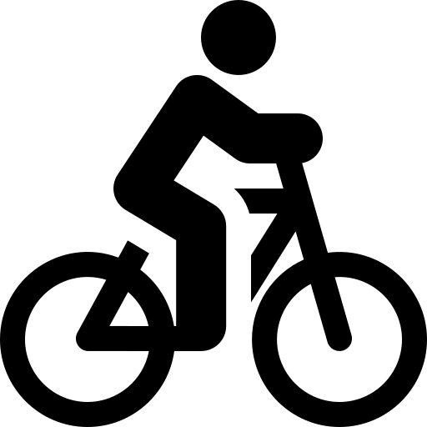

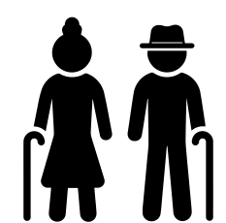

Current population and context
Population
Population projections
Main causes of early death in Islington
Cancer
Cardiovascular Disease
Respiratory Disease
Approximately 31% of Islington's population has one long-term condition and 11% have two or more. Diabetes and hypertension are highly prevalent, contributing to early mortality.
225,000
(2024)
225,000
Age 0-4 10,466
(5%)
Age 5-19 30,405 (14%)
-1.4%
50% of the borough is now covered by a low traffic neighbourhood (2nd highest amongst inner London boroughs).
221,890
(2033)
Age 20-35 85,591 (38%)
Age 36-64 76,833 (34%)
Islington adults walking or cycling for travel at least 5 times a week is consistently higher compared to London. Although it declined during the pandemic it is back on the rise.
Age 65+ 21,783 (10%)
The biggest population increases are expected in those over 65 years but remains the smallest in absolute numbers.
In a 2023 survey, residents prioritized:
Health (physical and mental)
60% of the population identify as non-White British, with increases in Other White and Black African communities.
Financial stability
For the younger population financial stability was the most important.
+
30%
(6,420)
Friends and relationships
Housing

Slide 97

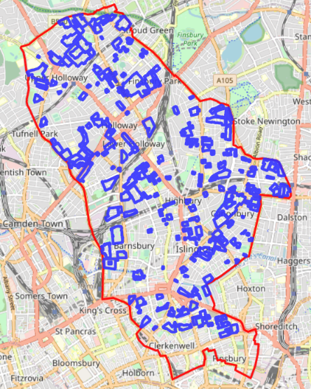
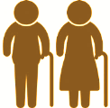
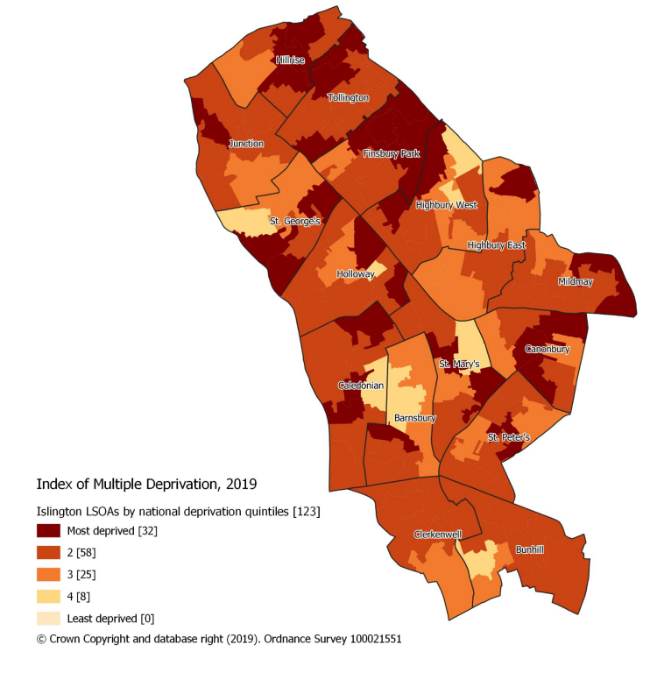
Deprivation
Deprivation levels
Poverty concentrated at either end-of-life course
Pattern of deprivation
6th most deprived borough in London and 53rd most deprived across England.
The Index of Multiple Deprivation (IMD) is a measure of the level of deprivation. The scores are ranked from 1 (most deprived - dark red) to 5 (least deprived - light yellow).
The pattern of deprivation in Islington differs to other London boroughs, with affluent areas immediately next to deprived areas.
This is displayed below in the map of social housing estates which are scattered throughout the borough.
Islington is the 2nd most deprived borough for children in London
Map of Islington according to The Index of Multiple Deprivation (IMD).
and is the 4th most deprived for older people in London

