Slide 1
The state of the borough
September 2024

Slide 2
Contents
 | Chapter | Slides
1 | Executive summary | 4 - 13
2 | Current population | 14 - 21
3 | Employment and Labour market | 22 - 33
4 | Income and poverty | 35 - 42
5 | Housing | 43 - 63
6 | Children and young people/education | 64 - 76
7 | Environment and climate | 77 - 83
8 | Health and Wellbeing | 84 - 102
9 | Crime and safety | 103 - 110
10 | Community cohesion and belonging | 111 - 118

Slide 3
Purpose of the report
This report provides a snapshot overview of the current state of the borough, using key data available. The themes and data in the report have been selected to provide a broad and high-level understanding of Islington’s population and key challenges and broadly mirrors the ambitions of our missions.
The report focuses on how Islington is doing overtime, compares the borough to London as a benchmark and provides information by inequality where available.
The report is by no means exhaustive and links to further reports and analysis that explore the themes covered in this report in detail will be provided.
The audience for the report are all council colleagues, local politician's members and our partners, whom can you use the information in this report to frame discussions around our missions and support the development of policies and programmes.
Questions for reflection and discussion
What is this telling us about our Borough? Anything new or surprising?
Thinking about a future corporate plan from 2026, how does this influence or shape what we need to do to continue to create a more equal Islington? Are there gaps in our knowledge on any areas?
Where do we have well informed plans? Where do we have gaps in our thinking or plans?
Where do we need to work with others to shape our thinking and next steps?

Slide 4
Executive Summary

Slide 5
Summary - Current population and context
Islington is estimated to be home to approximately 225,000 people according to Greater London Authority estimates. Islington is a young borough, with a high proportion of residents aged 20-35.
The boroughs population is expected to slightly decrease (-1.4%) over the next decade, which is a contrast to previous estimates which have always shown a growth in the population. Some of this decrease is likely to reflect reduction in fertility rates and people moving out of the borough due to affordability of housing.
The boroughs population is ageing. The older population, aged 65+, will see the biggest percentage increase (30%) over the next decade but remains the smallest in absolute numbers (currently around 21,000 people).
As with other inner London boroughs there is a high degree of churn amongst Islington’s population, with young people arriving in the borough to study, but people aged 30-39 leaving the borough.
Islington’s diversity has increased over the past decade with 60% of the population identifying as non-White British. Over the past decade we have seen increases in communities identifying as Other White and Black African. Spanish has taken over from Turkish as the most spoken language after English, but amongst children Somali is the most common language after English.
Islington is becoming a more secular borough with more people stating not having a religion. Of those that do have a religion, Christianity and Islam are the most common.
In a resident survey undertaken 2023 the top 4 things that matter most to residents in terms of living a good life are health (physical and mental), financial stability, friends and relationships and housing. For the younger population financial stability was the most important.

Slide 6
Summary - Employment
Financial stability is important to Islington residents to live a good life. Good quality and secure employment opportunities for residents with good incomes are therefore important.
Islington is a small densely populated borough and currently home to 22,655 business the majority of which are small medium enterprises. The boroughs businesses are largely concentrated in the south of the borough.
The number of businesses establishing themselves in the borough have been growing over the past decade and generally there is a net gain in new businesses, i.e more new businesses are established in the borough compared to closing.
82% of the working age (16-64) population in Islington are economically active. This is higher than London and England (both at 79%). However, between 6-9% of people aged 16 and over in Islington are estimated to be unemployed. This was an increase compared with the same period in the previous year.
Certain population groups are disproportionately impacted in the labour market. In Islington people who identify as having a disability are significantly less likely to be in employment compared to those who are don’t have a disability. This gap has remained persistent over the years.
Data on employment rates for people who identify as White compared to who are non-White shows some evidence that this gap has closed since 2017. However, it is important to note that these data are based on surveys and subject to fluctuation.
Finally, employment rates for people with a heath condition or illnesses lasting more than 12 months has been approximately 50% over the past years with the exception of 2022 and 2023 where it was around 70%, higher than London.
Employment by housing tenure, unsurprisingly, shows residents in social housing have higher rates of unemployment compared to those in other tenures.

Slide 7
Summary - Income and poverty
The median gross annual pay of Islington residents is higher than London overall and shows an increasing trend since 2021, however income estimates by small geographies within Islington shows a two-fold difference in income within Islington, highlighting income inequalities.
There are limited data available to help us understand how poverty has changed in the borough overtime.
The Index of Multiple Deprivation (2019) is the best available metric for ranking boroughs by deprivation. Islington is ranked 6th most deprived borough in London but crucially also shows that poverty in Islington is concentrated at either end of the life course. The Income Deprivation Affecting Children Index (IDACI) measures the children aged 0-15 living in income deprived families and ranks Islington as the 2nd most deprived in London and the Income Deprivation Affecting Older People Index (IDAOPI), measures the proportion of all those aged 60 or over who experience income deprivation and ranks Islington the 4th most deprived in London for older people.
However, the data used for this index are considerably old and we know that significant events have occurred in since the IMD that will have changed the picture of poverty. Provisionally the next IMD is scheduled for release in late 2025.

Slide 8
Summary - Income and poverty (2)
The official measure for poverty nationally is measured as households with income below 60% of the national median. For child poverty this translates into 18% (7,500 children) of Islington children live in poverty before housing costs which is the 9th highest in London. Once housing costs are taken into consideration it is estimated that number of children living in poverty rises to 37% (14,000 children), which is the 8th highest in London.
Rates of child poverty look to be declining using the official measure, but it is unclear if this is a real decline, as figures that might capture the impact of the cost-of-living crisis have not yet been released and other indicators such as increase in free school meal eligibility suggest a rise in poverty.
In absolute terms, there are approximately 27,400 household, with 14,000 children receiving Universal Credit, council tax support and/or housing benefits (i.e. classed as “low income”) in Islington based on the Low-Income Family Tracker dashboard developed by Policy in Practice as of June 2024.
7,715 of these households are below the poverty line, with 6,651 children. These data are based on households in receipt of benefits only and therefore we might expect benefits recipients to be more likely to experience lower standards of living and higher rates of poverty than the population as a whole.

Slide 9
Summary - Housing
Secure, affordable and decent housing is important to Islington residents. In the Let's talk Islington survey in 2021, it was the top issue for residents and in 2023 over 40% of residents stated it was important for a good life.
Islington has a distinct tenure profile from London. Whilst the proportion of private rented properties are similar to London, Islington has a significantly higher proportion of properties that are socially rented. We are in fact the second largest landlord in London. These tenures collectively make up approximately 70% of housing tenure in Islington.
The proportion of people living in private rental accommodation in Islington has implications for unequal vulnerability to the cost-of-living crisis, and subsequent tenure insecurity, as rents rise faster than inflation. Private rents rose to an average of £2,510 per month in June 2024, an annual increase of 14.6% from £2,191 in June 2023. This was higher than the rise in London (9.7%) over the year. Private rented sector also has a higher proportion of non decent homes in the private rented sector is likely to reflect in part the fact that there is a higher share of older homes in the sector.
The backdrop of this means we have the 7th highest rate in London for households assessed as homeless.
More households in Islington approached when they were already homeless (relief) (4.2 per 1,000) compared to prevention stage (2.0 per 1,000). Although Islington's rate of temporary accommodation benchmarks well Islington has seen the 4th highest % increase in homelessness compared to Q4 last year.

Slide 10
Summary - Children and young people
Islington’s children and young population is more diverse than the overall population with an estimated 74% being non-White British and just over 60% children aged 0-17 live in social housing (Council and Housing association).
School readiness in the early years and educational attainment are key to achieving good life chances across the life course. In Islington as in London differences in Good Level of Development in the early years exist most significantly by Special Educational Needs Status and Free School Meal status. This gap continues towards the end of the schooling period at key stage 4.
The number of pupils in Islington schools with an Education Health and Care (EHC) plan increased by 15.4% between 2021/22 and 2023/24. The largest change in EHC plans by the type of need is for EHC plans for Autistic Spectrum Disorders (ASD) followed by Speech, Language and Communications needs and Social, Emotional and Mental Health needs, with the latter rising the quickest, with a 133% increase between 2017/18 and 2023/24.
Approximately 5,000 children in Islington missed 10% or more of school sessions. Trends in persistence absence has been rising in Islington since 2018/19, similar to London and England.
Rates of children looked after and children in need are both significantly higher than London and England.

Slide 11
Summary - Environment and Climate
Islington has the second lowest proportion of green space in the country, with only 2.83 square meters per resident. Despite this, most residents can reach a public park or green space within a 15-minute walk, and 71% of households have access to a private outdoor space.
In Islington emissions from Commercial and domestic buildings are responsible for 70% of total greenhouse emissions. Greenhouse gas emissions have decreased in Islington over the past 10 years, with the biggest reduction seen in the commercial sector 56% from 2010 - 2022.
Compared to London Islington has achieved a 23% reduction in GHGs emissions between 2017 and 2022, higher than that of London (17%) and 20% reduction in CO2 emissions, higher than that of London (17%).
The boroughs fine particulate matter (PM2.5) level is 9.1 ug/m3, is higher than the London of 8.7 ug/m3 and Englands 7.4ug/m3. Road traffic is a significant source of this pollution. Concentration of PM2.5 had been declining since 2018 like London but has slightly risen between 2021 and 2022.
The borough is doing well in terms of creating an environment that supports active travel. 50% of the borough is now a Low traffic neighbourhoods, the second highest amongst inner London boroughs. The proportion of adults who walk or cycle for travel purposes at least 5 times per week is consistently higher in Islington compared to London throughout the years, although it declined during the pandemic it is back on the rise.

Slide 12
Summary - Health and Wellbeing
Life expectancy in Islington is higher for females than males in Islington but has been slowing down in recent years, primarily due to the impacts of COVID. Cancer, Cardiovascular disease and respiratory disease remain the top causes of mortality in Islington and contributors to the inequality gap in life expectancy for males and females.
The inequalities in life expectancy are stark for males in Islington, with a 14-year gap between the least and most deprived areas of Islington. This gap has been largely driven by an exceptionally rapid increase in life expectancy among people living in the least deprived parts of the borough, particularly for men.
Approximately 31% of Islington’s population has a long-term condition and at least 11% 2 or more long term conditions. Diabetes and hypertension are highly prevalent conditions in Islington and significantly contribute to early death. As well as prevention, earlier diagnosis of these conditions, facilitating lifestyle advice and earlier medical management help to prevent disease progression and improve outcomes.
Islington has the second highest prevalence of diagnosed Serious Mental ill health and Depression in London, second to Hackney. There are higher diagnosis rates of Serious Mental ill health amongst our communities identifying as Black. For Depression the rates are higher amongst White and mixed communities. Overall, there is a higher prevalence of long-term conditions amongst our deprived communities.

Slide 13
Summary - Health and Wellbeing (2)
Leading a healthy lifestyle can prevent illness or at least delay it for many years. Unlike other factors such as age and genetics, poor lifestyle behaviours can be altered and in the medium term improve population health outcomes. Smoking, excess alcohol consumption and excess weight caused lack of physical activity and diet are the key lifestyle issues facing residents in both boroughs and disproportional impact certain populations more than others.
Healthy life expectancy, that is the years spent in good health is arguably more important than life expectancy overall. It considers both the length of life and the quality of life. On average healthy life expectancy for males and females in Islington is lower than London but has been improving. For Males is it 63 years compared to 63.8 in London and for females its is 63.8 years compared to 65 years in London.
The number and proportion of residents who are living with a disability has increased since 2011 to 16.2%. This trend is primarily driven by an increase in people living with disabilities who are limited a little in their daily activities. To contrast, across London overall there has been a decrease in the proportion of people living with a disability. Islington has the highest proportion of residents living with a disability in London.
Islington’s adult social care supports 10,475 residents per 100,000 aged 65 and over. This gives Islington the 4th highest rate among all London boroughs. Islington’s adult social care supports 910 residents per 100,000 aged 18-64. This gives Islington the 10th highest rate among all London boroughs.
With an ageing population and potential increased morbidity there needs to be a continued focus on how we can keep people healthy and independent.

Slide 14
Summary - Crime and safety
Islington has a lower positive perception to the police compared to London when asked about questions related to Trust and Confidence of the Metropolitan Police Service. These perceptions have been declining overtime for Islington and for London as a whole.
In 2023/24 there were approximately 29,100 offences reported to the police in Islington. Theft makes up most reported offences followed by violence against a person. This distribution has remained the same over the past 5 year and is similar to what is seen in London overall.
Islington is a diverse residential borough which generally falls below the London average for hate crime. In 2023 there were on average 3,400 reported incidents of hate crime in Islington. Racist and religious offences were the most common type of hate crime reported followed by homophobic crime. Finsbury Park is the area in Islington that sees the highest volume of hate crime.
In 2023, there were on average 2,500 reported incidents of domestic abuse. The volume of reported domestic abuse incidents saw some increased levels during lockdown periods in Islington and have shown a reduction in the recent year. However, it should be noted that levels of domestic abuse tend to be under reported.
Domestic abuse victims identifying as Black are overrepresented amongst victims.

Slide 15
Summary - Communities
In 2023, a resident wellbeing survey was undertaken which asked a representative sample of residents questions about perception of safety, belonging, cohesion, having a say in decision making and social contact amongst others.
When considering safety after dark, the proportion feeling safe within Islington (62%) is 11-percentage points below the latest national benchmark, with one in five feeling unsafe.
42% of respondents agree that they have a say about the decisions made in the local area, with almost the same proportion in disagreement.
Males, residents from a Black background and Muslim residents are less likely to respond positively to having a sense that Islington is a place where people get on well together.
Less than half of respondents agree that they have a say about the decisions made in the local area, with almost the same proportion in disagreement.
Results showed loneliness increases with age.
People with a disability or ill health responding negatively to most questions.

Slide 16
Current population

Slide 17
Islington is home to approximately 225,000 people.
Census 2021 day was in the middle of the third lockdown of COVID-19 and estimated Islington’s population at 216,587.
This is likely to be an underestimate of the population, as we know that at this time many families and young adults left the borough.
The Greater London Authority provides population estimates for all London boroughs considering housing planning. Based on these estimates Islington's current population is estimated to be 225,000.
Islington’s population is young with a higher proportion of residents aged 20-35 (38%) compared to London (27%).
Source: Office for National Statistics for all authorities in England and Wales. 220,600 (ONS 2023 mid-year estimates).

Slide 18
Overall, Islington’s population is estimated to see a slight decrease (1.4%) over the next 10 years.
Over the next ten years Islington’s population is estimated to see a slight decrease (1.4%).
However, the change in population is different by age groups. Over the next decade there are estimated to be fewer school aged children and a growing share of people aged 65+.
The working age population is projected to stay similar, but with churn.
21,783 residents aged 65+, approx. 10% of population expected to grow to 28,203 by 2033, which is an increase of almost 30%.
Source: GLA 2022-based housing led (central fertility trend) demographic projections

Slide 19
As of June 2023 more, people left Islington than arrived.
At the end of June 2023, an estimated 25,585 people moved into the borough from within the U.K and an estimated 29,908 people moved out of the borough, giving a net outward flow of 4,323 people.
The age-groups with the largest net outward outflow are those aged 30-39. The reasons for this could include the high cost of housing in London and the limited availability of larger housing for families.
The age groups with the largest positive net flow to Islington are those aged 20-24. This positive flow maybe related to accessing education and finding work.
The reduction in the extent of outflows from age five reflects a reduced tendency for families to relocate once children start attending primary school. A further reduction in outflows from age 12 would correspond to the period when children start secondary school.
Source: Office for National Statistics, 2024

Slide 20
Islington’s population has become more diverse over the last decade.
Islington’s population has become more diverse over the last decade. 40% of Islington’s population identified as White British in the 2021 Census compared to 48% in 2011.
60% of Islington residents in 2021 were born in the UK. This proportion decreased since 2011 (down from 65%).
Most residents not born in the UK were born in the EU. The proportion born in EU countries increased from 12% in 2011 to 14% in 2021.
Source: ONS Census 2011, 2021

Slide 21
After English, Spanish is the most spoken language in Islington.
This is followed by French, Italian, Turkish, and Somali.
Romanian saw the largest increase in terms of number and proportion of people speaking it, changing its ranking from 28th most spoken language in 2011 to 17th in 2021.
People who do not identify English as a main language were asked to report how well they could speak English.
In Islington, 85% of usual residents who do not identify English as their main language, can speak English very well or well, 13% cannot speak English well, and 2% cannot speak English at all.
In Islington schools, Somali is the most spoken language after English.
Source: ONS Census 2011, 2021

Slide 22
Islington is becoming more secular. 41% percent of Islington residents said they have no religion.
Based on Census 2021, 41% of residents said they have no religion and 8% did not answer the question.
The proportion with no religion increased between 2011 and 2021, whereas the proportion who did not answer decreased by an equivalent figure.
35% of Islington residents are Christian and 12% are Muslim.
Source: ONS Census 2011, 2021

Slide 23
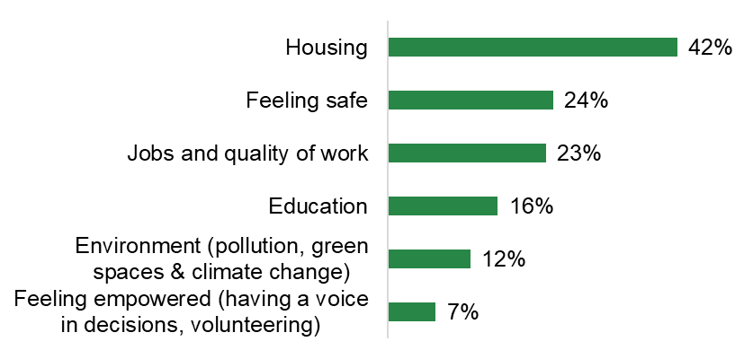
In 2023, good health, financial stability, and friendships & relationships are the factors Islington residents most commonly identify as important to live a good life.
Top 5 most important factors by age
16-33 | 35-54 | 55-74 | 75+
Financial stability 66% | Health (physical and mental) 64% | Health (physical and mental) 73% | Health (physical and mental) 79%
Health (physical and mental) 58% | Financial stability 58% | Financial stability 56% | Friendships and relationships 69%
Friendships and relationships 51% | Housing 46% | Housing 54% | Housing 43%
Housing 34% | Friendships and relationships 38% | Friendships and relationships 46% | Feeling safe 35%
Jobs and quality of work 27% | Jobs and quality of work 25% | Feeling safe 24% | Financial stability 31%
63%
60%
46%
Health (physical and mental)
Financial stability
Friendships and relationships
Base size: 1,039
Q6. Thinking about your life at the moment, which of these do you feel are the most important to live a good life?

Slide 24
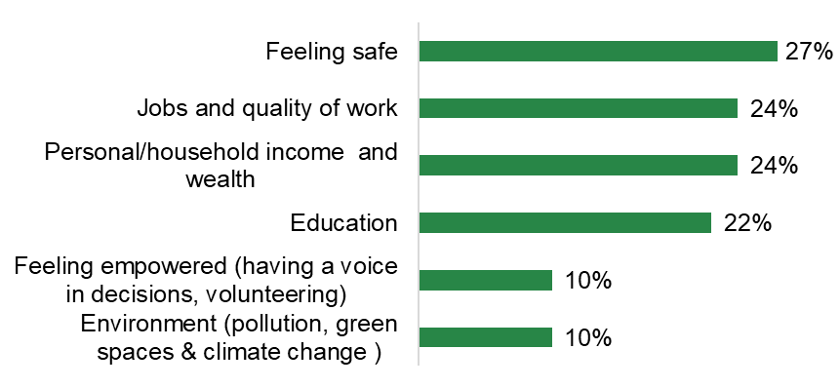
Two of the three factors rated as most important in living a good life are also factors that residents are most satisfied with currently.
Although residents stated that health (physical and mental) was the most important factor in living a good life, comparatively, a lower proportion are satisfied with this area (63 vs. 53%)
Satisfaction with health is significantly higher among those without limitations due to health issue or disability (56%), while those limited a lot (36%) and limited a little (30%) are significantly less satisfied
A higher proportion are satisfied with friendships and relationships, consistent across most subgroups
Notably, satisfaction with friendships and relationships is significantly higher for those who have don’t have dependent children living with them than those who do (69% vs. 60%)
67%
53%
36%
My friendships and relationships
My health (physical and mental)
Housing
Base size: 1,039
Q7. Thinking about your life at the moment, which of these areas are you most a satisfied with?

Slide 25
Economy and employment

Slide 26
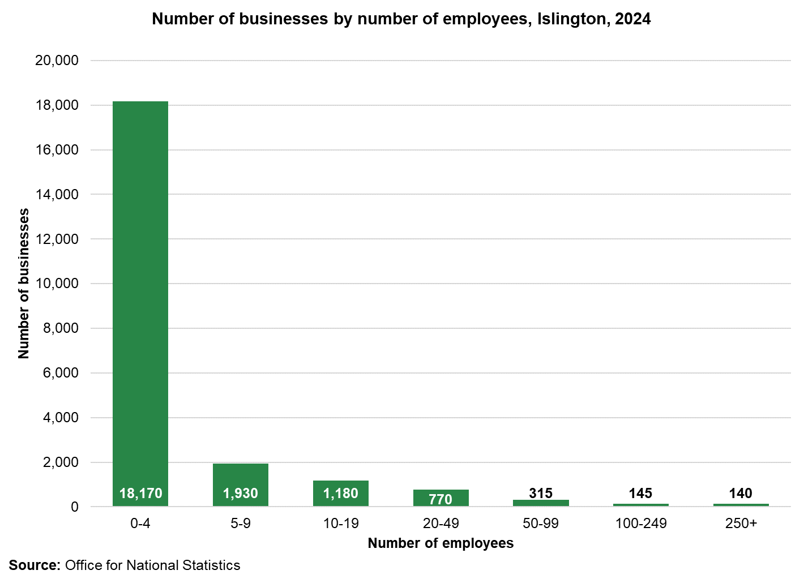
Islington is home to approximately 22,600 businesses, largely consisting of small businesses.
Islington has seen a steady growth in new businesses over the last couple of decades and the most recent data shows it is home to 22,655 businesses. Most of these businesses are small employing up to 4 people and only a small number employing more than 250 people.
Source: Office for National Statistics

Slide 27
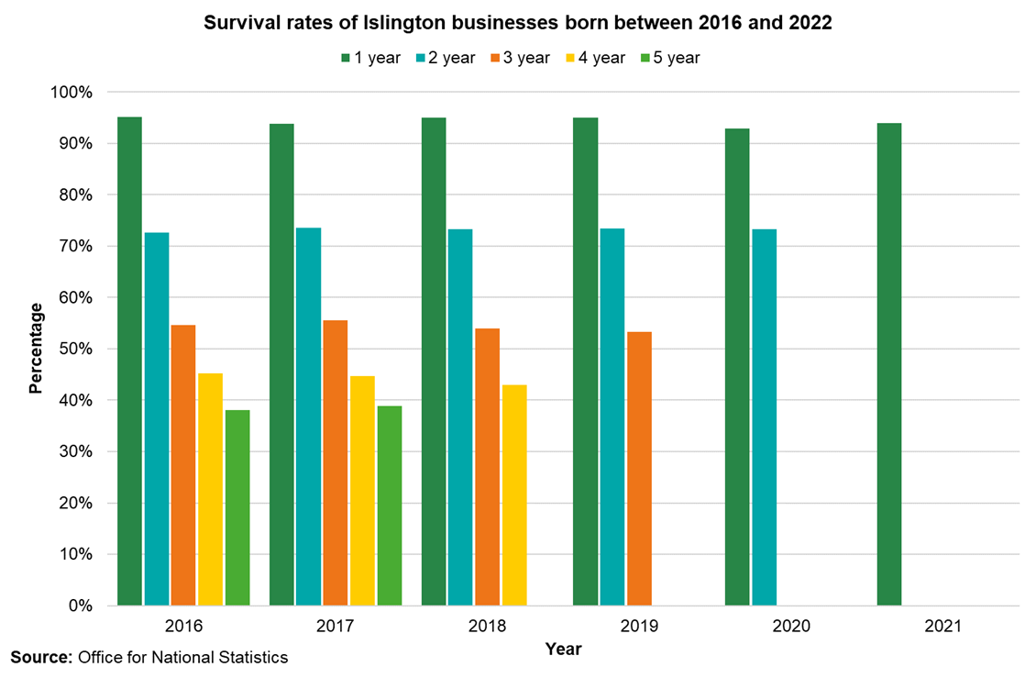
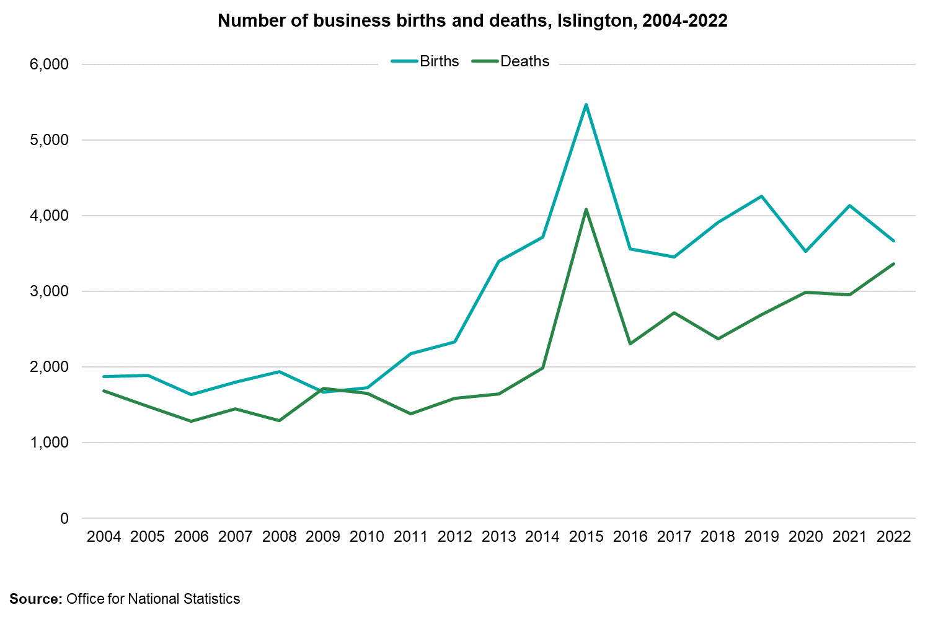
Majority of businesses in Islington have a good survival rate of up to 2 years and generally seen more new businesses setting up then closing down across the years.
Source: Office for National Statistics

Slide 28
82% of the working age population in Islington are economically active.
Economically active (82%) (n=149,800)
82% of the working age population in Islington are economically active. This is higher than London and England (both at 79%).
About 9% of the working age population in Islington are unemployed (8.5%) which is significantly higher than England (4.0%), though like London (5.2%)
19% are economically inactive, which is slightly below London and England figures (both 21%).
10% of Islington residents are economically inactive students. This is equivalent to 55% of the economically inactive people in Islington, which is significantly lower than the London (34%) and England (27%) averages.
Unemployed (9%) (n=12,800)
Economically inactive* (19%) (n=34,000)
Student (10%)
(n=18,800)
Long-term sick (4%)
(n=7,300)
Employed (75%)
n=(137,000)
Looking after family (3%)
(n=4,800)
Other (1%)
(n=2,000)
Unknown (1%)
* People who have not sought work in the last four weeks or do not want a job;
Source: Office for National Statistics Annual Population Survey

Slide 29
Islington has a higher job density ratio compared to London and has seen an increasing trend since 2020.
Job density in Islington is increasing at a faster rate than in London and has remained higher since 2010.
Source: Office for National Statistics

Slide 30
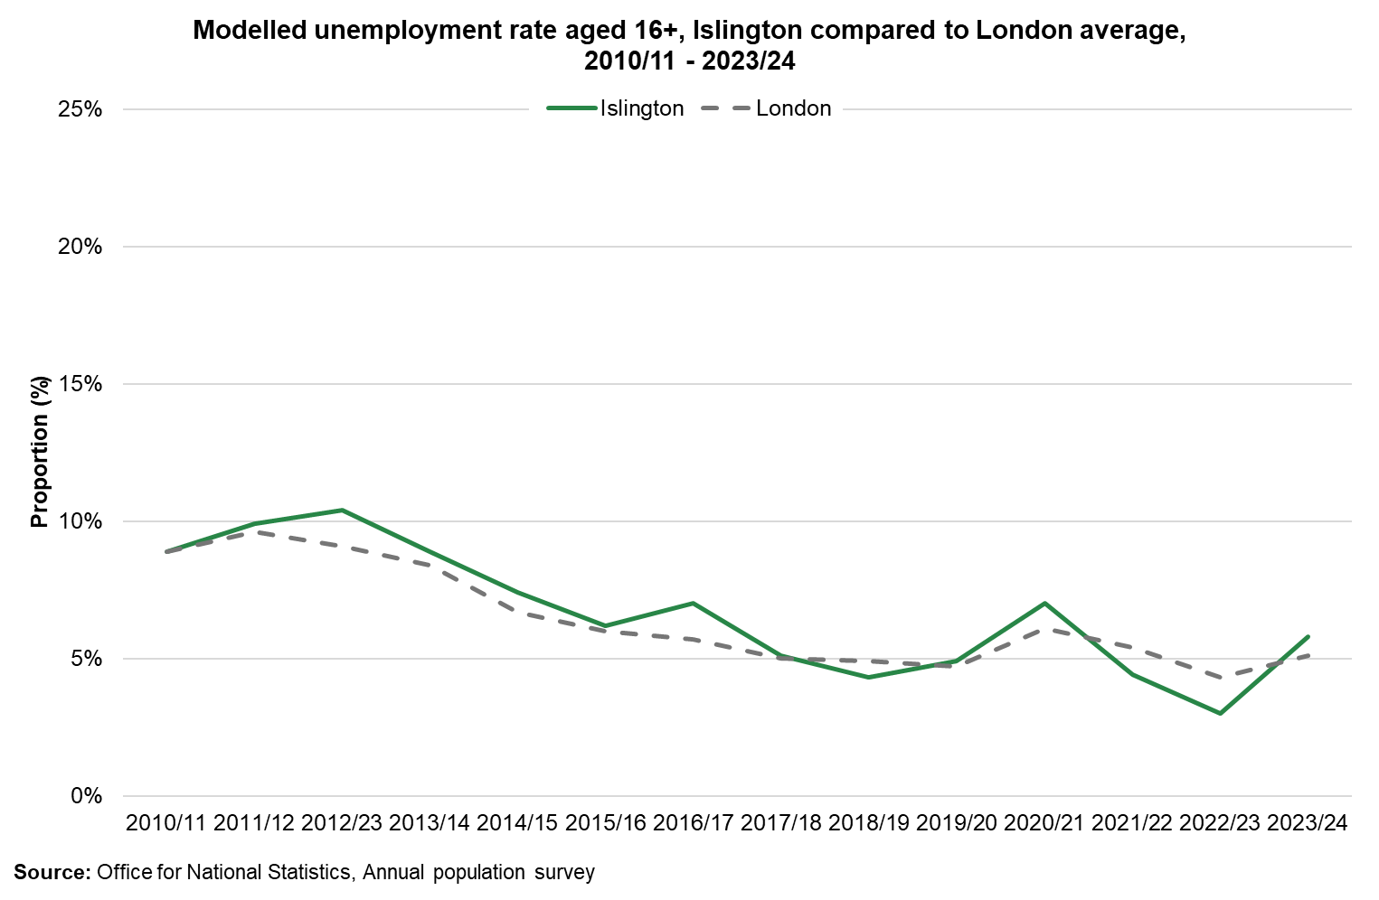
Employment rate in Islington is 75% and has been rising since the pandemic, before a slight dip in the latest period.
As of March 2024, 75% of Islington residents aged 16-64 living in Islington were estimated to be employed. This is similar to the London average. The unemployment rate is the number of unemployed people out of everyone "economically active" in the labour market, that is, everyone who is employed or actively looking for work.
The employment rate is out of the working-age population including "economically inactive" people. Unemployment estimates are modelled to improve their precision compared to those based only on responses provided via the Annual Population Survey. Around 8,900 people aged 16 and over in Islington were unemployed in the year ending 2023/24. This is a rate of 5.8%. This was an increase compared with the same period in the previous year when the unemployment rate was 3% and is higher compared to London (5.1%).
Source: Office for National Statistics Annual Population Survey

Slide 31
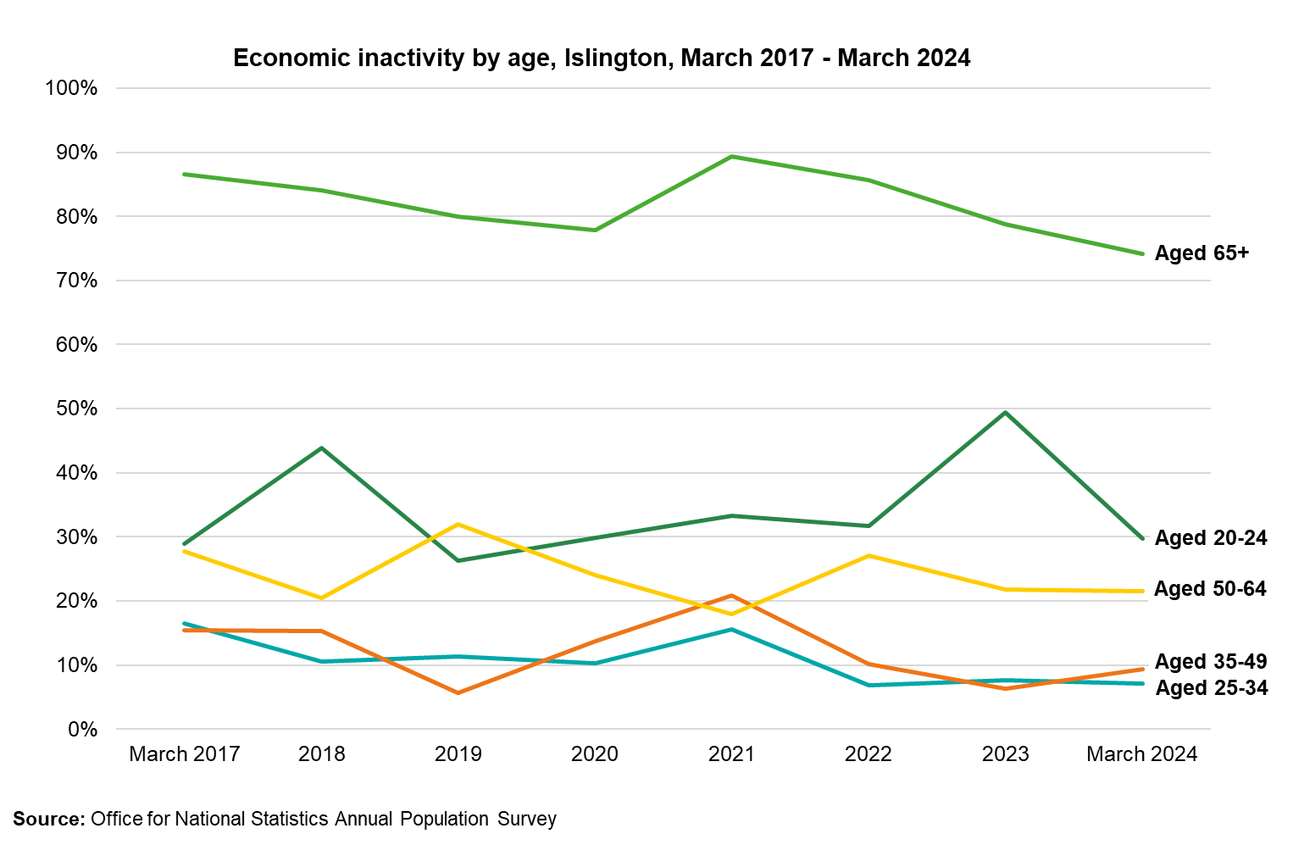
The main reason for people not being in employment or seeking employment in Islington is due to being a student.
People are classed as "economically inactive" if they are not in employment but don't meet the criteria for being "unemployed". This means they have not been seeking work within the previous four weeks or were unable to start work within the next two weeks.
Around 31,000 people or 17.1% of the population aged 16 to 64 years in Islington were "economically inactive" in the year ending December 2023. This compares with around 19.4% in the same period in the previous year.
In Islington, the main reason for not seeking employment is due to being a student, followed by looking after family/home.
Inactivity by age shows a decline for the 65+ and a recent sharp dip for those aged 20-24
Source: Office for National Statistics Annual Population Survey

Slide 32
People identifying as white have a higher employment rate compared to other ethnic groups. There is evidence that the gap has been closing overtime.
The employment rate gaps show the difference in employment rate for Islington residents aged 16-64 in one group and that for another.
The latest gap between all white Islington residents and Islington residents from all other ethnic backgrounds currently stands at 16%.
This gap was the smallest in 2020 and 2021.
Source: Office for National Statistics Annual Population Survey

Slide 33
The rate of employment with people with health conditions or illnesses lasting more than 12 months.
The rate of employment with people with health conditions or illnesses lasting more than 12 months has been approximately 50% over the past years with the exception of 2022 and 2023 where it was around 70%, higher than London.
It is important to note that these data are based on survey data and subject to fluctuation.
Note: Data of employment rate for people with no health conditions was not available
Source: Office for National Statistics Annual Population Survey

Slide 34
The rate of employment with people with a disability compared to those without a disability remains persistent.
The gap in employment rate for people with a disability and those without remains persistent.
In the 12 months to March 2024 the gap is double between those with disabilities and those without.
Note: Disability is defined as being either of the following 2 categories: Equality act core disabled includes those who have a long-term disability which substantially limits their day-to-day activities or Work-limiting disabled includes those who have a long-term disability which affects the kind or amount of work they might do.
Source: Office for National Statistics Annual Population Survey

Slide 35
The percentage of young people Not in Education Employment or Training is higher than London and reducing at a slower rate.
Every year, an average proportion of 16–17-year-olds who are Not in Education, Employment or Training is taken across December to February.
The level of NEETs has gradually reduced in Islington over the last few years. However, the proportion of NEETs is falling slower than it is across London overall.
The proportion of NEETs is higher in Islington than the overall London average, although Islington has a lower level of NEETs than the national average.
Source: Department for Education

Slide 36
The proportion of Islington adults with level 4 or above qualification is higher than London.
Islington has a higher proportion of residents with a level 4 qualification compared to London and this has increased between 2022 and 2023.
Note: From 2022, the qualification framework presented in the data moved from National Vocational Qualifications (NVQ) to Regulated Qualification Framework (RQF)
Source: Office for National Statistics Annual Population Survey

Slide 37
Income and poverty

Slide 38
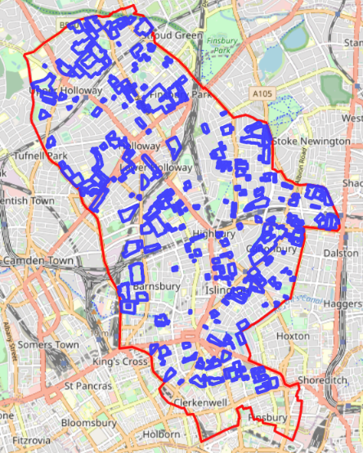
Islington is the 6th most deprived borough in London according to the Index of Multiple deprivation.
The level of deprivation in an area can be used to identify those communities who may be in greatest need of services. The Index of Multiple Deprivation (IMD) is a measure of the level of deprivation. Deprivation scores are ranked nationally from most deprived to the least deprived areas.
In 2019, Islington was the 6th most deprived London borough, and the 53rd most deprived in England..
When areas of Islington are ranked nationally there is no area in Islington that is in the least deprived quintile.
The geographic pattern of deprivation in Islington is very different from many other areas. Whereas many boroughs have clear distinctions between poorer and more affluent wards, Islington’s mix of housing means that deprivation is very disseminated across the borough and is strongly concentrated into social housing estates in Islington
Index of multiple deprivation, 2019
Location of social housing estates
Source: Indices of Multiple Deprivation 2019

Slide 39
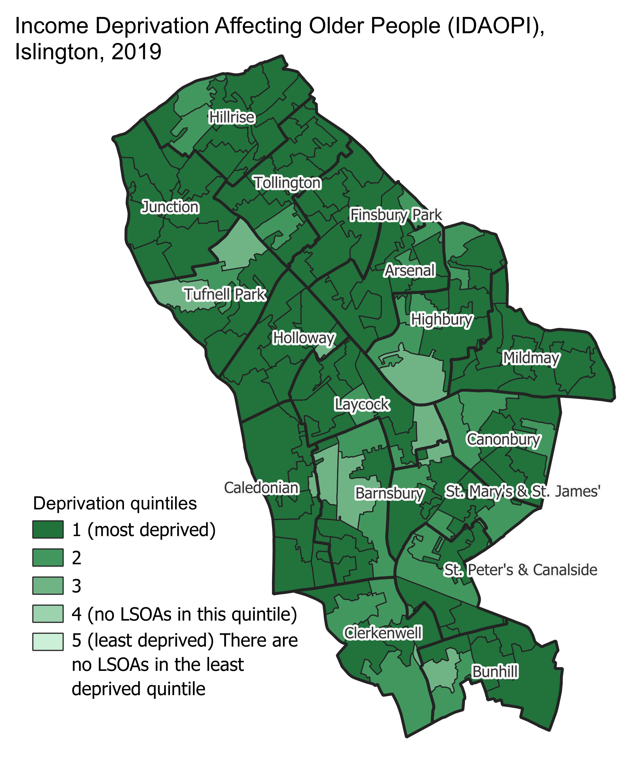
Income Deprivation affecting Children and Older People
Deprivation is strongly concentrated into children and families and older people in Islington, who have among the highest deprivation levels in the country.
The Income Deprivation Affecting Children Index (IDACI) measures the children aged 0-15 living in income deprived families and the Income Deprivation Affecting Older People Index (IDAOPI), measures the proportion of all those aged 60 or over who experience income deprivation.
In 2019, Islington ranked 2nd most deprived in London for children and 4th most deprived in London for older people.
Source: Indices of Multiple Deprivation 2019

Slide 40
Approximately 7,500 children aged 0-16 live in poverty, and this rises to over 14,000 children after housing costs.
Child poverty is measured as the share of children living in households with income below 60% of the median.
18% of Islington children live in poverty before housing costs which is the 9th highest in London. Official statistics on children living in poverty published by the government (children living in relative low-income families) don’t account for housing costs. In areas such as London, where housing costs are high, this underestimates childhood poverty.
Once housing costs are taken into consideration it is estimated that number of children living in poverty rises to 37%, which is the 8th highest in London.
Source: Department for Work and Pensions; Centre for Research in Social Policy at Loughborough University

Slide 41
Levels of poverty vary by definition
Poverty definition | Islington households | 16 boroughs (mixture of inner and outer)
Absolute poverty households. Households with an income below 60% of the median income in 2010/11. | 22.7% | 25%
Relative poverty line. Households with income below 60% of the median income in that year | 29.8% | 31%
Social Metric Commission poverty line. Households whose total resources available (net income plus liquid assets minus inescapable costs) are less than 54% of the three-year smoothed national median for available resources. | 22.9% | 23%
Minimum income standard. Minimum Income Standard shows what households need to spend to have an acceptable standard of living, as judged by members of the public | 58% | 61%
There are approximately 27,400 household, with 14,000 children receiving Universal Credit, council tax support and/or housing benefits (i.e. classed as “low income”) in Islington based on the Low-Income Family Tracker dashboard developed by Policy in Practice as of June 2024.
7,715 of these households are below the poverty line, with 6,651 children. These data are based on households in receipt of benefits only and therefore we might expect benefits recipients to be more likely to experience lower standards of living and higher rates of poverty than the population as a whole.
Source: Policy in Practice and Joseph Rowntree foundation – May 2024

Slide 42
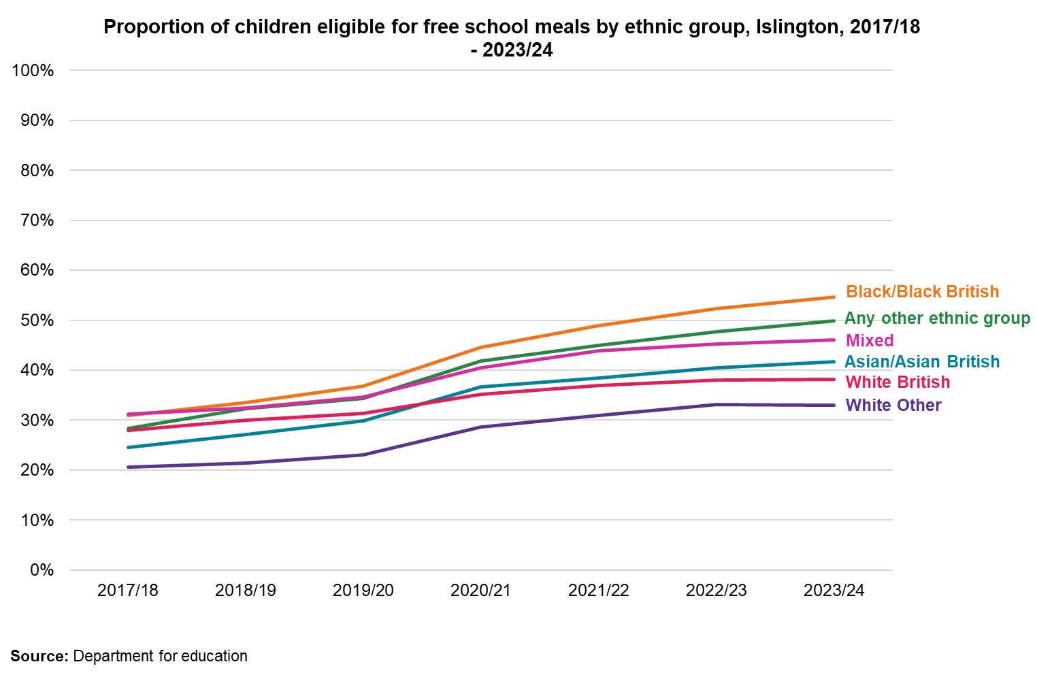
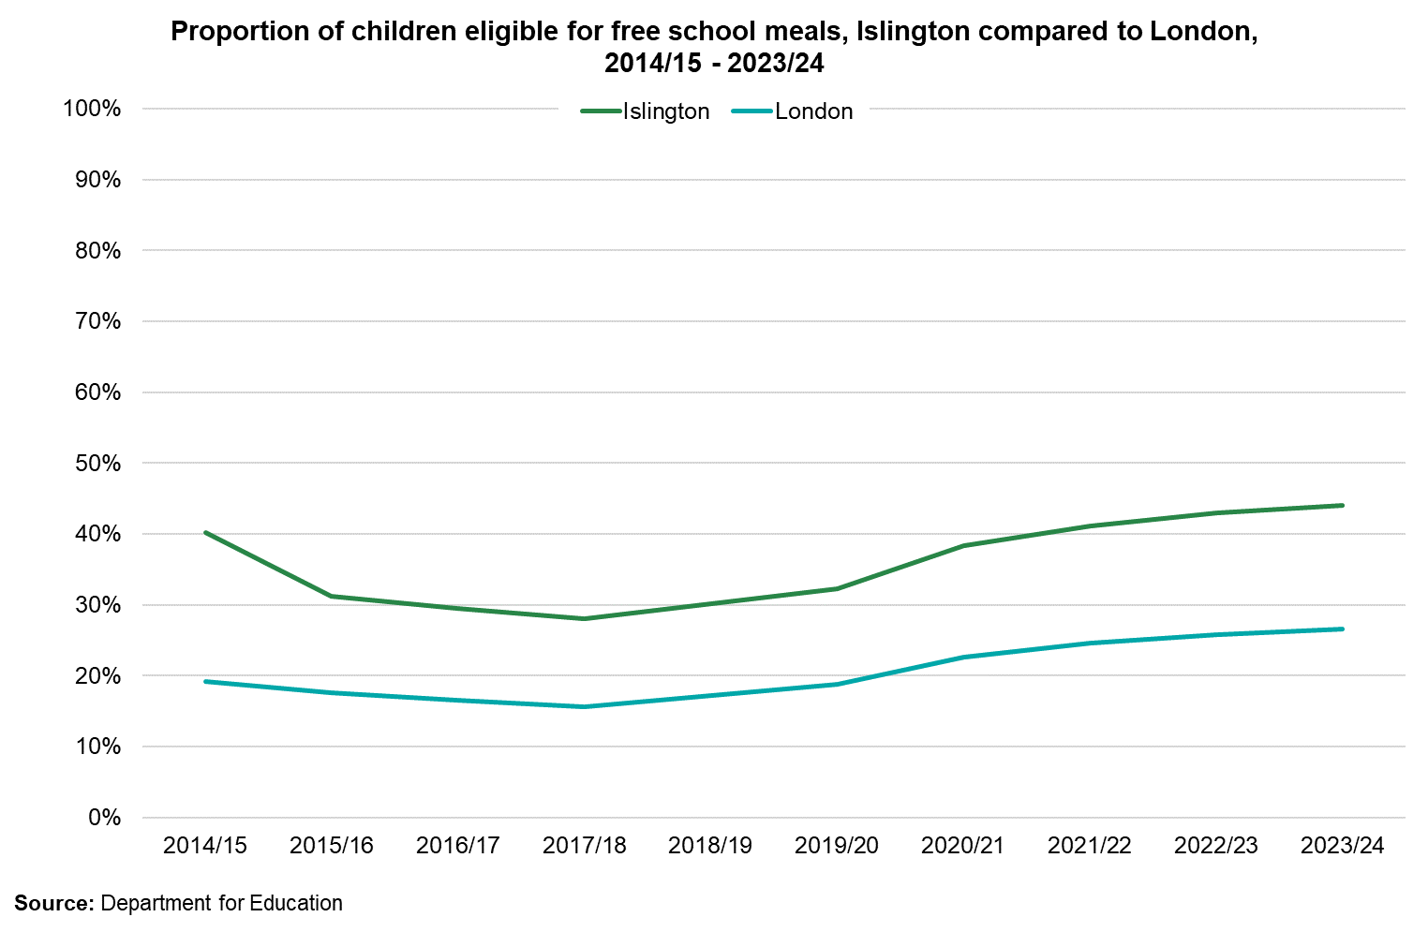
The proportion of children eligible for Free School Meals (FSM) has increased in Islington and rest of London.
Free School Meal eligibility has increased among all ethnic groups between 2019/20 and 20222/23. This is at least in part due to a change in recording. Since 2018, if a child is found to be eligible, they remain eligible until the end of their current phase of schooling (e.g. primary school pupils remain eligible until they start secondary school).
The proportion of eligible children has increased slightly more among Black/Black British children, whereas there has been less of an increase among White British children.
Source: Department for Education

Slide 43
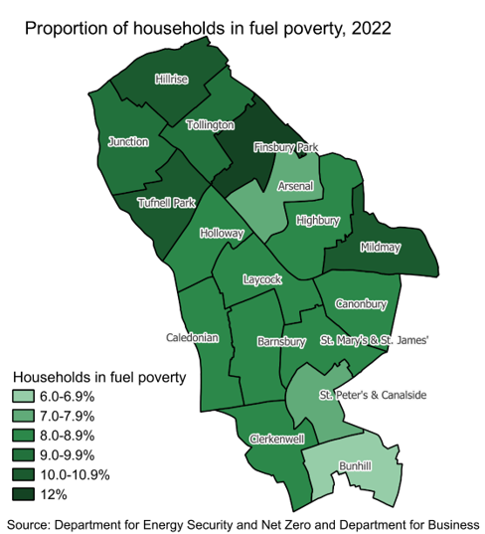
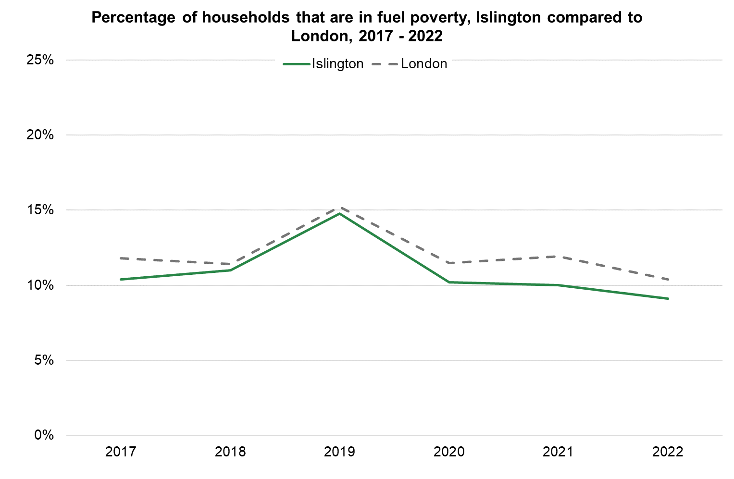
The percentage of households that are fuel poor has been decreasing in both Islington and London since 2020.
Fuel poverty is measured using the Low-Income Low Energy Efficiency (LILEE) indicator. Under this indicator, a household is fuel poor if they are living in a property with a fuel poverty energy efficiency rating of band D or below AND when they spend the required amount to heat their home, they are left with a residual income below the official poverty line (defined as 60% of the median equivalised disposable income)
Source: Department for Energy Security and Net Zero and Department for Business, Energy & Industrial Strategy

Slide 44
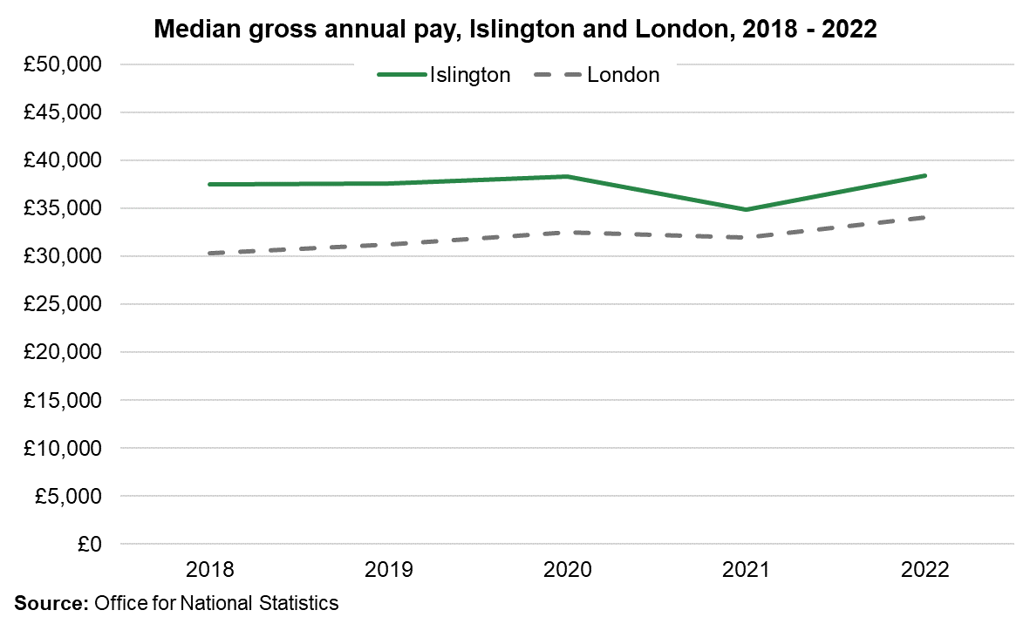
The median gross annual pay of Islington residents is higher than London overall and shows an increasing trend since 2021.
There is a 2-fold difference in the mean household disposable income within the borough
Mean household disposable (net) income, equivalised to account for household size, before housing costs in local areas
Source: Office for National Statistics: Income estimates for small areas, England and Wales, financial year ending 2020

Slide 45
Employee jobs below the London Living Wage (LLW)
Approximately 9% of employee-jobs in Islington were paid below the LLW in April 2023, a lower share than London’s (13.3%).
The proportion of Islington employees earning below the LLW gradually declined between 2020 and 2022 and more recent trend shows an increase in the proportion of employees earning below the LLW.
The decrease observed between 2020 and 2022 may be due to the number of low-paid jobs decreased sharply, coinciding with wider job losses during the pandemic that disproportionally affected low-pay sectors.
Source: Office for National Statistics Annual Survey of Hours and Earnings

Slide 46
Housing

Slide 47
A third of Islington's households are private rented similar to London and a further 40% are social rented from the council or housing association.
There are just under 112,000 residential properties in the borough of which 40% of households live in social rented accommodation (council and housing association).
Approximately 40% of the Islington population lives in a socially rented property.
There is mixed evidence for the change in the availability of private rented homes:
Local statistics using deposit scheme data shows that privately rented accommodation have not significantly changed.
Estate agents report 41% fewer rental properties available than before the pandemic (Savills & LSE).
Source: Census 2021; Deposit scheme data and Savills

Slide 48
Tenure by socio-economic group
The socio-economic status of people in socially rented accommodation varies significantly compared to other tenures, with a higher proportion of households not employed or in long-term unemployment
Source: Census 2021

Slide 49
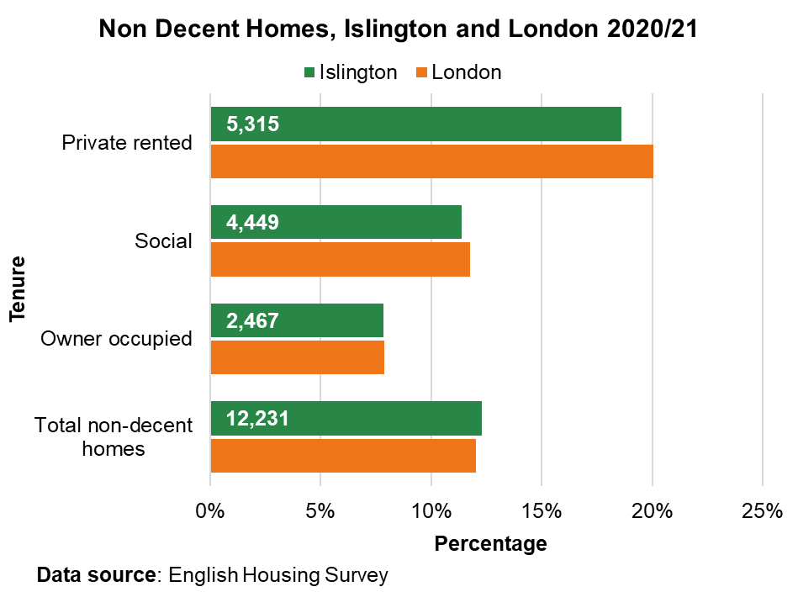
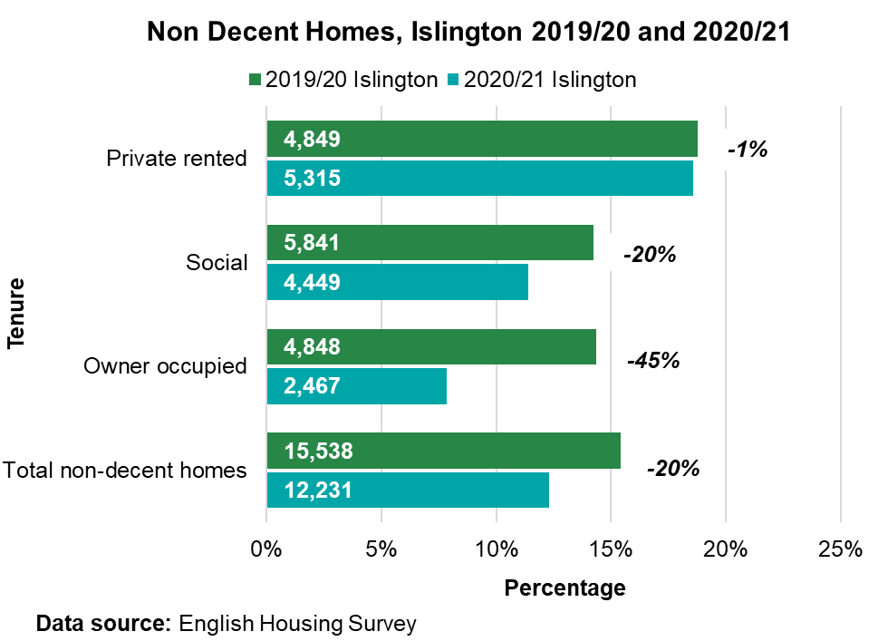
Privately Rented Properties have the highest % of non-decent homes.
The higher proportion of non decent homes in the private rented sector is likely to reflect in part the fact that there is a higher share of older homes in the sector.
Since 2019/20, Islington has seen a decrease in the % of non-decent homes across all tenures apart from private rented.
Note: The English Survey recently started to model local authority analysis.
Source: English Housing Survey

Slide 50
Islington private rents rose by 14.6% compared to June last year.
Private rents rose to an average of £2,510 per month in June 2024, an annual increase of 14.6% from £2,191 in June 2023.
This was higher than the rise in London (9.7%) over the year.
Given the high proportion of people living in private rental accommodation in Islington this has implications for unequal vulnerability to the cost-of-living crisis, and subsequent tenure insecurity, as rents rise faster than inflation.
Source: Office for National Statistics Price index of private rents

Slide 51
Islington residents spend 14 times their annual earnings buying a home, higher than London (12 times their earnings).
In 2023, Islington residents in full-time work could expect to spend around 13.8 times their annual earnings buying a home. The equivalent figure in London is 12.0 times their annual earnings.
At a London and National level, the 2023 affordability ratios are similar to 2022, and represent a return to the pre-coronavirus (COVID-19) pandemic trend after a large increase between 2020 and 2021.
Source: Office for National Statistics Housing affordability in England

Slide 52
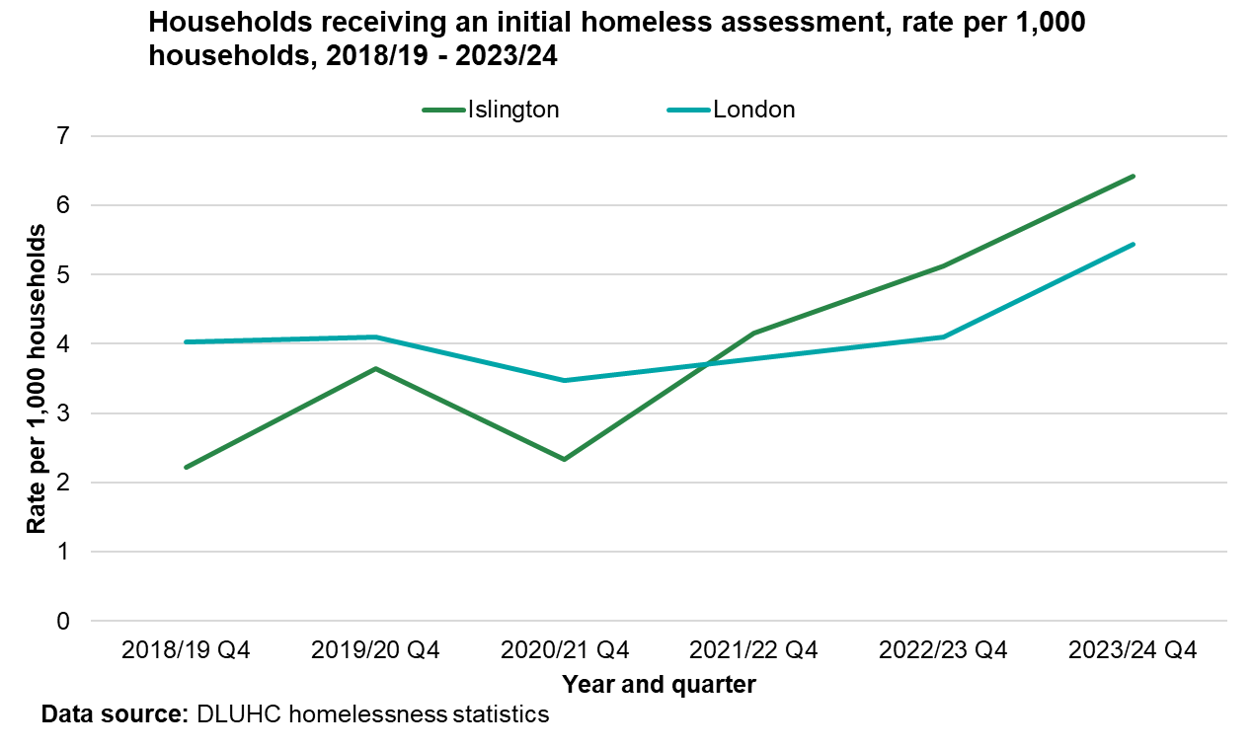
Homelessness has increased over time, with significantly more homeless assessments in Islington than London.
In quarter 4 of 2023/24, 698 initial assessments were carried out, meaning 6.4 per 1,000 households had a homeless assessment.
Islington has the 8th highest rate in London for households assessed as homeless.
Since quarter 4 last year there has been a 25% increase in number of initial assessments (557 in quarter 4 2022/23).
Islington is significantly higher than London (5.4 per 1,000) and England (3.9 per 1,000).
Source: Department for Levelling up, Housing, and Communities Homelessness statistics

Slide 53
Households are more likely to approach the service when already homeless compared to London.
More households in Islington approached when they were already homeless (relief) (4.2 per 1,000) compared to prevention stage (2.0 per 1,000) - green lines on chart.
Islington's relief approaches (4.2 per 1,000) are significantly higher than London (2.9 per 1,000) and 4th highest in London.
The trends show that the rate of relief approaches has seen a bigger increase over time compared to prevention.
Source: Department for Levelling up, Housing, and Communities Homelessness statistics

Slide 54
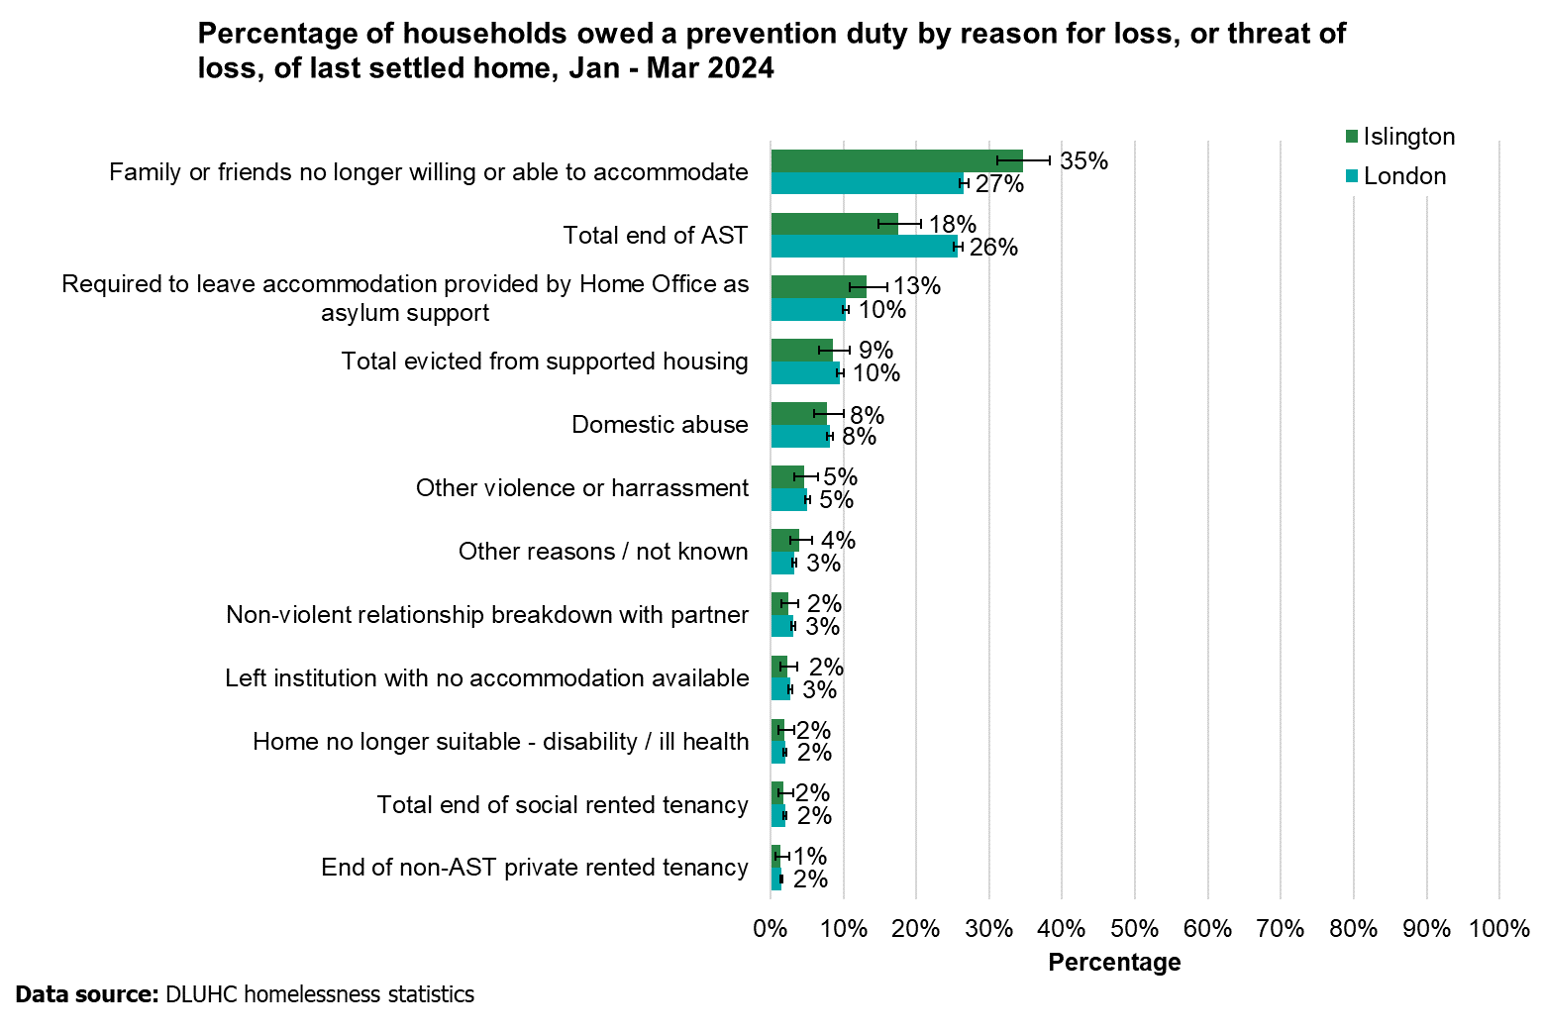
The main reason for approach, was due to friends or family no longer being willing or able to accommodate.
35% of households owed a prevention or relief duty had a reason of loss being that family or friends were no longer able to accommodate.
Family and friend is the key area to focus on encouraging earlier presentations for help; before things reach crisis point.
Data quality in this area has improved. In quarter 4 last year Islington had the highest % in the whole of the country. This is because coding wasn’t statutory at the time.
Source: Department for Levelling up, Housing, and Communities Homelessness statistics

Slide 55
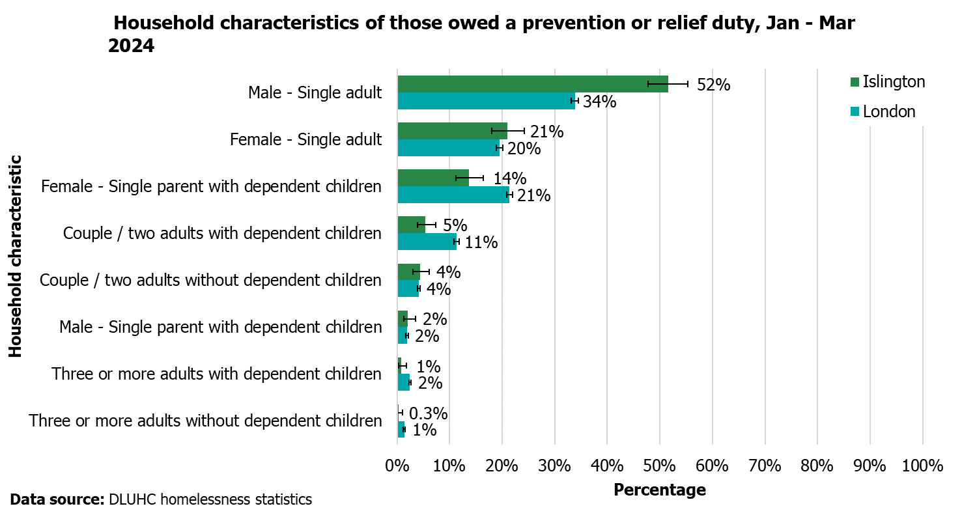
Islington has a higher percentage of single homeless males than London.
Islington has a significantly higher percentage of male single adults owed a prevention or relief duty compared to London.
Compared with London, Islington has a lower % of female single parents and couples and three or more adults with dependent children
Source: Department for Levelling up, Housing, and Communities Homelessness statistics

Slide 56
Islington has fewer households in temporary accommodation compared to London.
In Islington as of March 2024, 1,239 households were in temporary accommodation, 11.3 per 1,000 households were in temporary accommodation.
Islington’s rate is significantly lower than the London average (18 per 1,000).
Source: Department for Levelling up, Housing, and Communities Homelessness statistics

Slide 57
Islington has fewer households with dependent children in temporary accommodation compared to London.
In Islington as of March 2024, 1,215 dependent children were in temporary accommodation, living in 793 households. A rate of 7 per 1,000 households were in temporary accommodation.
Islington’s rate is significantly lower than the London average (12 per 1,000).
Source: Department for Levelling up, Housing, and Communities Homelessness statistics

Slide 58
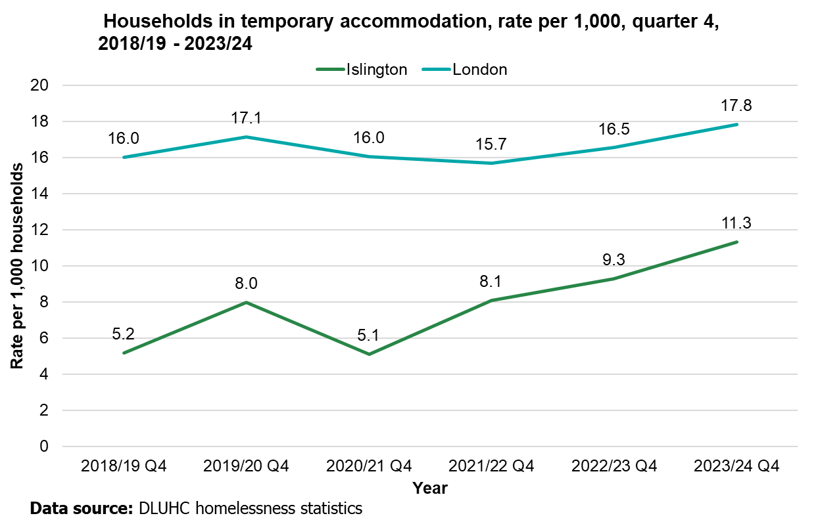
Islington has seen an upwards trajectory in temporary accommodation.
Islington's temporary accommodation rate has remained below London over the past 6 years.
Temporary accommodation rates are increasing. Islington has seen a 23% increase in TA compared to the same point in time last year (an addition 231 households). This is a larger percentage increase that London (9% increase compared to Q4 last year).
Note: COVID-19 impacted the 2020/21 return
Source: Department for Levelling up, Housing, and Communities Homelessness statistics

Slide 59
Since last year, Islington has seen a 22% increase in the rate of temporary accommodation.
Of the 26 local authorities that submitted quarter 4 figures in 2023/24:
22 boroughs had a % increase and 2 had a % decrease, 2 had no change.
The temporary accommodation rate per 1,000 in Islington increased by 22% this quarter 4 compared to quarter 4 last year.
Although Islington's rate of temporary accommodation benchmarks well (see previous slide), Islington has seen the 4th highest % increase in homelessness compared to Q4 last year.
Source: Department for Levelling up, Housing, and Communities Homelessness statistics

Slide 60
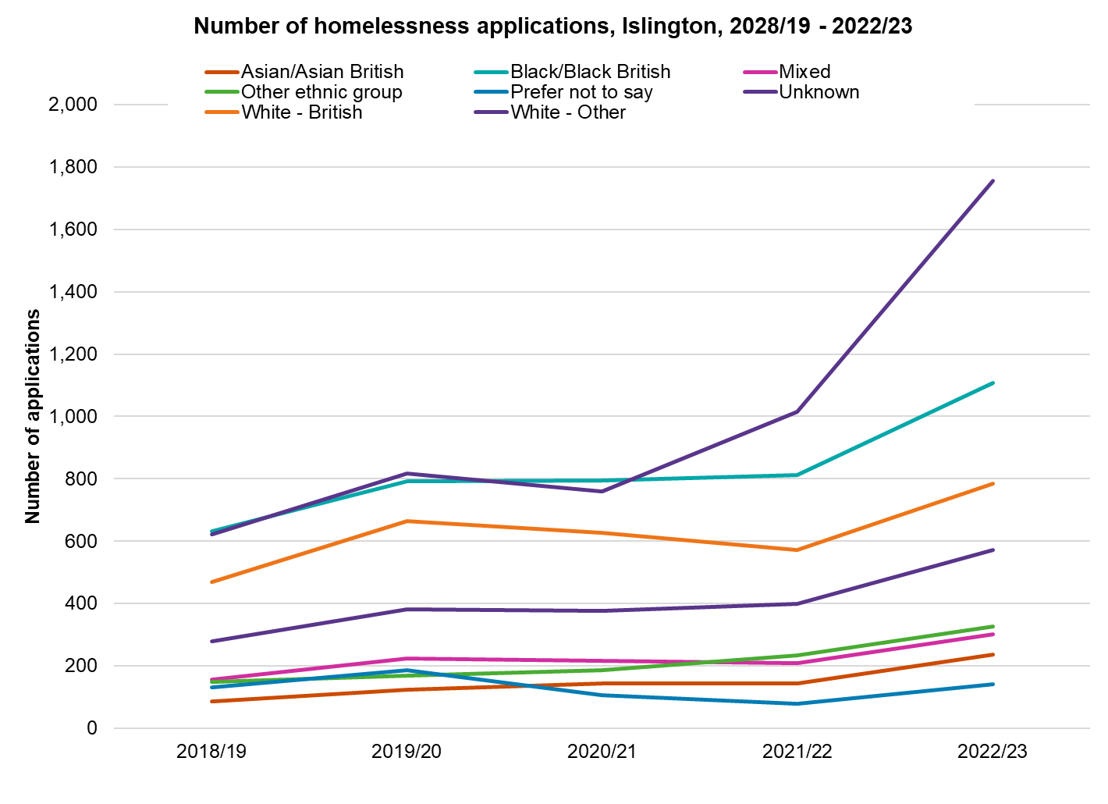
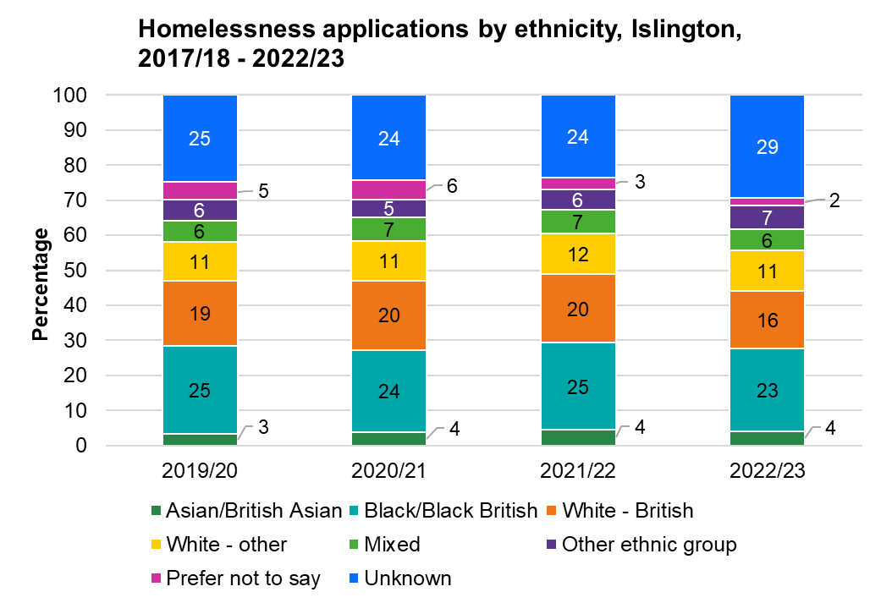
The number of homelessness applications increased among all ethnic groups between 2021/22 and 2022/23, but most among households without stated ethnicity.
There is little difference in the percentage distribution of ethnic group over the different years, with all stated ethnic groups seeing marginal decreases while the proportion of unknown has increased.
Source: Islington Council Homelessness data (Sep 2023)

Slide 61
Black/Black British households are over-represented with respect to homelessness applications.
Comparing Islington Council’s data on homelessness applications with Census 2021 population level data, shows that Black/Black British households are over-represented (21%) compared to the overall population profile (13%).
The proportion of homelessness applications with unknown ethnicity is very large (36%), meaning it is not possible to draw robust conclusions about disaggregated ethnicity data
Source: Islington Council Homelessness data (Sep 2023) and Census 2021 data

Slide 62
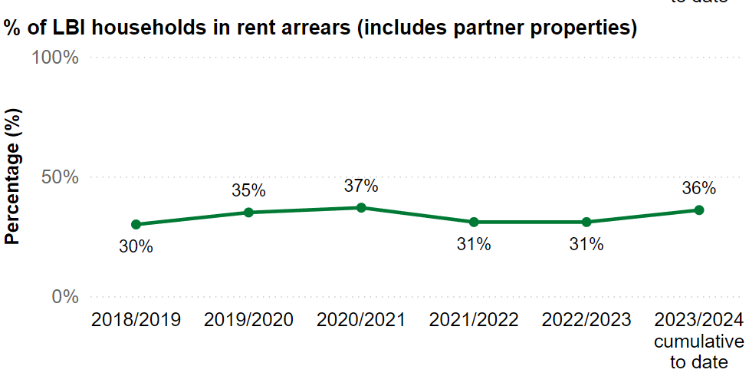
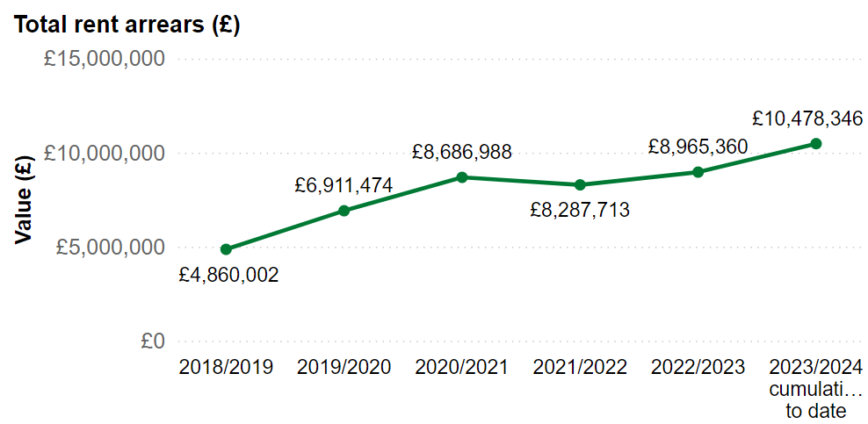
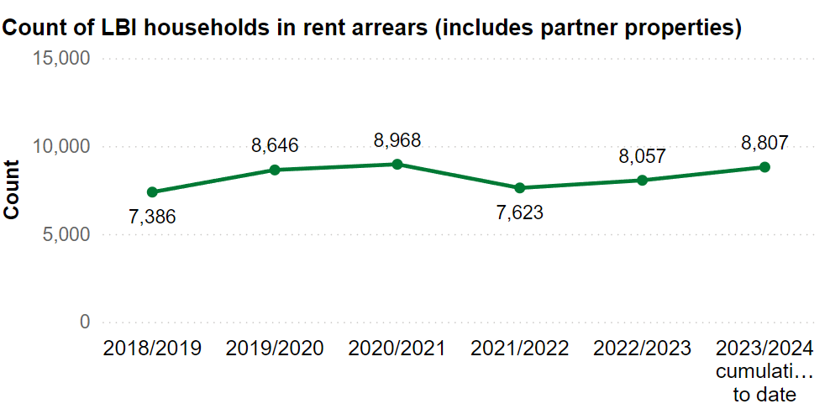
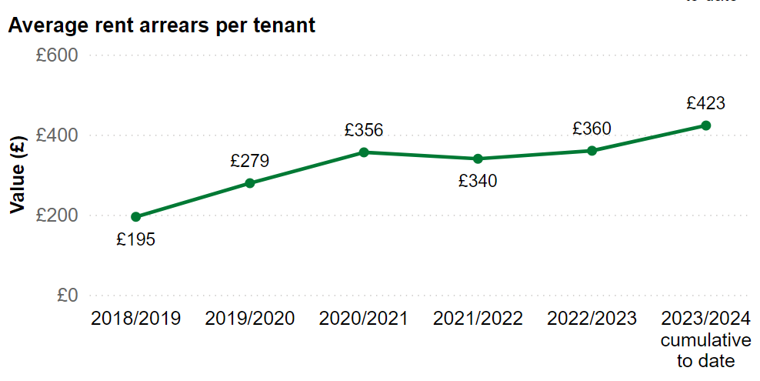
Proportion and number of households in rent arrears has increased and so has the average rent arrears per tenant.
Data as of February 2023
Source: Islington Council Cost of Living dashboard

Slide 63
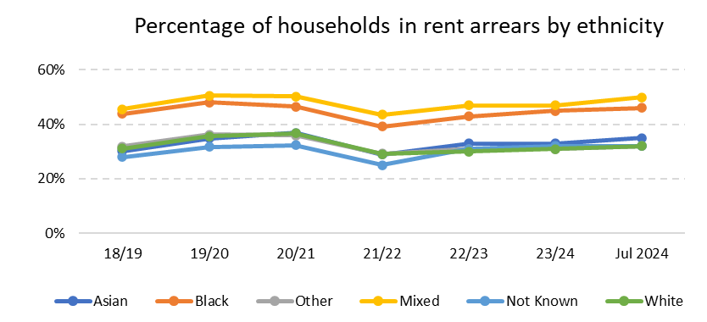
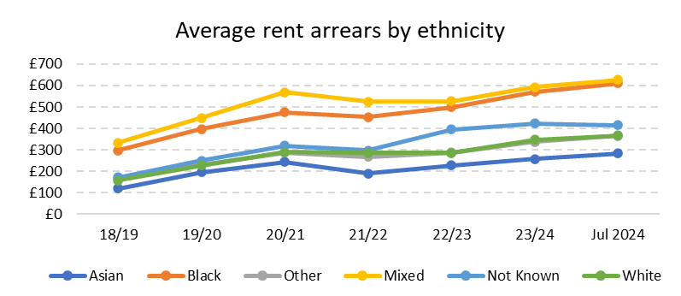
All ethnic groups have seen an increase in the proportion of households in rent arrears.
There has been an increase the proportion of households in rent arrears across all ethnic groups, with similar trends in the percentage of households that are in rent arrears, although the ‘White’ group has seen a slightly smaller increase.
The average amount of arrears has increased more steeply than the proportion of households in arrears. Moreover, there has been more variation in the average amount over time, with Black/Black British and Mixed households seeing steeper increases in the average amount of arrears since 2021/22, suggesting that households already in debt have fallen further behind in their arrears among these ethnic groups.
The average amount of arrears among Black/Black British households was £611 as of Jul 2024 (among approx. 2200 households), whereas it was £626 among Mixed households (about 400 households).
Source: Islington Council Rent Arrears dashboard

Slide 64
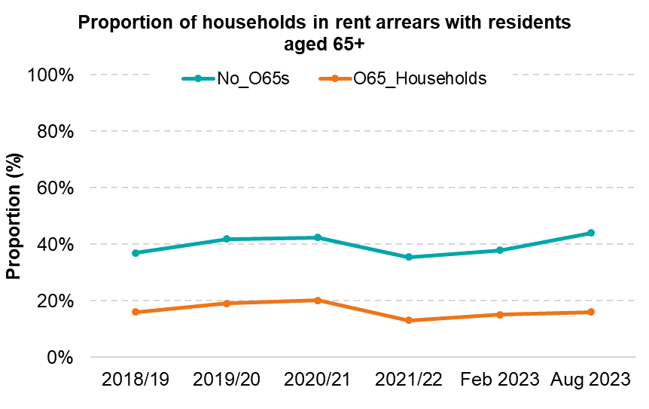
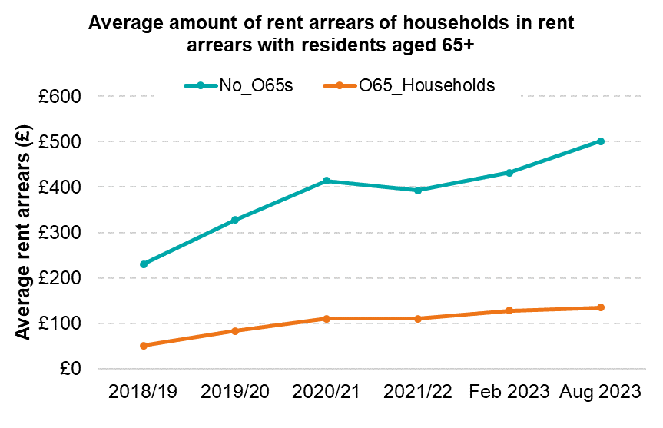
Households with over 65s have experienced a slightly less negative impact on rent arrears compared to other households.
A smaller proportion of households with over 65s are in rent arrears compared to other households. The trend in the percentage of households in arrears is flatter for households with over 65s compared to those without over 65s, suggesting households with no over 65s have experienced less severe effects.
The average amount of rent arrears has increased less among households with over 65s compared to other households, suggesting they have remained relatively better off.
Source: Islington Council Rent Arrears dashboard

Slide 65
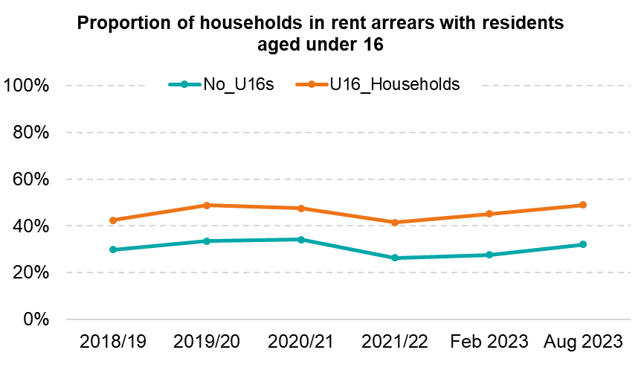
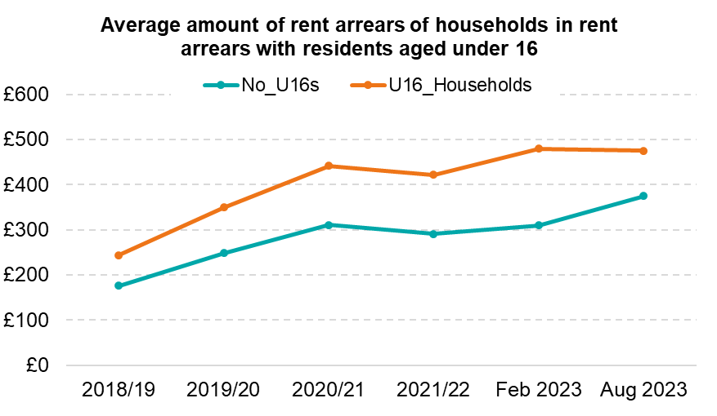
There is little evidence that households with under 16s have become relatively worse off in terms of rent arrears compared to other households.
The percentage of households in rent arrears have followed a similar trend among households with under 16s compared to other households.
The average amount of rent arrears among households with under 16s has also increased broadly in line with other households, as of August 2023. That said, while the average amount increased slightly more for households with under 16s as of February 2023, between February and August 2023 the average amount remained stable for these households, whereas it increased for other households.
As of August 2023, there were about 3,000 households with under 16s in rent arrears. The average amount of arrears was £475.
Source: Islington Council Rent Arrears dashboard

Slide 66
Although rent arrears is increasing, as a proportion of rent roll, Islington performs better than the London median.
The total amount of rent arrears is at its highest (£10M) and the average rent arrears per tenant has increased to £424 in 2023/24.
Although rent arrears is increasing, Islington benchmarks well against the London for rent arrears as a proportion of rent roll
Source: Local Authority Housing Statistics LAHS

Slide 67
Children and young people and education

Slide 68
Children and young people population
There are an estimated 68,480 number of children and young people aged 0-25 years in Islington, making up 30% of the total population.
12,383 are aged 5 and under and 35,682 under 18’s comprising 6% and 16% respectively.
Projections show the Islington population of children and young people is due to fall in future years.
Islington’s children and young population is more diverse than the overall population with an estimated 74% being non-white British.
64% of children aged 0-17 live in social housing.
Source: School census January 2024

Slide 69
Islington has a higher proportion of pupils of children with Special Educational needs with and without an Education Health and Care plan compared to London.
The number of pupils in Islington schools with an Education Health and Care (EHC) plan increased by 15.4% between 2021/22 and 2023/24. These include out of borough residents who attend Islington schools.
The largest change in EHC plans by the type of need is for EHC plans for Autistic Spectrum Disorders (ASD). The number of pupils with EHC plans for ASD in Islington schools has more than doubled between 2017/18 and 2023/24.
The second most common need is for Speech, Language and Communications needs, which have increased by 44% over the same period.
The third most common need is for Social, Emotional and Mental Health needs, and the number of EHC plans for these needs is rising the quickest, with a 133% increase between 2017/18 and 2023/24.
Note: Includes pupils with SEN support in state-funded schools and pupils with SEN without an EHC plan in Independent schools
Source: Special Educational Needs in England, Academic Year 2023/24, DfE Statistical First Release

Slide 70
Annual change in pupils with an Education & Health Care Plan or Statement of Special Education Needs (SEN).
On average, the number of pupils in Islington schools with an EHC plan has been increasing at an average rate of 8% a year over the last five years. This is during a period where the total school roll for Islington schools is falling at a rate of on average 1% a year.
The biggest percentage increase was seen between 2020/21 and 2021/22.
These increases are not limited to Islington – the number of pupils with an EHC plan across London has been increased at a rate of 9% a year.
Source: Department for Education

Slide 71
The primary need on Islington Education Health and Care plans is Autistic Spectrum Disorders.
Islington maintains the EHC plan for our resident pupils. These pupils often attending Islington settings, but a significant minority of these pupils attend settings outside of Islington. This group is a different group to those represented in the previous two slides, although the groups overlap.
The primary need on Education Health and Care plans maintained by Islington is Autistic Spectrum Disorders and this has risen steeply over the past 8 years compared to all other primary needs.
Social, Emotional and Mental Health needs are the second fastest growing primary need.
Source: Islington Council

Slide 72
The rate of children looked after in Islington is higher than London and England.
The rate of children looked after in Islington is higher than London and England and whilst the rate for London and England has remained consistent, in Islington, the trend has fluctuated each year.
Across the country, local authorities with higher rates of deprivation affecting children tend to have higher rates of children looked after.
Based on the relationship between levels of deprivation and rates of looked after children, Islington could expect to have a rate of 113 looked after children per 10,000 residents aged under 18 given the level of deprivation affecting Islington children. Islington’s rate of children looked after has never reached this level.
Source: Department for Education

Slide 73
Rates of children in need is significantly higher than London and England.
Children known to social care is a good indication of the increasing level of needs amongst families in the borough. The children in need rates looks at all children and young people with an open referral to children’s social care.
Only two years of comparable data are currently available, as revised historical population estimates were not available when the last data was published.
The Islington rate of children in need is consistently above the London and England rates. Again, authorities with higher levels of deprivation tend to have higher rates of children in need.
Source: Department for Education

Slide 74
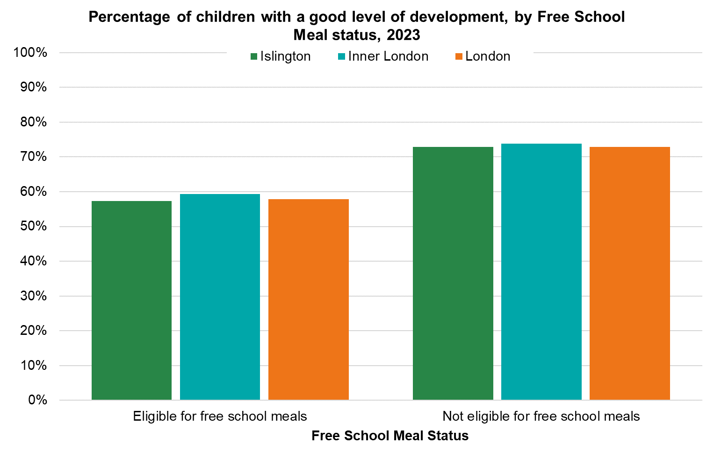
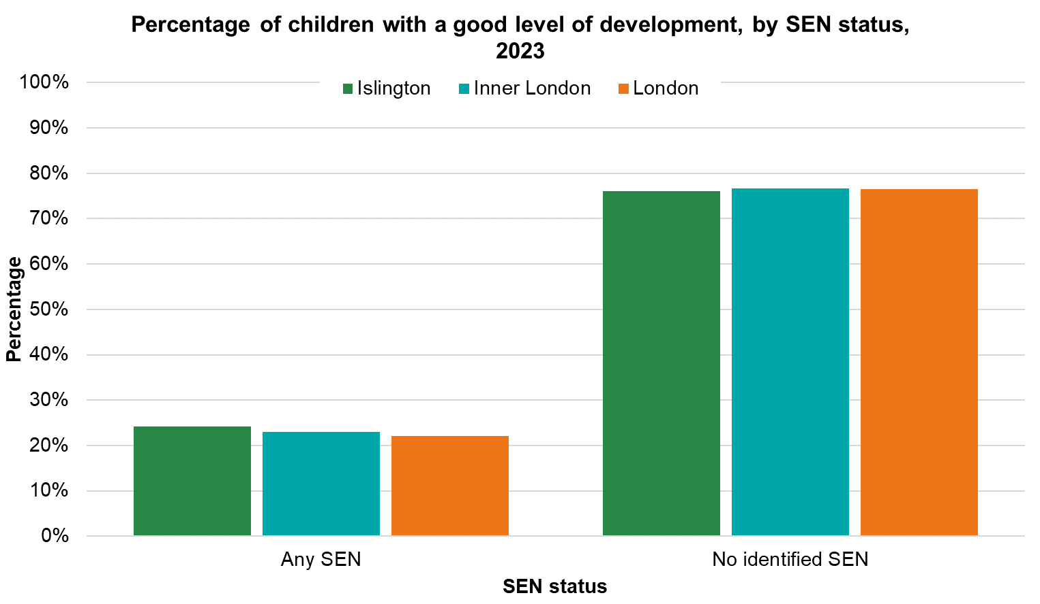
66.6% of Islington children had a Good Level of Development at age, but differences exist by Free School Meal status and Special Education Need status.
The percentage of children in Islington with a Good Level of Development (GLD) at age 5, in 2023 has improved from 2022 (64.7% to 66.6%) but remains just below England (67.2%) and Inner London figures (69.1%).
However significant inequalities exist:
57% of children eligible for free school meals (FSM) in Islington meet the expected school readiness standard, relative to 73% for children not eligible. Both figures are similar to Inner London and London.
Children with a Special Educational Need or Disability (SEND) are also significantly less likely to meet the standard (24%) than children without a SEND need (76%). This pattern is also seen in Inner London and London.
Islington has higher proportions of pupils eligible for FSM and/or with SEND, which explains why the overall results are below comparators.
Source: Department for Education

Slide 75
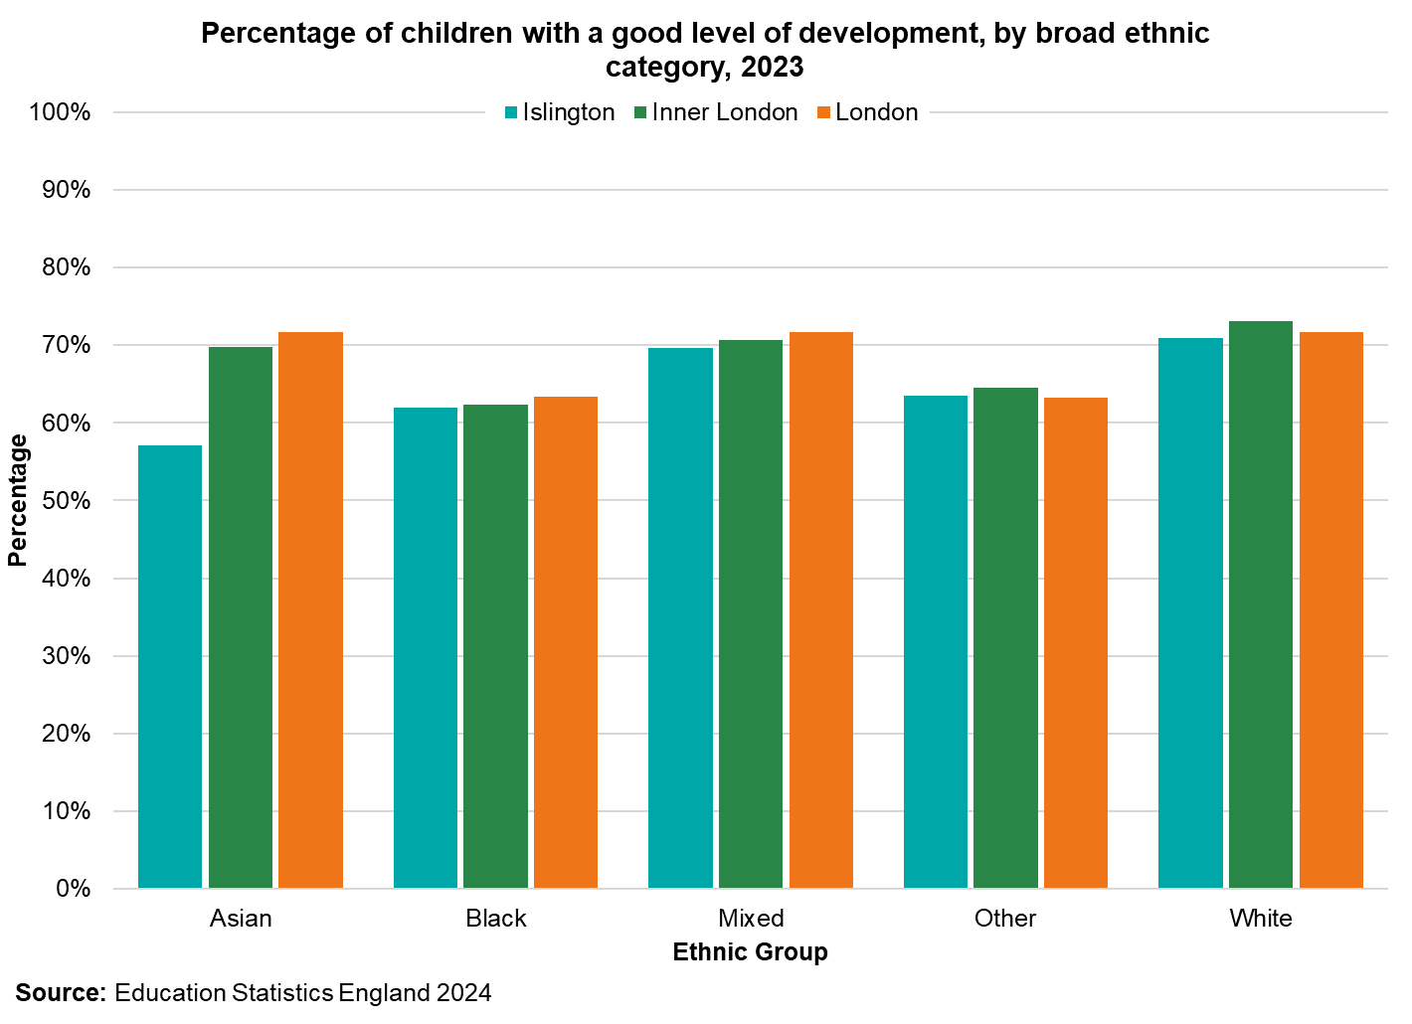
Good level of development by ethnicity is similar to Inner London and England.
Children identifying as White and Mixed in Islington had the highest proportion of GLD, whilst those identifying as Asian, Black and other in Islington are less likely to have a good level of development at age 5. For Asian children this is lower than Inner London and London but for Black children and those identifying as other it is similar.
The table shows the percentage of Islington children reaching the expected school readiness standard for 2021-22 and 2022-23 and the percentage difference in achievement between these two years by more detailed ethnic groups.
The percentage of children identifying as White-Other reaching a good level of development increased the most between the two years. A similar picture can be seen for children identifying as Turkish or from Any Other Ethnic Group, though a gap remains in overall achievement between this group and the Islington average.
Children identifying as Black African Somali and Bangladeshi have shown the greatest decline in reaching expected standards for school readiness between 2021-22 and 2022-23 alongside those without an ethnicity recorded, with overall proportions being lower than the Islington average too.
Ethnicity | 2021-22 | 2022-23 | % difference
Black - Other | 65.5 | 76.9 | 11.4
White - Other | 76.4 | 73.9 | -2.5
Asian - Other | 65.6 | 72 | 6.4
White - British | 67.8 | 71.5 | 3.7
Mixed - Other | 69.2 | 68 | -1.2
Mixed - White & Black Caribbean | 56 | 65.8 | 9.8
Black - African Other | 63.1 | 64.7 | 1.6
Any Other Ethnic Group | 50.4 | 63.1 | 12.7
Kurdish | 54.5 | 62.5 | 8
Black - Caribbean | 57.3 | 60.6 | 3.3
Turkish | 43.8 | 54.2 | 10.4
Black - African Somali | 60.9 | 54.1 | -6.8
Asian - Bangladeshi | 62.9 | 52.6 | -10.3
Not recorded/unknown | 53.1 | 48.7 | -4.4
England | 65.2 | 67.2 | 2
Islington | 64.7 | 66.6 | 1.9
Note: Once we break down the Islington cohort of children to this level of detail, some of the groups can be small. Results can be volatile, year-on-year, so caution should be used in interpreting the results for single years.
Source: Department for Education

Slide 76
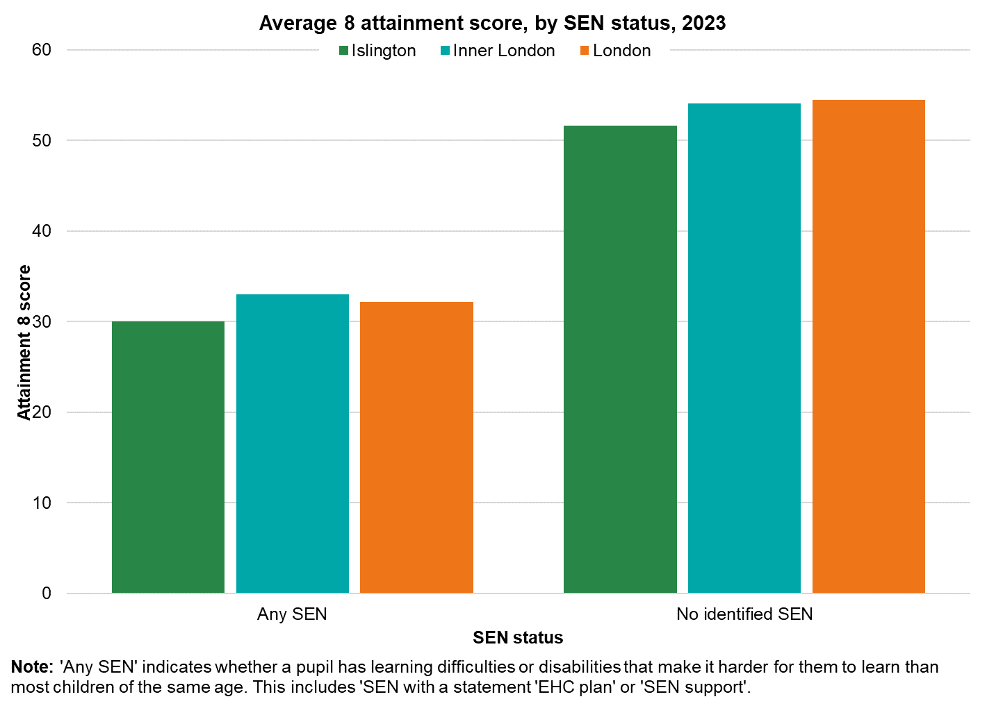
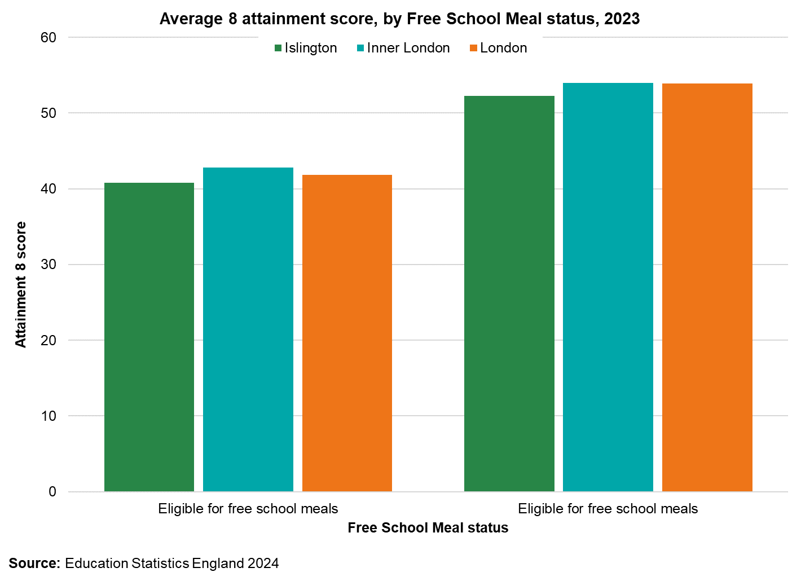
Key stage 4 attainment gaps exist by Special Educational Need and Free School Meal eligibility.
In 2023 pupils in Islington schools had lower average 'Attainment 8' score compared to Inner London (46.7 vs 49.7) but do slightly better than those across England (46.4).
The attainment gap for pupils with SEN and no SEN is higher than those for FSM eligibility and not eligible for free school meals
Note: Due to the COVID-19 pandemic, GCSE exams were cancelled in 2020 and 2021. Pupils’ grades were determined through other methods. Grade boundaries were changed in 2022 and again in 2023, so results in recent years are not comparable with each other.
Source: Department for Education

Slide 77
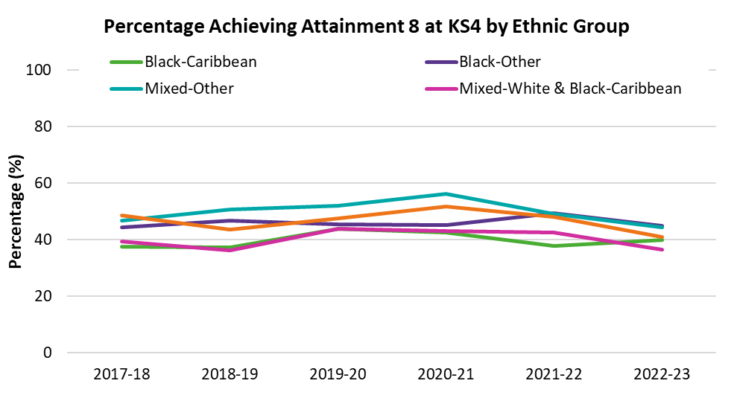
Key stage 4 gaps by ethnicity
The ethnicity gap continues towards the end of the school period. Asians now outperform all other cohorts as do the other cohort. The Black cohort and white cohort have lower achievement amongst the broad ethnic groups.
Amongst the Black cohort there are differences in attainment when results are broken down into more specific ethnic groups. Black African pupils have an average attainment score of 48.9 compared to the Black Caribbean group at 39.7. These differences are seen across Inner London and London.
In the mixed cohort it is the White and Black Caribbean ethnic group that have the lowest average attainment at 36.5 compared to 40 in Inner London and London.
Source: Department for Education

Slide 78
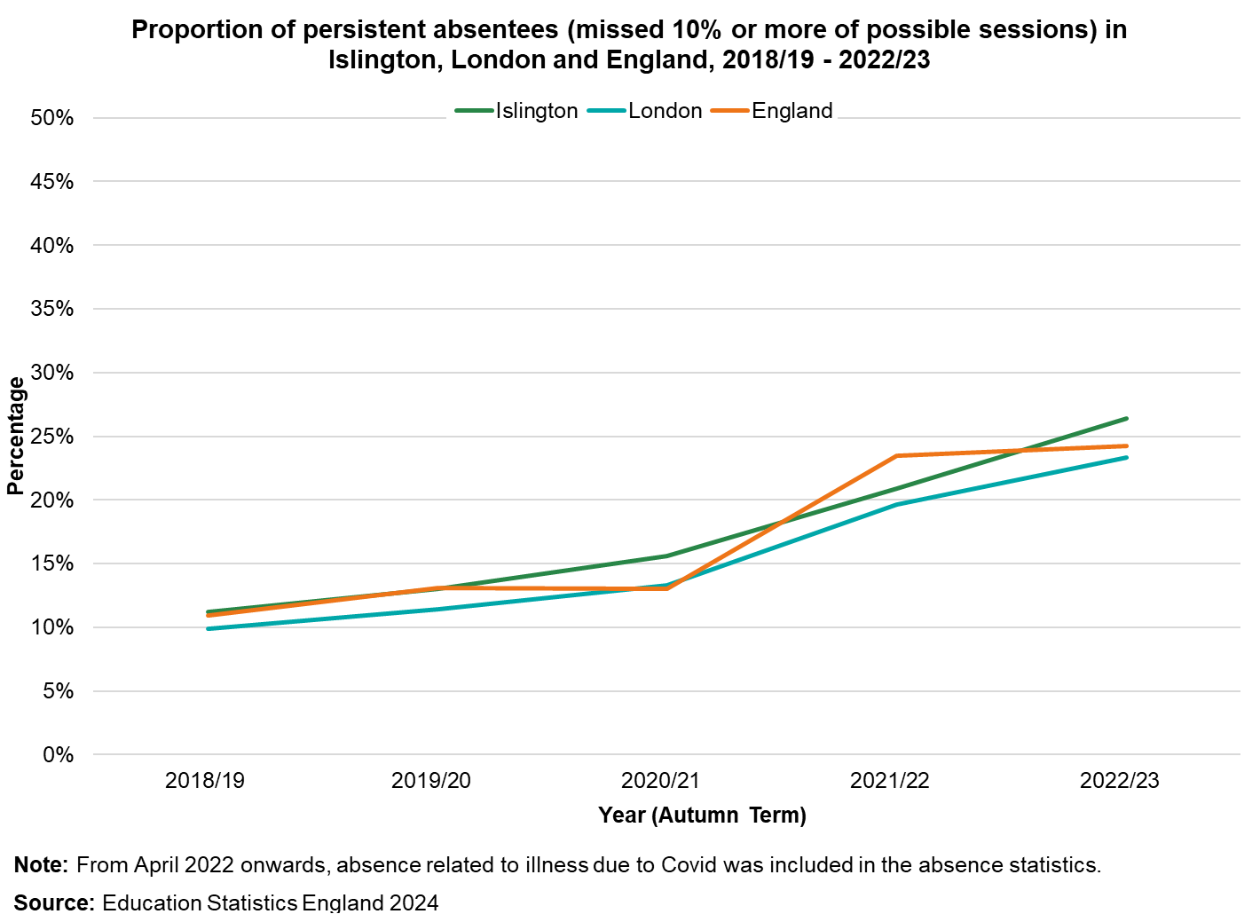
Persistence absence amongst Islington School children has been rising since 2020/21 as has it in London.
In 2022/23 approximately 5,000 children in Islington missed 10% or more of school sessions.
The trends in persistence absence has been rising in Islington since 2018/19, similar to London and England.
In April 2022, absence related to Covid started to be included in the statistics, whereas previously this had been included. Absence levels across the country increased after this change.
A lot of work is being undertaken to look at the reasons behind this increase, such as increases in Emotional Based School Avoidance.
Note: From April 2022 onwards, absence related to illness due to Covid was included in the absence statistics.
Source: Department for Education

Slide 79
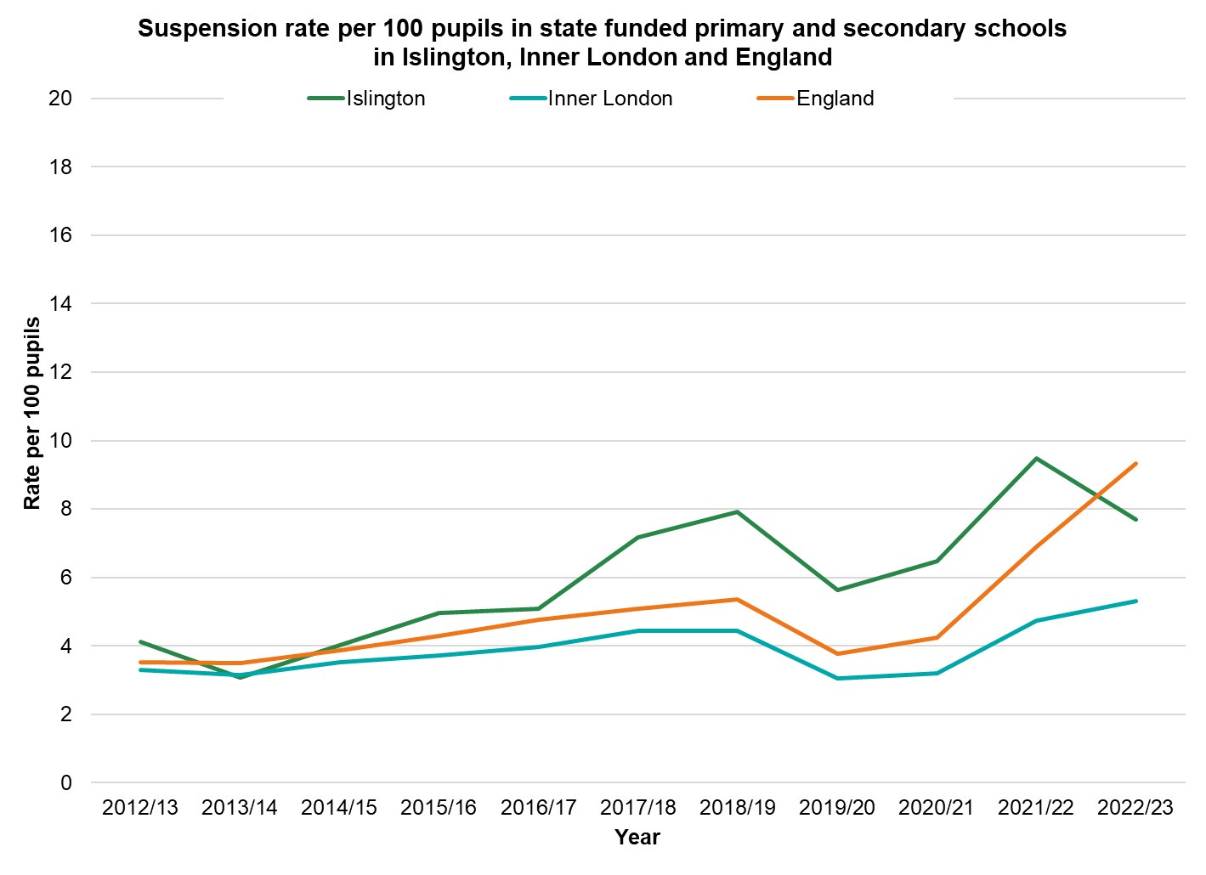
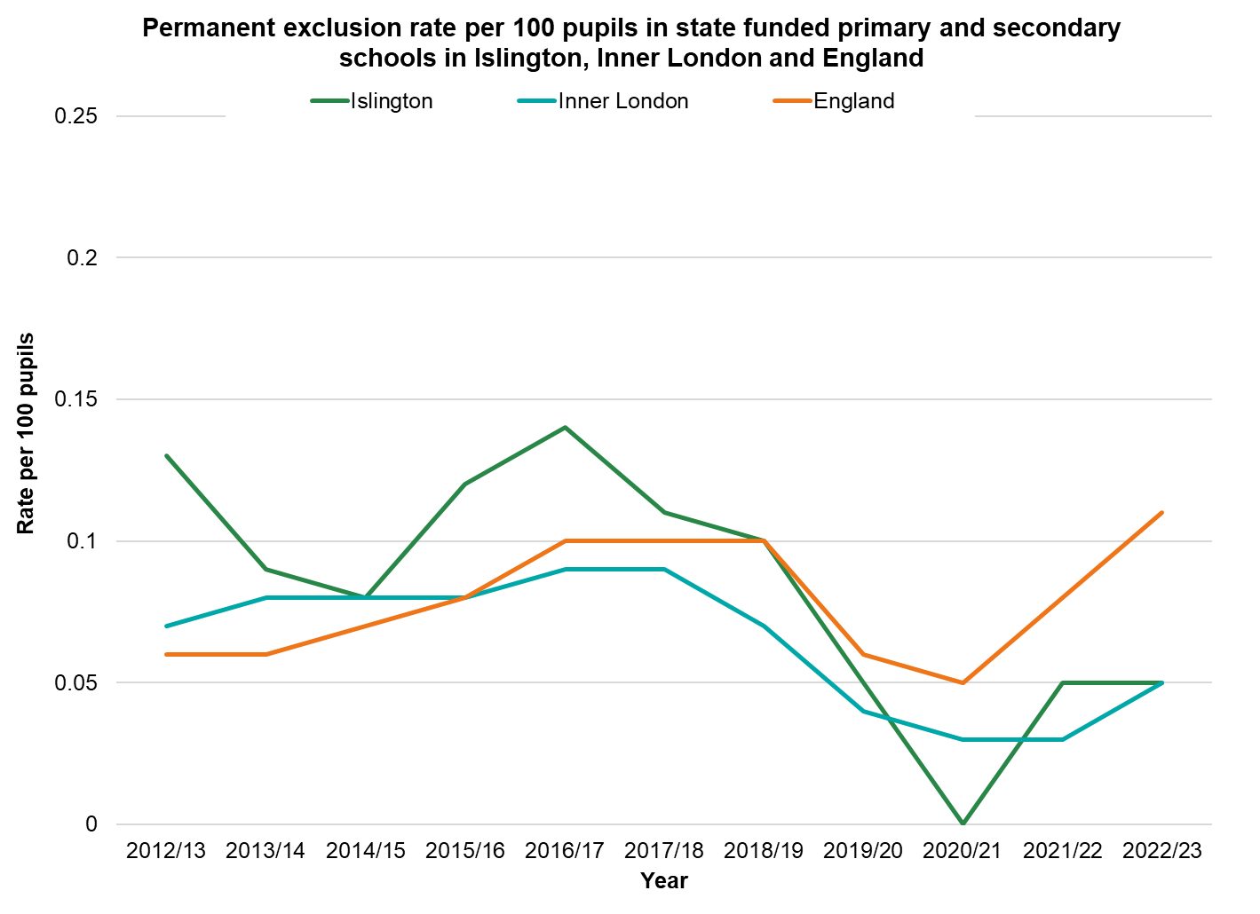
School suspensions and exclusions
The rate of suspensions from Islington schools has tended to be above the Inner London and England rates in recent years. However, the rate for England increased significantly in 2022/23, whilst the Islington rate fell to below the England rate.
The most common reason for suspensions is ‘persistent disruptive behaviour’, both in Islington and across England overall.
Suspension rates are highest for pupils who are eligible for Free School Meals, pupils with Special Education Needs and pupils from the Black-Caribbean and Mixed-White & Black-Caribbean ethnic groups, both in Islington and across England.
The rates of permanent exclusions are generally based on relatively low numbers of exclusions, so can be volatile, year on year. However, the Islington rate has been below the national rate in each of the last four years.
Note: For 2019/20 and 2020/21, while suspensions and permanent exclusions were possible throughout the academic year, pandemic restrictions will have had an impact on the numbers presented and caution should be taken when comparing across years.
Source: Department for Education

Slide 80
Environment and climate

Slide 81
Islington residents have some of the lowest access to green spaces in London.
Green spaces in Islington, such as parks and gardens, play a vital role in supporting health and wellbeing, but access in the borough is limited.
Islington has the second lowest proportion of green space in the country, with only 2.83 square meters per resident.
Despite this, most residents can reach a public park or green space within a 15-minute walk, and 71% of households have access to a private outdoor space.

Slide 82
Greenhouse gas emissions have decreased in Islington over the past 10 years, with the biggest reduction seen in the commercial sector.
In Islington emissions from Commercial and domestic buildings are responsible for 70% of total greenhouse emissions
Greenhouse gas emissions have decreased in Islington over the past 10 years, with the biggest reduction seen in the commercial sector 56% from 2010 - 2022.
Compared to London Islington has achieved a 23% reduction in GHGs emissions between 2017 and 2022, higher than that of London (17%) and 20% reduction in CO2 emissions, higher than that of London (17%).
Source: Department for Energy Security and Net Zero

Slide 83
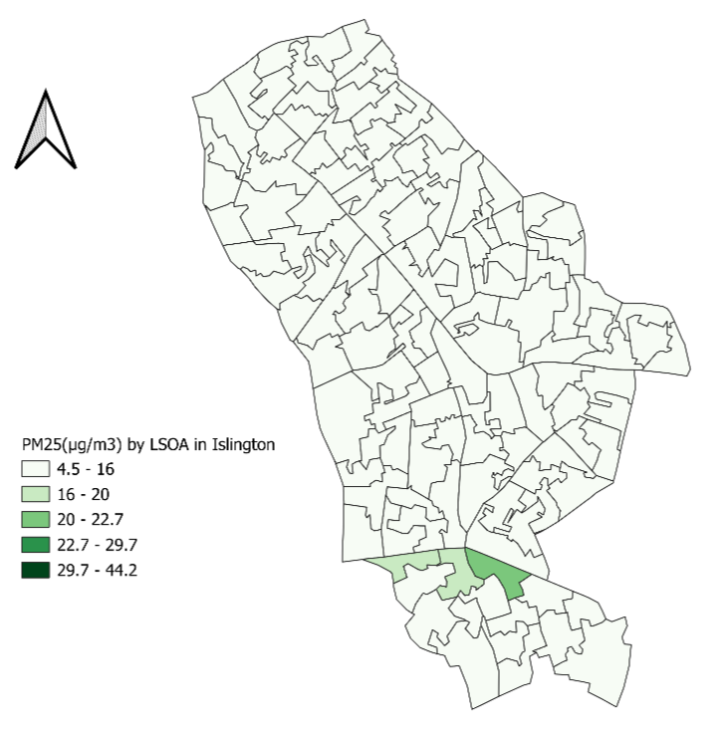
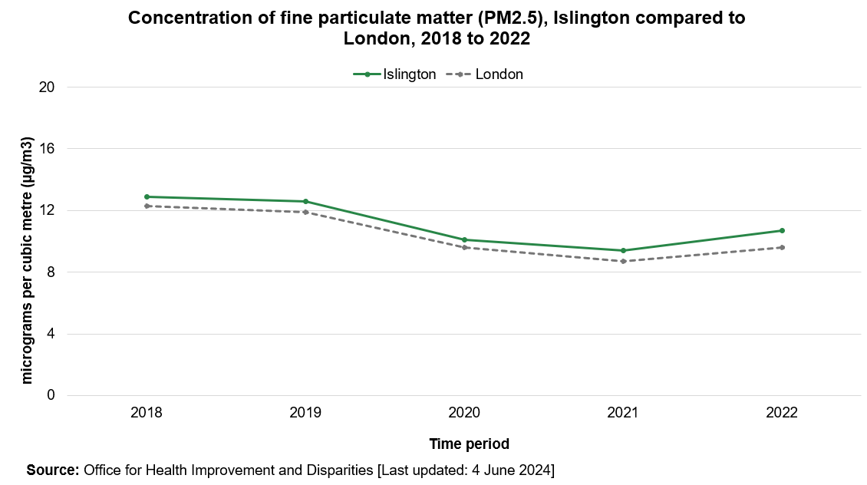
Air pollution
The boroughs fine particulate matter (PM2.5) level is 9.1 ug/m3, is higher than the London of 8.7 ug/m3 and England's 7.4ug/m3. Road traffic is a significant source of this pollution.
Concentration of PM2.5 had been declining since 2018 like London but has slightly risen between 2021 and 2022.
Source: GLA, 2022

Slide 84
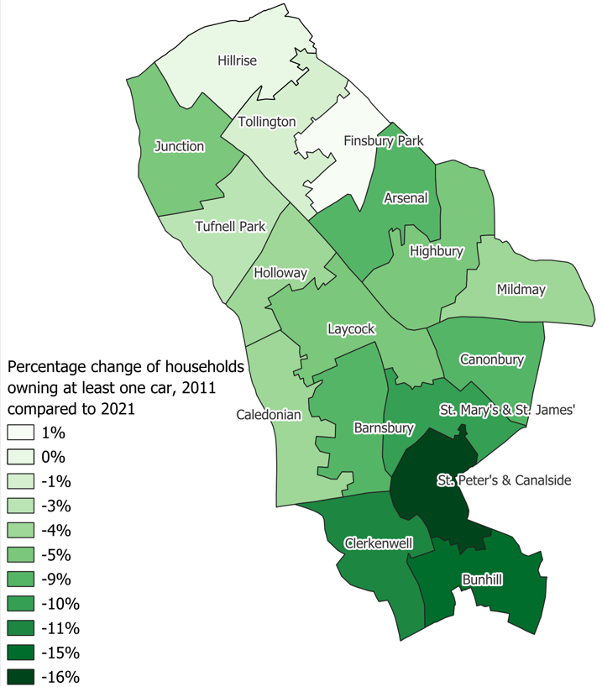
Car ownership amongst Islington residents is lower than London overall and has been declining since 2019.
Source: Department for Transport and Driver and Vehicle Licensing Agency; Census 2011 and 2021
Notes:
Finsbury Park - total number of households with cars increased from 1,604 to 1,782. % change in proportion of households is +10%; % change in car ownership is +1%. We don't have the actual number of cars at the ward level and the Dft/DVLA data provides number of registered vehicles at the borough level. At the same time, if we look at St. Peter's, % of households increased by 26% but car ownership has decreased by 16%. I wonder if this indicate differences in factors like public transport availability, urban planning, or shifts in lifestyle preferences.

Slide 85
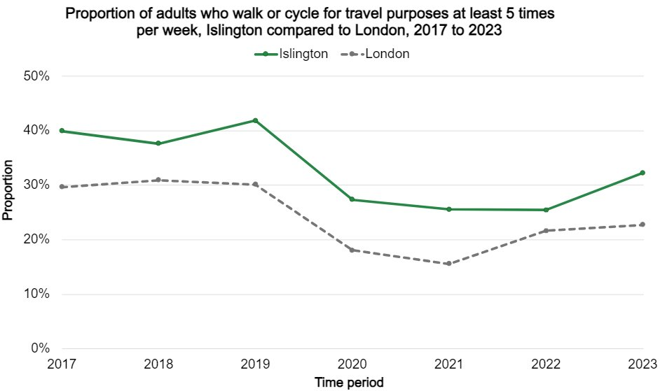
Almost 50% of the borough is now a Low traffic neighbourhoods, the second highest amongst inner London boroughs.
The proportion of adults who walk or cycle for travel purposes at least 5 times per week is consistently higher in Islington compared to London throughout the years. The proportion in Islington peaked in 2019 at 42% followed by a decline most likely due to the pandemic. However, there has since been an increase in the proportion from 2022 (25%) to 2023 (32%).
Note: Data is based on respondents who are 16 years old and over; Data for 2020, 2021 and 2022 is likely influenced by the COVID-19 pandemic
Source: Healthy Streets Scorecard; Sports England Active Lives Survey 2024

Slide 86
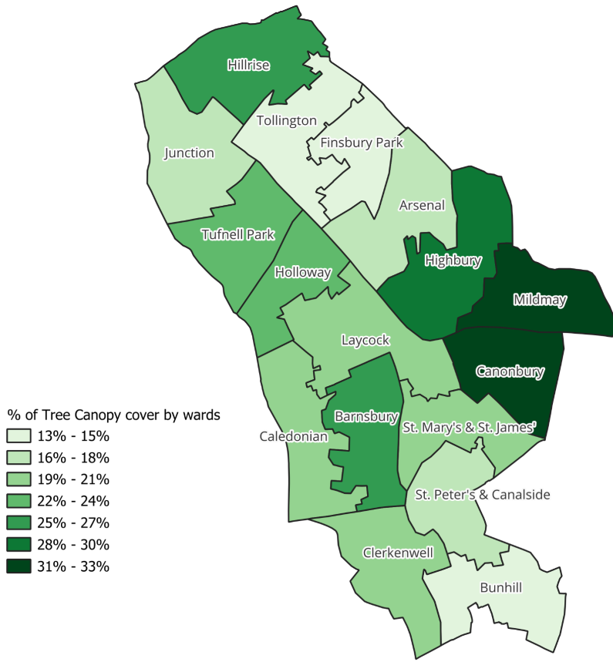
Overall climate risk
Recent climate vulnerability mapping using a variety of metrics on vulnerability (age, income, ethnicity matched against risks of surface water flooding, tree cover, air pollution measures) shows that Islington (in particular the south of the borough) is at particularly high risk of impacts from surface water flooding and overheating (Mayor of London, 2021). There are additional high-risk areas in the central part, including Laycock Ward, and the northern region, including Finsbury Park Ward.
Source: GLA and Bloomberg Associates, Climate Risk Mapping 2024
Source: GLA, Tree Canopy Cover 2024

Slide 87
Health and Wellbeing

Slide 88
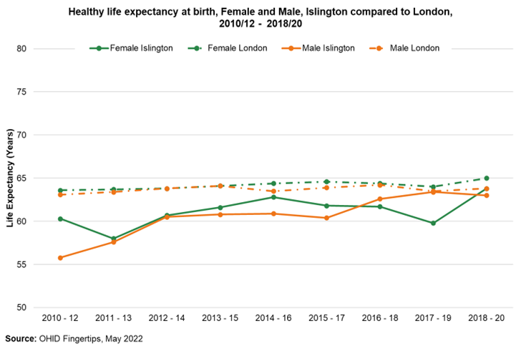
Life expectancy in Islington is higher for females than males in Islington but has been slowing down in recent years, primarily due to the impacts of COVID.
A female born in Islington can expect to live to 82.6 years compared to 83.6 in London. This is longer than a male born in Islington, who can expect to live to 78 years compared to 79.1 in London.
Healthy life expectancy (HLE) provides an estimate of lifetime spent in good health, without suffering from significant illness or disability. It considers both the length of life and the quality of life. On average healthy life expectancy for males and females in Islington is lower than London but has been improving. For Males is it 63 years compared to 63.8 in London and for females its is 63.8 years compared to 65 years in London.
Source: OHID Fingertips

Slide 89
Healthy life expectancy for males and females aged 65+ in Islington had been increasing until 2016-18. It has subsequently continued to rise for females whilst for females has dipped.
Healthy life expectancy (HLE) provides an estimate of lifetime spent in good health, without suffering from significant illness or disability in those aged 65 and over. It considers both the length of life and the quality of life.
For Males in Islington healthy life expectancy at 65 years is 11.2 years versus 10.3 years for London and for females it is 8.9 years compared to 11.2 years in London.
Source: OHID Fingertips

Slide 90
Inequalities in life expectancy at birth in Islington has been increasing more significantly for males than females and is higher than London.
Breakdown by each local deprivation decile shows that the widening inequality gap within Islington for males has been driven by an exceptionally rapid increase in life expectancy among people living in the least deprived parts of the borough, particularly for men. For people living in the other 80 to 90 percent of the borough, the trend in life expectancy by deprivation decile has been broadly similar, with life expectancy falling in 2018–20 in some of Islington’s more deprived deciles.
For females, the gap is less stark and has not changed significantly over the last decade.
Note: (1) Most deprived decile refers to the most deprived 10% of LSOAs and (10) Least deprived decile refers to the least deprived 10% of LSOAs within the borough
Source: OHID Fingertips

Slide 91
Cancer, circulatory disease and COVID19 were the biggest contributors to the inequality in life expectancy gap.
Top 5 contributors to the life expectancy gap, by contributing years​
Cause​ | Male (years)​ | Female (years)​
Other​ | 1.19​ | 1.47​
COVID-19​ | 0.57​ | 1.07​
Lung cancer​ | 0.83​ | 0.63​
Chronic lower respiratory diseases​ | 0.28​ | 0.77​
Other cancer​ | 0.28​ | 0.75​
Source: Segment Tool, OHID [Last Updated: January 2023]

Slide 92
The rate of preventable deaths from cancer is higher amongst Islington males and females compared to London and England.
Deaths from many cancers can be prevented by effective early intervention. These include lung, liver, skin, cervical, and female breast cancers.
In Islington, males are twice as likely to die from preventable cancers than females (95 per 100,000 compared to 44 per 100,000 in 2020-2022).
For both, the rate of mortality from preventable cancers has been decreasing since 2001-2003.
Source: OHID Fingertips; Avoidable mortality methodology

Slide 93
Preventable mortality from circulatory disease has been decreasing in Islington, following a similar trend to London.
Preventable deaths from circulatory diseases include hypertension, ischemic heart disease, and cerebrovascular diseases
In Islington, males are twice as likely to die from preventable cardiovascular diseases than females (50 per 100,000 compared to 19 per 100,000 in 2020-2022).
There has been a drastic decrease in the rate of mortality among males from a peak of 118 per 100,000 in 2001-2003.
The rate among females has remained relatively stable since 2011-2013.
Source: OHID Fingertips; Avoidable mortality methodology

Slide 94
Preventable mortality from respiratory disease for males shows a sharp increase between 2012-14 and 2019-21 and has since showing signs of decline.
In Islington, males are twice as likely to die from preventable respiratory diseases than females (31 per 100,000 compared to 15 per 100,000 in 2020-2022).
The mortality rate among males had been decreasing from 2001-2003, before increasing again in 2013-2015. It appears that the rate has started to drop again in the most recent years.
Source: OHID Fingertips; Avoidable mortality methodology

Slide 95
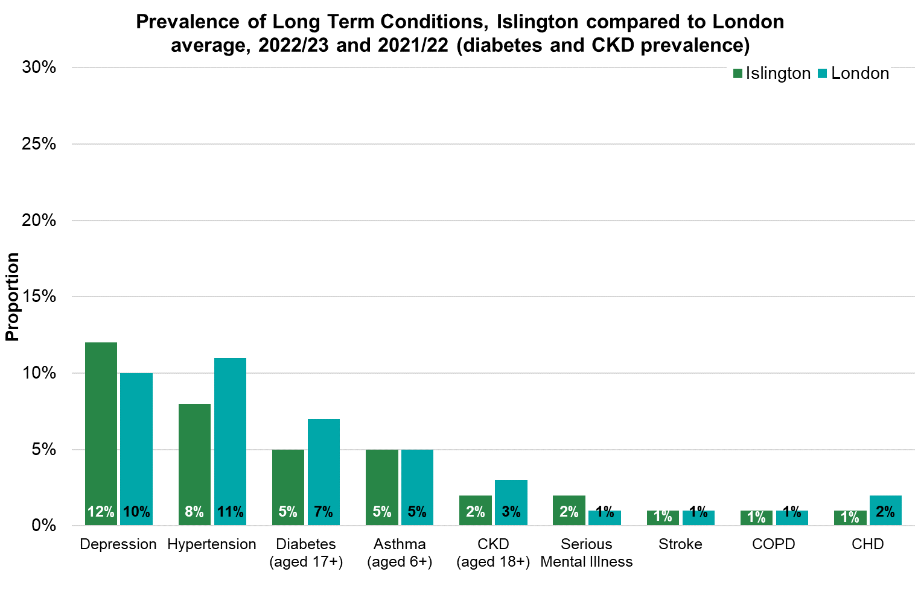
31% of Islington's population has at least 1 Long Term Condition (2024).
Long Term Condition | Number diagnosed in Islington | % diagnosed in Islington
Depression | 30,526 | 12%
Hypertension | 23,401 | 8%
Asthma (aged 6+) | 13,536 | 5%
Diabetes (aged 17+) | 11,116 | 5%
Serious Mental Illness | 4,280 | 2%
CKD (aged 18+) | 3,878 | 2%
CHD | 3,819 | 1%
COPD | 3,784 | 1%
Stroke | 2,690 | 1%
Source: Quality Outcome Framework 2022/23, Quality Outcome Framework 2021/22 (diabetes and CKD prevalence), HealtheIntent 2024

Slide 96
The proportion of people living with at least one long term conditions increases with deprivation.
The proportion of people living with at least one long term condition increases with deprivation.
34% of people in the most deprived area have at least one long term condition. 7% have 2 long term conditions and 6% have 3 or more long term conditions.
Source: HealtheIntent Population Health Needs and Inequalities dashboard [Data accessed on 03/09/2024]

Slide 97
11% of people in Islington live with two or more long-term conditions.
5% of people in Islington have 3 or more long term conditions.
41% of people from a Black ethnic group have at least one long term condition, with 17% having 2 or more long term conditions
Source: HealtheIntent Population Health Needs and Inequalities dashboard [Data accessed on 03/09/2024]

Slide 98
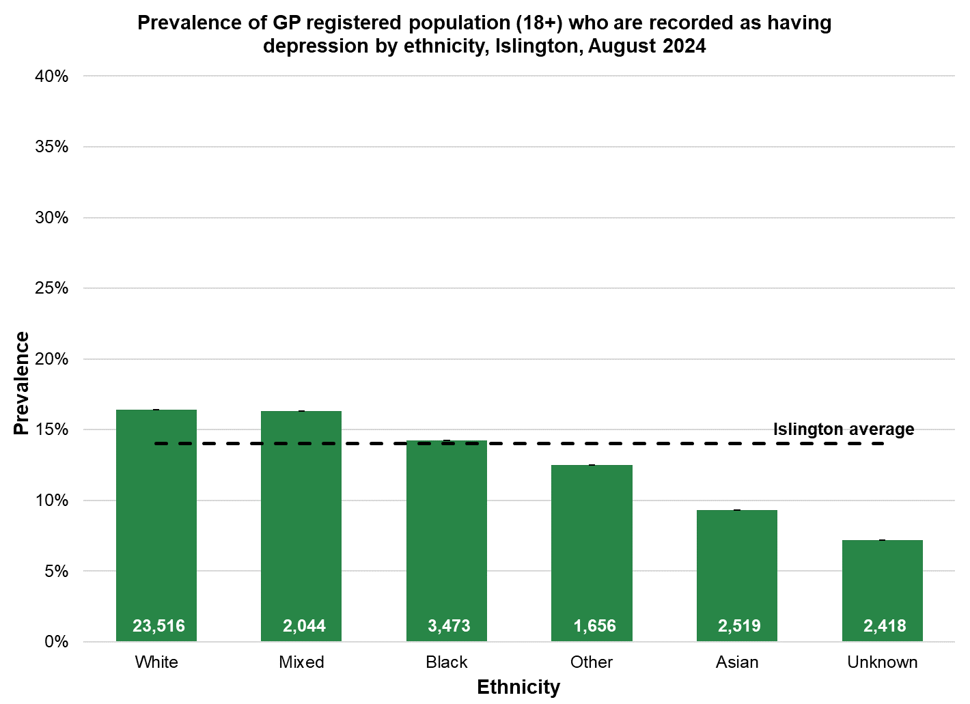
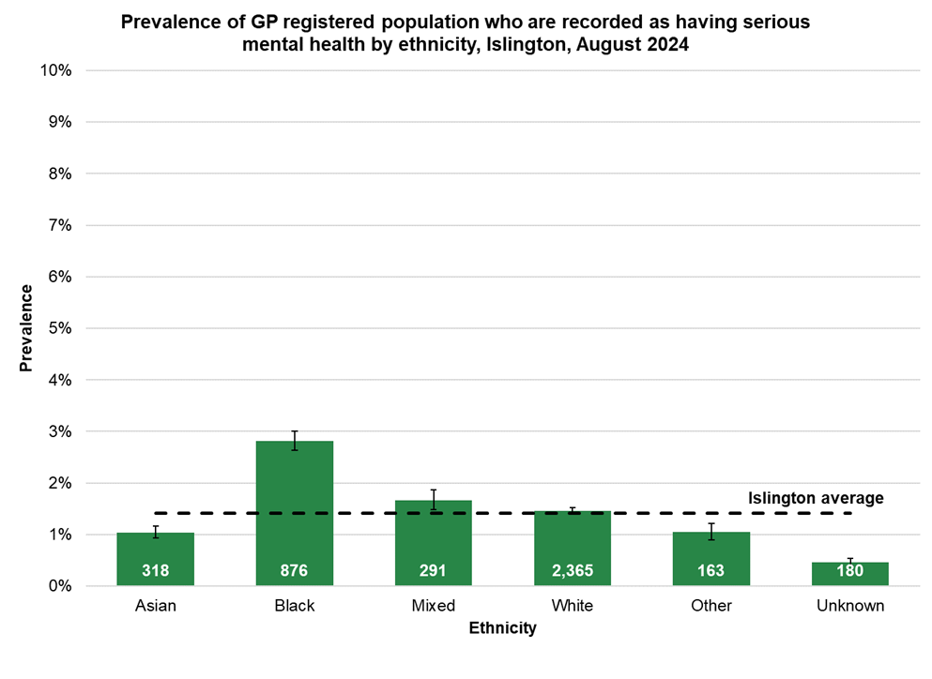
Islington has the second highest prevalence of people diagnosed with Serious Mental Illness and Depression in London. Second to Hackney.
People from a Black ethnic group (2.8%) are significantly more likely to be diagnosed with a serious mental health condition (schizophrenia, bipolar affective disorder and other psychoses) than all other ethnic groups.
People from a White ethnic group or Mixed ethnic have a higher prevalence of diagnosed depression compared to the Islington average.
Note: Data label refers to count.
Source: HealtheIntent Population Health Needs and Inequalities dashboard [Data accessed on 06/08/2024]

Slide 99
Smoking prevalence in Islington has been declining over the last decade but remains high in certain populations.
Approximately 42,000 (17%) of Islington's adult population are registered by their GP as being current smokers. More people smoke in Islington than the London average, but in both Islington and London the rate has been decreasing since 2013/14.
Smoking prevalence varies by 7.8% across the different ethnic groups, with 19.5% of people from a White ethnic group recorded as smokers, compared to 11.7% in an Asian ethnic group.
Note: Data label refers to count.
Source: HealtheIntent Population Health Needs and Inequalities dashboard [Data accessed on 06/08/2024]

Slide 100
2.4% of Islington’s population are recorded by their GP as being dependent on alcohol.
The largest number of people with alcohol dependency live in the more deprived areas of Islington.
People from a White ethnic background have the highest rate of alcohol abuse or dependency at 3.5% whereas people from an Asian ethnic background have the lowest at under 1%.
2% of men and 3% of women are recorded as having alcohol dependency.
Note: Data label refers to count.
Source: HealtheIntent Population Health Needs and Inequalities dashboard [Data accessed on 06/08/2024]

Slide 101
20% of Islington’s adult population are recorded by their GP as being overweight, 12% are recorded as obese and 2% as severely obese.
The prevalence of overweight, obese and severely obese increases with age, with around a quarter of people aged 50+ above normal weight.
40% of people from a Black ethnic group are obese or very obese. This is significantly higher than all other ethnicities.
The prevalence of overweight, obese, and severely obese increases as deprivation increases, with almost half of people living in the most deprived areas of Islington above normal weight.
Note: BMI is adjusted for ethnicity according to NICE guidance
Note: Data label refers to count.
Source: HealtheIntent Population Health Needs and Inequalities dashboard [Data accessed on 06/08/2024]

Slide 102
People in the ‘Other ethnic group’ has the poorest health, among those aged 65+.
Data from the 2021 census shows the number of people who self-reported their health as being bad or very bad.
People from an ‘Other’ ethnic group had the worst self-reported health, which started at aged 35-49 and peaked in aged 65+ where 29% reported their health as bad or very bad.
The Asian/Asian British ethnic group has the second highest proportion of people aged 65+ who are in bad or very bad health (23%, also about 320 persons). There is no noticeable difference, however, between Asians and other ethnic groups in the younger age bands.
Source: Census 2021

Slide 103
The number and proportion of residents who are living with a disability has increased since 2011.
This trend contrasts that seen in London overall.
This rise is due to more people living with disabilities who are limited a little in their daily activities. The proportion and number of people living with disability who are limited a lot has decreased in Islington, as well as London.
Islington has the highest proportion of people living with disabilities who are limited a lot in London.
Laycock, Hillrise, and Tufnell Park have the highest proportions of residents living with a disability.
N=32,271
N=35,063
Source: Census 2011 & 2021
Notes:
The number and proportion of residents who are living with a disability has increased since 2011 to 16.2%. This trend is primarily driven by an increase in people living with disabilities who are limited a little in their daily activities. To contrast, across London overall there has been a decrease in the proportion of people living with a disability.
Islington has the highest proportion of residents living with a disability in London.
The proportion of residents living with a disability is highest in Laycock, Hillrise, and Tufnell Park wards.

Slide 104
Islington adult social care supports significantly more residents compared to London.
Islington’s adult social care supports 10,475 residents per 100,000 aged 65 and over. This gives Islington the 4th highest rate among all London boroughs.
Islington’s adult social care supports 910 residents per 100,000 aged 18-64. This gives Islington the 10th highest rate among all London boroughs.
The reasons people receive adult social care support include:
Physical Support – 60%
Learning Disability – 24%
Mental Health – 11%
Memory and Cognition – 5%
Sensory < 1%
Social Support < 1%
Source: ASCRF

Slide 105
Just over 60% of children registered with an Islington GP have had all their vaccinations, with the lowest uptake amongst the Black community.
There are significant differences in the uptake of childhood vaccinations amongst children registered with Islington GPs.
Only around half of children from Black ethnicities have received all of their vaccinations by 5 years old (ranging from 53% among Black Caribbean children to 57% among Black African and Other Black ethnic groups).
Note: Data label refers to count.
Source: HealtheIntent Childhood vaccinations dashboard [Data accessed on 02/09/2024]

Slide 106
Crime and safety

Slide 107
Islington has a lower positive perception to the police compared to London as a whole.
 | % Of Islington respondents 12 months to March 2024 | London MPS 12 Months to March 2024
Trust in the police | 62% | 69%
Agree the police listen to the concerns of local people | 52% | 56%
Agree the police can be relied upon to be there when needed | 56% | 59%
Agree the police treat everyone regardless of who they are. | 53% | 61%
Agree the police are dealing with things that matter most to this community | 53% | 56%
Overall Islington generally has a lower positive perception to the police compared to London when asked about questions related to Trust and Confidence of the Metropolitan Police Service.
These perceptions have been declining overtime for Islington and for London as a whole.
Source: MOPAC Public Attitude Survey – Trust and confidence

Slide 108
Theft and violence against a person make up 50% of notified crimes in Islington.
In 2023/24 there were approximately 29,100 offences reported to the police in Islington.
Theft makes up most reported offences followed by violence against a person. This distribution has remained the same over the past 5 year and is similar to what is seen in London overall.
Source: Metropolitan Police Box, locally analysed

Slide 109
Islington ranked 8th highest out of all London boroughs for theft in 2023.
Theft is mostly the stealing of belongings while the owners are distracted or have left them unattended. Theft does not include robbery which is a more direct and aggressive crime, often accompanied with intimidation. Islington is one of the most densely populated areas in the UK per square metre, and theft and population density have a very strong correlative relationship.
The borough ranked 8th highest (out of 32) for theft in 2023. Islington has at times had a 25% above average (compared to London) rate of theft over the last 6 years which has inflated our crime rates overall slightly.
Theft is up 27.4% across London from 2018 while Islington has seen only a 9% rise over the last 5 years
Source: Metropolitan Police Box, locally analysed

Slide 110
Since 2020 Islington’s rate of violence against a person has been rising like London.
In 2023 there were on average 7,100 reported incidents of violence against a person.
Violent offences across London are up by 19% from 2018 but only up by 9% in Islington within the same period, ranking us 21st out of 32 boroughs.
Source: Metropolitan Police Box, locally analysed

Slide 111
The volume of hate crime in Islington had been rising since 2020 and has reduced in the latest period.
Islington is a diverse residential borough which generally falls below the London average for hate crime.
In 2023 there were on average 3,400 reported incidents of hate crime in Islington.
Racist and religious offences were the most common type of hate crime reported followed by homophobic crime.
Finsbury Park is the area in Islington that sees the highest volume of hate crime.
Source: Metropolitan Police Box, locally analysed

Slide 112
The volume of reported domestic abuse incidents saw an increase during lockdown and have reduced in the recent period.
In 2023, there were on average 2,500 reported incidents of domestic abuse.
The volume of reported domestic abuse incidents saw some increased levels during lockdown periods in Islington and have shown a reduction in the recent year.
However, it should be noted that levels of domestic abuse tend to be under reported.
Domestic abuse victims identifying as Black are overrepresented amongst victims.
Source: Metropolitan Police Box, locally analysed

Slide 113
The rate of first-time entrants to the youth justice system is higher than London and England but has been declining.
Around a decade ago, Islington had one of the highest rates of First Time Entrants to the Youth Justice System in the country.
Islington’s rate has gradually reduced over time and the gap between Islington’s rate and the London and England rates has narrowed.
Islington has also seen reductions in the levels of re-offending amongst under-18-year-olds and the rate at which Islington young people are given custodial sentences has also reduced over time from historical high levels.

Slide 114
Community cohesion and belonging

Slide 115
When considering safety after dark, the proportion feeling safe within Islington (62%) is 11-percentage points below the latest national benchmark, with one in five feeling unsafe.
Islington
LGA Benchmark October 2023
The proportion of those who feel unsafe after dark is 6-percentage points higher than the benchmark (21% vs. 15%)
Those 16-34 are significantly more likely to feel safe after dark (66%) while those aged 75+ are significantly less likely (48%)
In line with earlier findings, females are significantly more likely to feel unsafe after dark than men (27% vs 13%). Comparatively, more than one in five men report feeling very safe (22%) after dark
Once again, social renters are reporting lack of safety, with significantly more likely to feel unsafe after dark (25%) when compared to homeowners (19%) and private renters (16%)
Households with dependent children are also significantly more likely to feel unsafe after dark when compared to those without (34% vs. 17%)
15%
Very safe
62% Safe
73% Safe
47%
Fairly safe
11% Neither
17%
Neither
15%
Fairly unsafe
21% Unsafe
15% Unsafe
6%
Very unsafe
Base size: 1,039
Q16. How safe or unsafe do you feel when outside in your local area? : After dark

Slide 116
Less than half of respondents agree that they have a say about the decisions made in the local area, with almost the same proportion in disagreement.
Levels of agreement and disagreement are mostly consistent across all subgroups.
Residents without limitations due to health problem or disability are significantly more likely to agree with this metric (51%) while 56% of those limited a lot are significantly more likely to disagree that they have a say in decisions in their area.
Those limited by health issues or disabilities are significantly more likely to report lower levels of trust
Those who identify as being of Black ethnicity are significantly more likely to disagree (51%) that they have a say in decision making
Those living at the address for 10+ years are significantly more likely to disagree (28%) while a quarter of those living in the area less than a year are significantly more likely to report ‘don’t know’ (25%)
Islington
7%
Definitely Agree
49%
Agree
42%
Tend to agree
25%
Tend to disagree
42%
Disagree
17%
Definitely disagree
9%
Don’t know
Base size: 1,039
Q13. Do you agree or disagree that you personally can have a say about decisions in your local area?

Slide 117
77% of Islington residents agree that their local area is a place where people from different backgrounds get on well together.
Islington
26%
Definitely agree
Agreement is significantly higher for those who identify as being of White ethnicity (79%)
Disagreement is significantly higher among males (22% vs. 17%), those who identify as being of Black ethnicity (31%) and those who identify as being Muslim (34%)
Disagreement is also significantly more likely to be true of those limited a lot by health problems or disabilities (28%)
77%
Agree
51%
Tend to agree
12%
Tend to disagree
19% Disagree
7%
Definitely disagree
3%
Don’t know
4% Don’t know or people of same background
1%
All same/too few people
Base size: 1,039
Q9. Do you agree or disagree that your local area is a place where people from different backgrounds get on well together?

Slide 118
More than four in five feel strongly that they belong to their local area, with 37% feeling this very strongly.
37%
Very strongly
Islington
Sense of belonging increases with age, with those 55-74 (92%) and 75+ (96%) significantly more likely to feel this way, while 16-34 are significantly more likely to disagree (22%)
Feelings of belonging are also significantly higher among social renters (89%) while significantly less so among private renters (74%)
Tenure of 10+ years are significantly more likely to agree (92%) while those of less than a year significantly less likely (63%)
Despite low agreement that people from different backgrounds get on well together, those limited a lot by health problems or disabilities have a significantly stronger sense of belonging (92%)
83%
strongly
46%
Fairly strongly
14%
Not very strongly
16%
Not strongly
2%
Not at all strongly
*%
Don’t know
Base size: 1,039
Q8. How strongly do you feel that you belong to your local area?

Slide 119
Two in three Islington residents have high or very high trust in other people (64%). One in nine (11%) display a low level of trust in others.
Trust is significantly higher among those who identify as being of White ethnicity, with a mean score of 6.9. More than half of this group rate trust as ‘high’ (56%). Trust is significantly more likely to be ‘low’ among those who identify as being of Black ethnicity (22%)
Households with dependent children also report significantly lower levels of trust (19% vs. 9% without dependent children)
Homeowners are significantly more likely to report trust as ‘high’ (58%) while social renters report low levels of trust (14%), despite their higher sense of belonging
How much do you think people can be trusted?
14%
Very High
64%
High
50%
High
25%
Medium
Mean score
6.8
11%
Low
Mean score by tenure
October 2023
Owned | Social rented | Private rented
7.1 | 6.5 | 6.8
Base size: 1,039
Q10. On a scale where 0 (zero) is not at all and 10 (ten) is completely, in general how much do you think people can be trusted?

Slide 120
Just under nine in ten Islington residents report having a ‘good’ amount of social contact with people they like (86%), with only 3% feeling socially isolated.
Those 16-34 (48%), those who identify as being of white ethnicity (47%) and those without limitation due to health or disability (46%) are significantly more likely to report having as much social contact as the want
Having as much social contact as desired decreases with age; those aged 75+ are significantly more likely than other ages to report having not enough social contact (20%) and feeling socially isolated (9%)
Social isolation is also significantly more likely to be true of those limited a lot (11%) or limited a little (6%) by health problems or disability
I have as much social contact as I want with people I like
43%
I have adequate social contact with people I like
43%
I have some social contact with people I like, but not enough
11%
I have little social contact with people I like and feel socially isolated
3%
Base size: 1,039
Q17. Thinking about how much contact you’ve had with people you like, which of the following statements best describes your social situation:

Slide 121
Six in ten Islington residents report hardly ever or never feeling lonely. Despite 86% of respondents reporting having adequate or as much social contact as they need, 38% report sometimes or often feeling lonely.
With social contact decreasing with age, is follows that loneliness increases with age, with those aged 75+ significantly more likely to ‘often’ feel lonely (12%)
Loneliness is also significantly more likely to occur often for those limited a lot by health issues or disability (13%) while more than half (58%) of those limited a little sometimes feeling lonely.
Those aged 16-34 are significantly more likely to hardly even or never feel lonely (65%), true also for men (65% vs. 58% women) and those who have dependent children in the household (69% vs. 59% without dependent children)
61%
Hardly ever or never
34%
Some of the time
4%
Often
Base size: 1,039
Q18. How often do you feel lonely?

